Slide 1
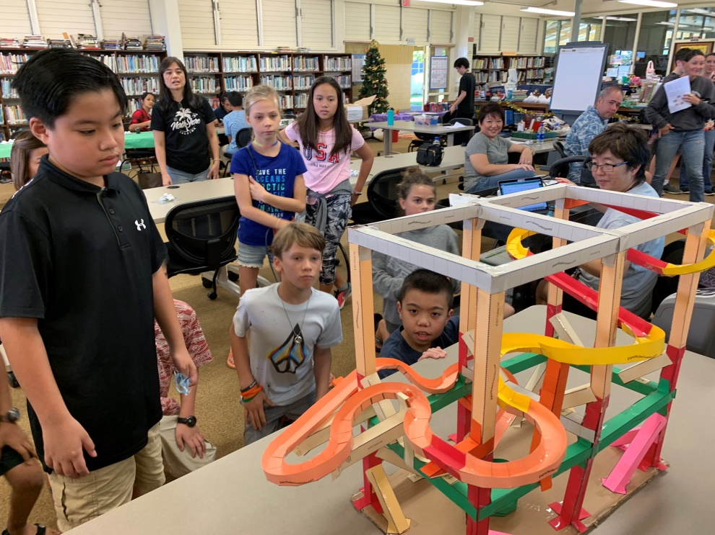
UNLEASH THE INNOVATOR IN EVERY CHILD

Slide 4
Science Camps!

Slide 5
Insert Science Camp Video

Slide 6
Insert STARS Video Here

Slide 7
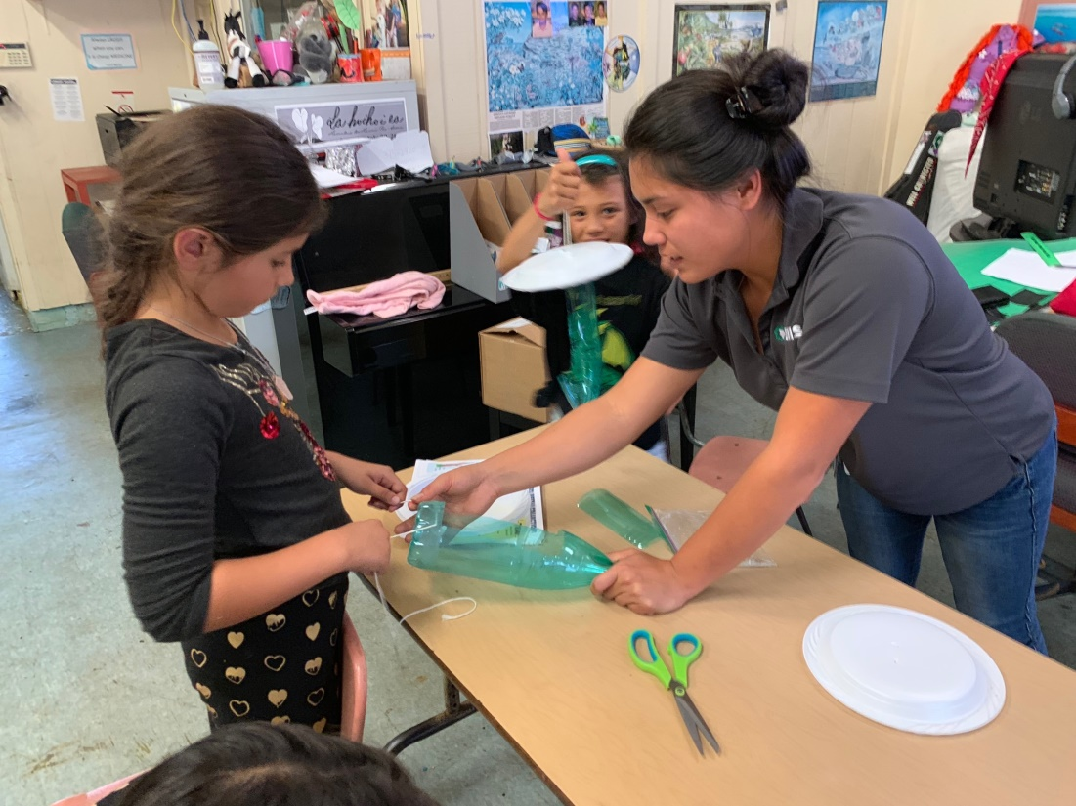
After School Programs
Partnership with Big Island Invasive Species Committee

Slide 8
Insert Eruption Video 1 Here

Slide 9
Insert Eruption Video 2 Here

Slide 10
Insert Eruption Video 3 Here

Slide 11
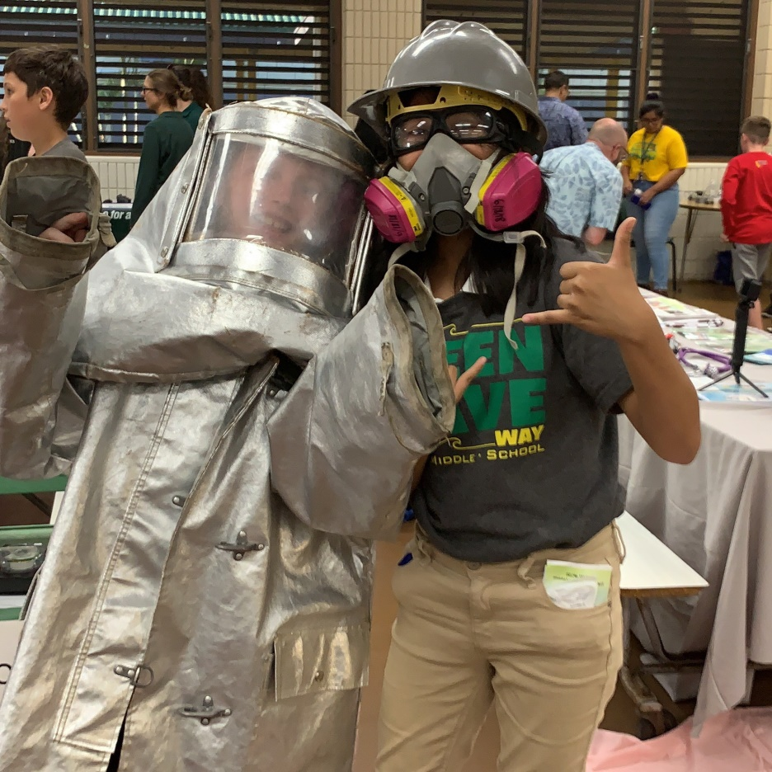
Kilauea Eruption Recovery Project
Mokupapapa Discovery Center Partnership

Slide 12
Insert Science Night Video Here

Slide 13
NISE ToolKits!!!!
Hide & Seek Moon
Pocket Solar System
Stomp Rockets!

Slide 14
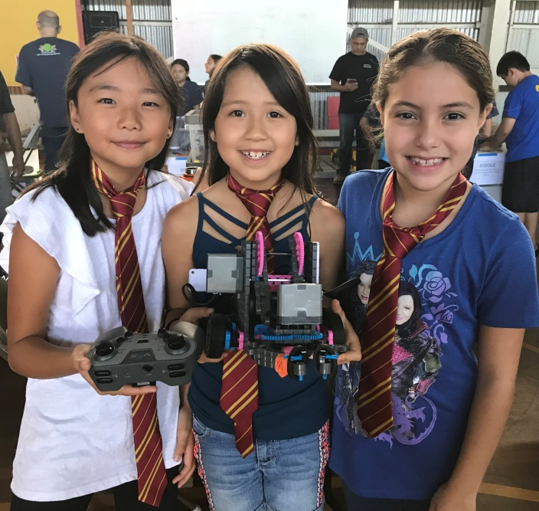
Robotics Education

Slide 15
Research and Development
Follow Us On:
Twitter: @HawaiiScience
Instagram: @HawaiiScienceMuseum
www.hawaiisciencemuseum.org

Slide 16
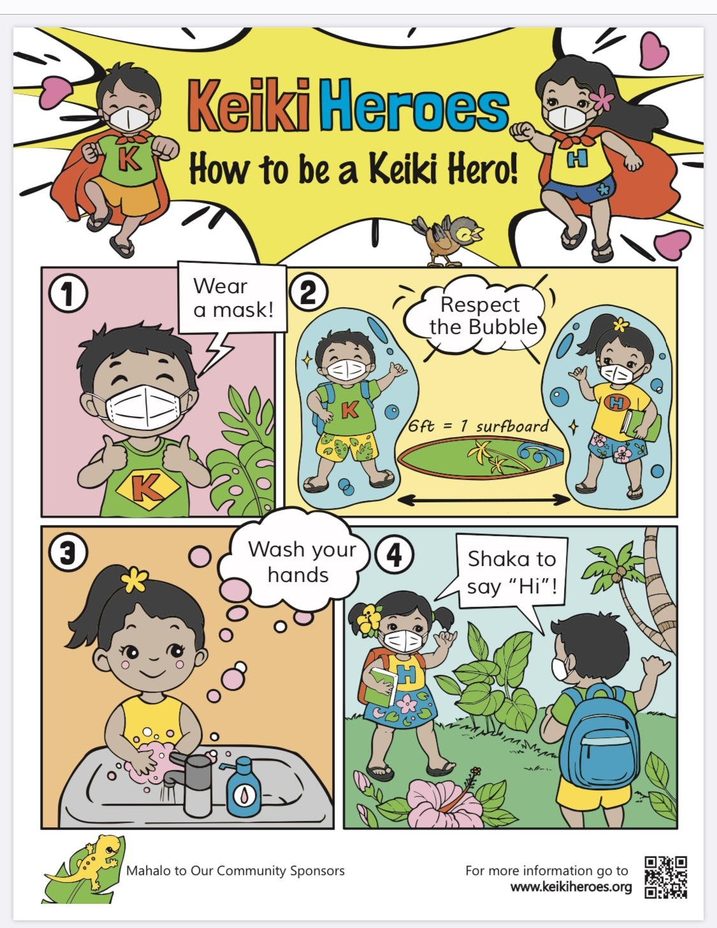
COVID-19

