Slide 1

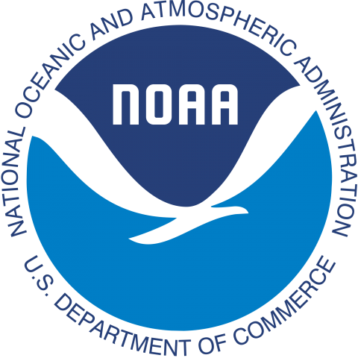
Understanding
El Niño
Using NOAA’s Data in the Classroom
Amy Dean
dataintheclassroom@noaa.gov

Slide 2
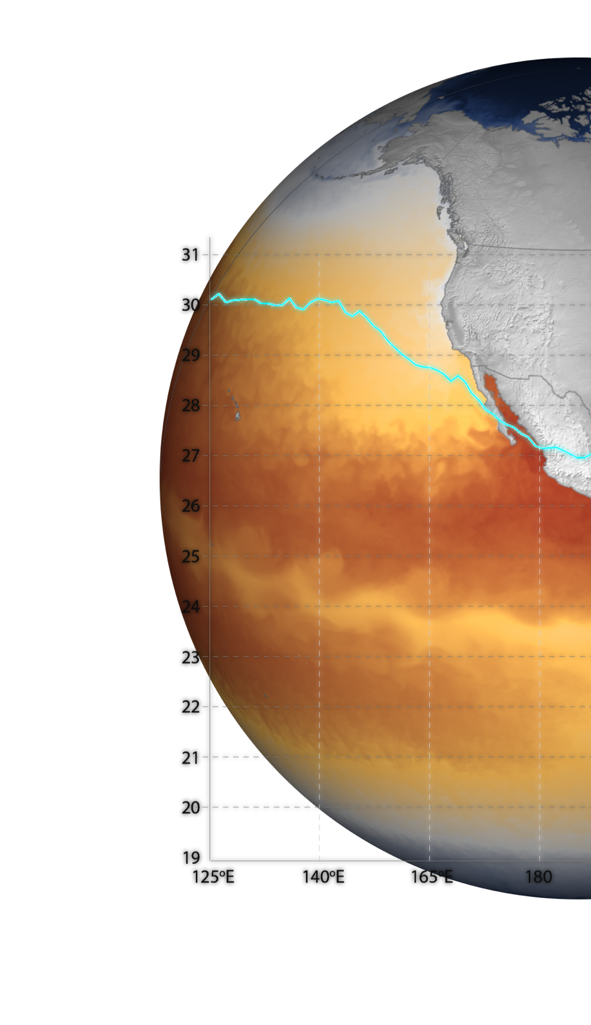
Understanding El Nino
01
02
03
04
The Science of
El Nino
Data in the Classroom
Module Demonstration
Wrap-Up
    What is El Nino?
    A look at what’s happening now & in the recent past
  Brief overview
    Explore the online platform activities
    Focus on data interpretation
    Connect with DITC
    Other ENSO resources

Slide 3

The Science of El Nino
01
    What is El Nino?
    A look at data & events from recent history

Slide 4
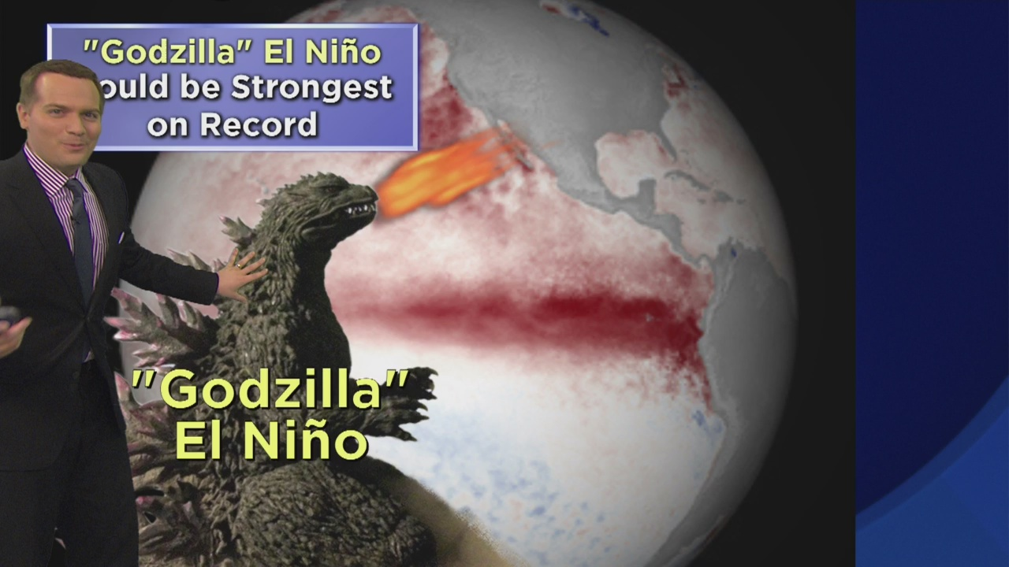
El Nino - in the news
Notes:
Connection to El Nino: likely from news reports, or living in a place directly impacted
Even makes it way into SNL. Why?
Most important climate pattern on earth – can change global climate patterns
CBS News, Dallas (winter 2015-2016)

Slide 5
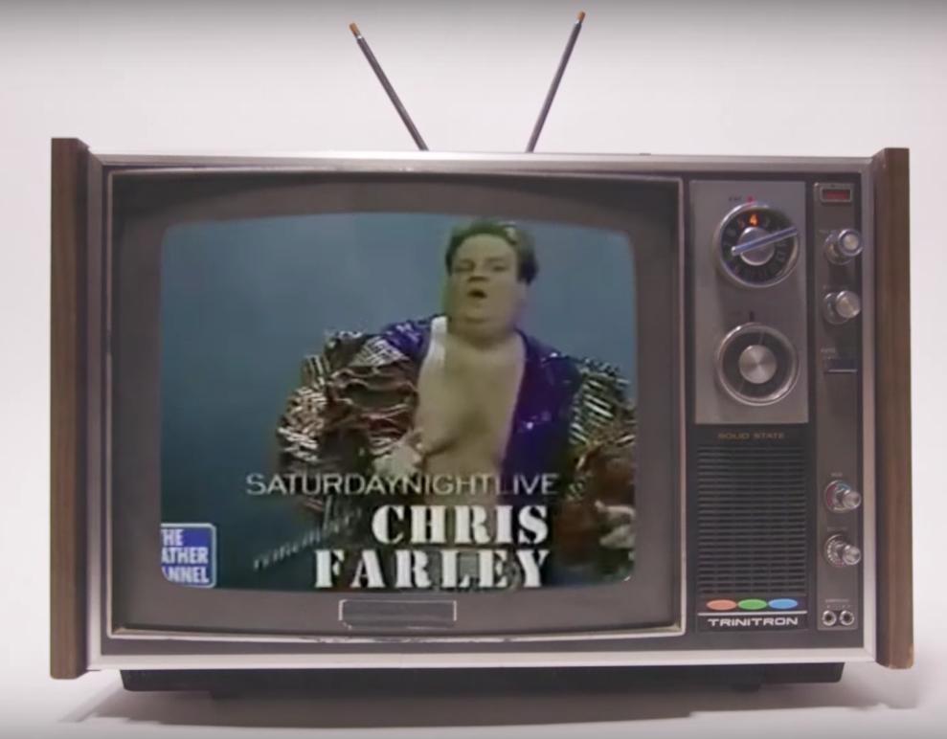
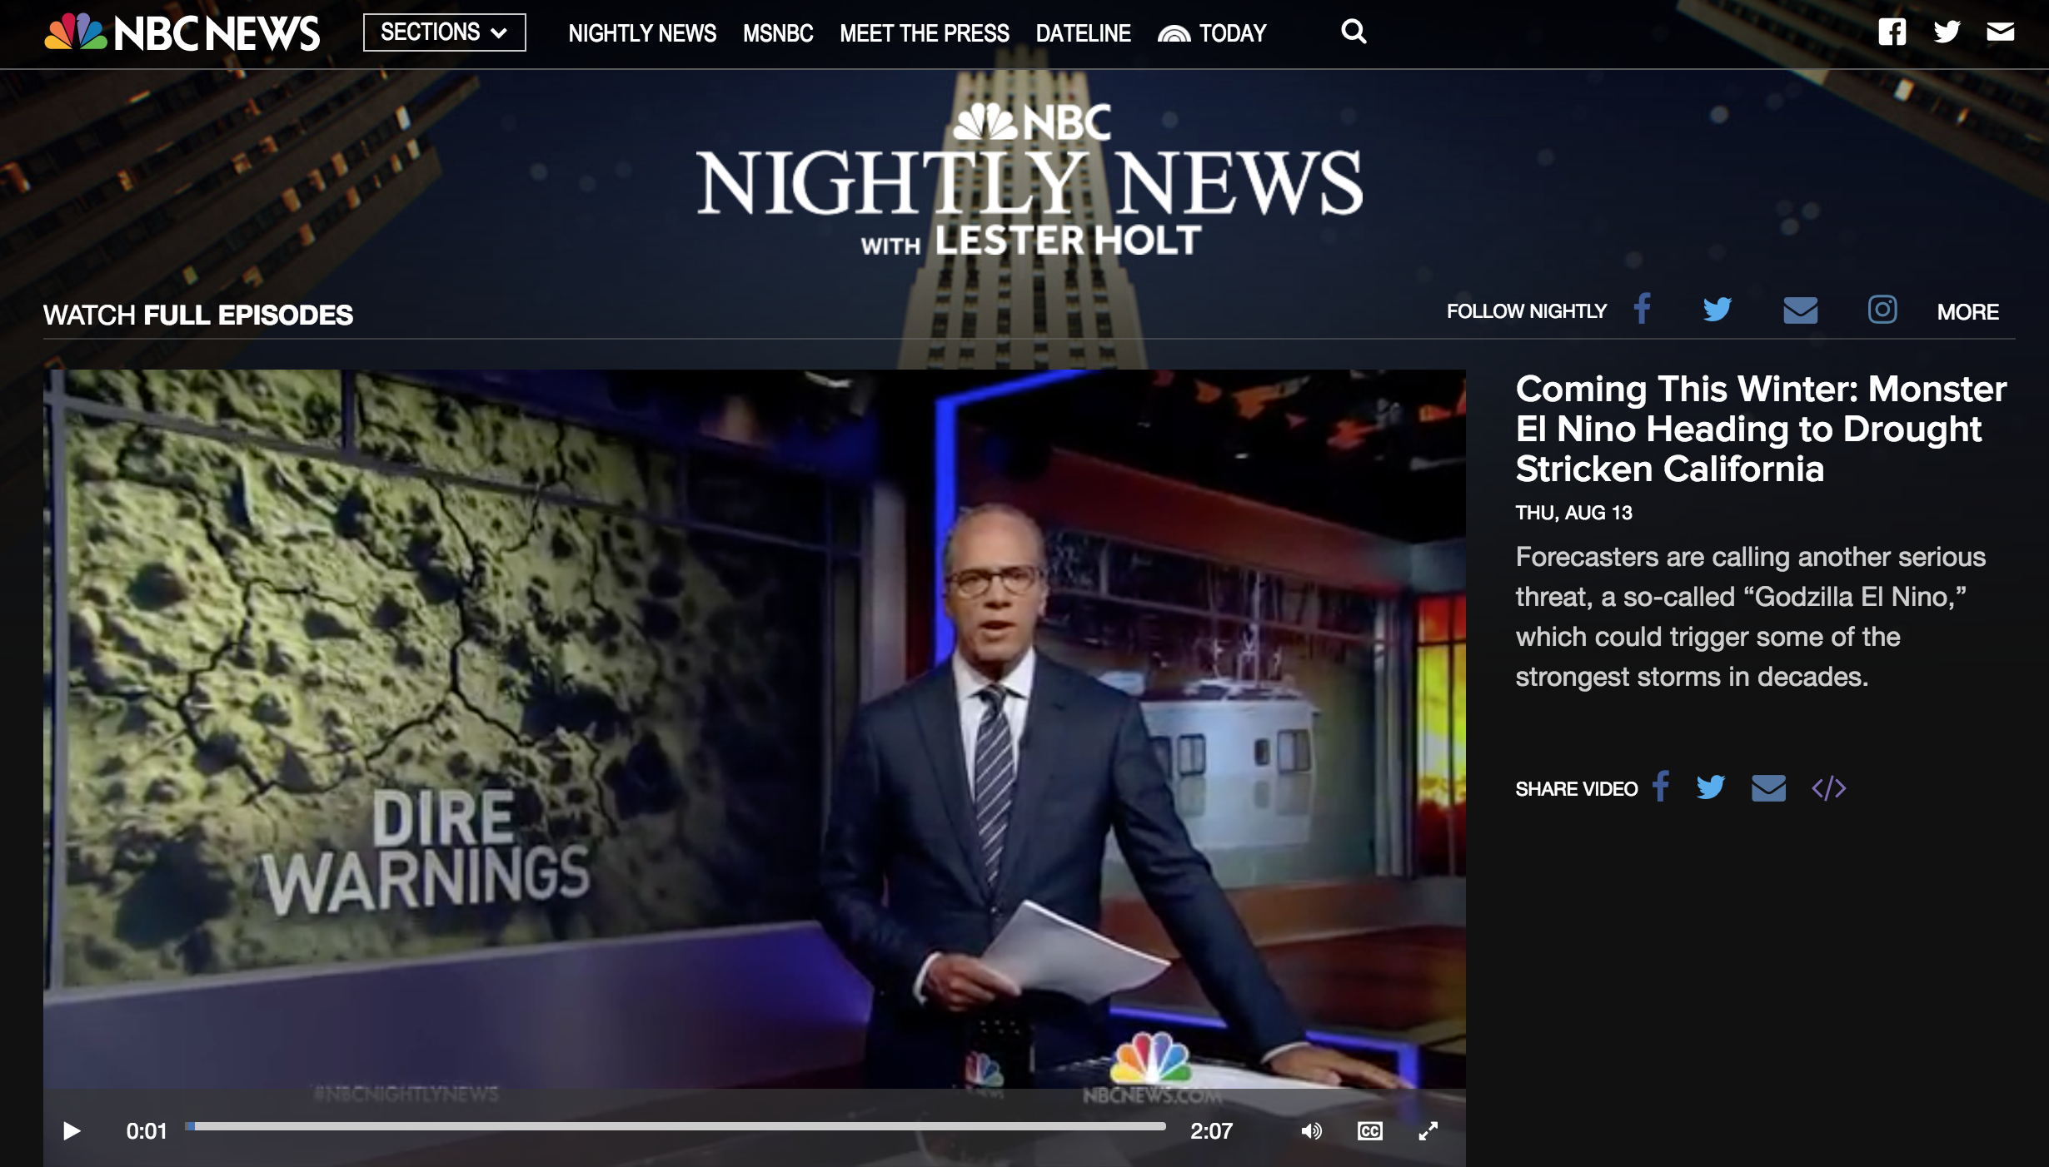
El Nino - in the news
Notes:
Connection to El Nino: likely from news reports, or living in a place directly impacted
Even makes it way into SNL. Why?
Most important climate pattern on earth – can change global climate patterns
CBS News, Dallas (winter 2015-2016)

Slide 6
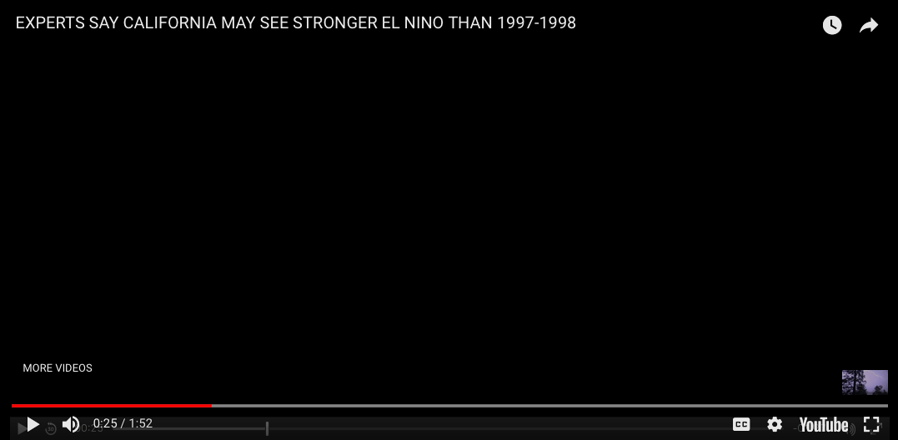
El Nino - in the news
Notes:
Insert <iframe title="New York Times Video - Embed Player" width="480" height="321" frameborder="0" scrolling="no" allowfullscreen="true" marginheight="0" marginwidth="0" id="nyt_video_player" src="https://static01.nyt.com/video/players/offsite/index.html?videoId=100000003102629"></iframe>
https://www.nytimes.com/video/science/100000003102629/how-it-happens-el-nio.html?action=click&contentCollection=Climate&module=RelatedCoverage&region=Marginalia&pgtype=article

Slide 7
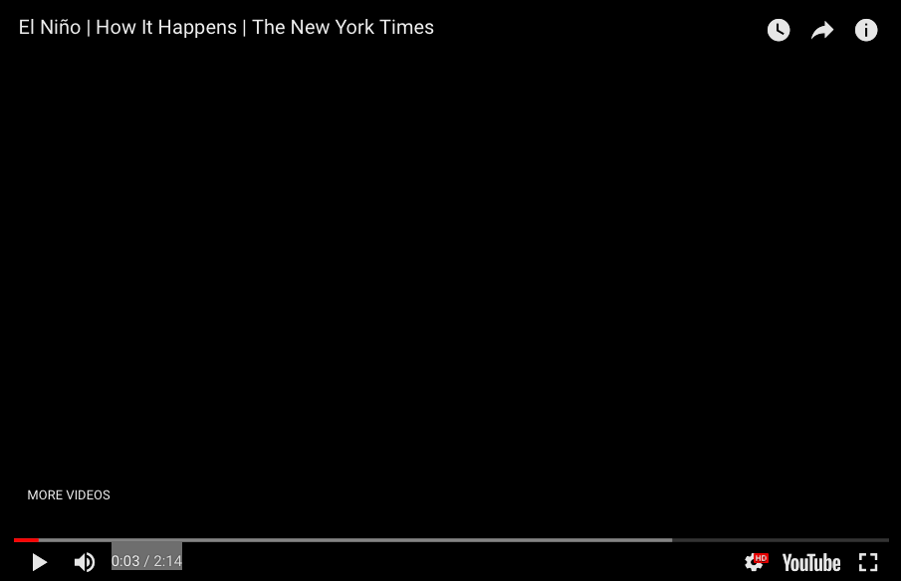
El Nino - in the news

Slide 8
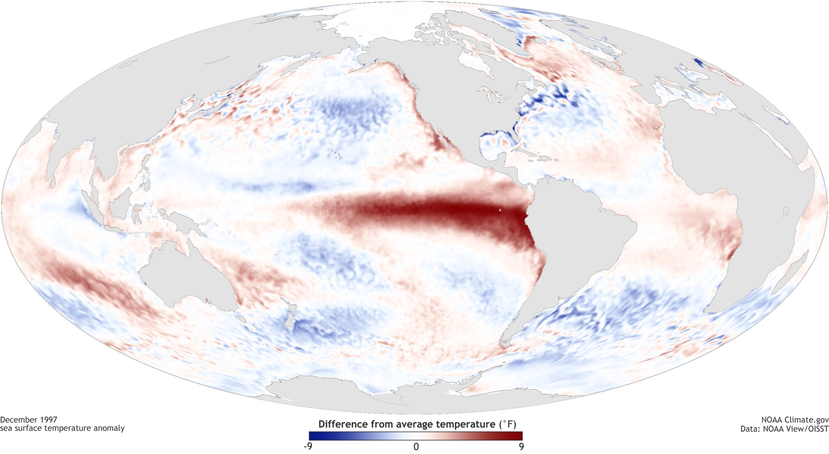
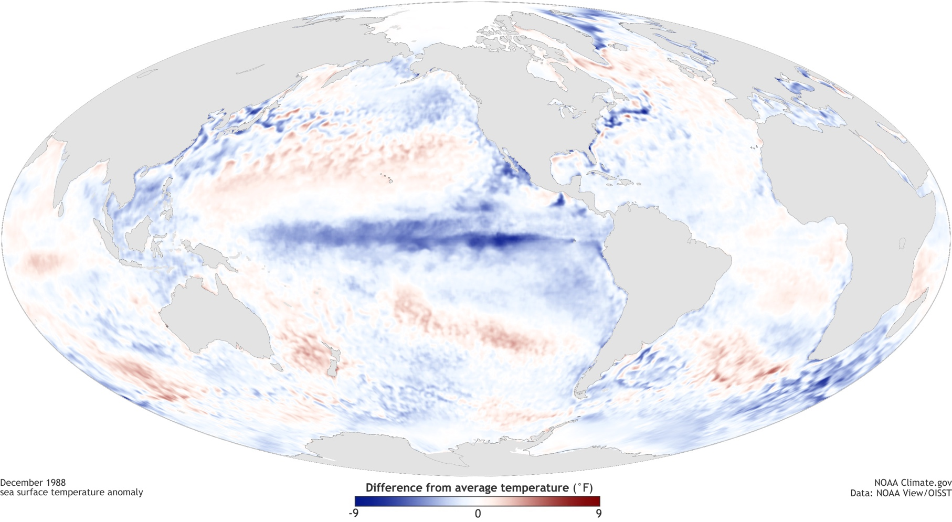
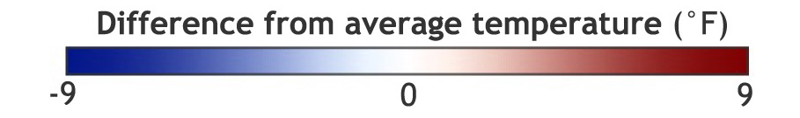
What is el nino?
El Nino (Dec 1997)
La Nina (Dec 1998)
Maps of sea surface temperature anomaly in the Pacific Ocean. By NOAA Climate.gov, based on data provided by NOAA View.
Notes:
There are plenty of videos that explain the El Nino phenomenon. But what I’d like to do today is focus on data. What can you figure out from observing the data on these maps? The video explains ……
Let’s now look at what was happening ‘thousands of miles away” from CA and southern US to cause those floods.
An iconic ‘strong’ la nina is on top. Iconic strong el nino on the bottom. Blue colors are colder than average SST. Red is warmer than average.

Slide 9



What is el nino?
El Nino (Dec 1997)
La Nina (Dec 1998)
(1) Characterized by SSTs that are warmer
than ‘normal’
(2) SST changes are happening in the Pacific Ocean,
(3) More specifically, located near the equator, in the central & eastern Pacific
Pacific Ocean
Notes:
Just by examining these data maps of SST, what can you learn?
ENSO has something to do with SST that are warmer or colder than normal.
Occurs in the Pacific Ocean
More specifically, located along the equator, in the eastern part of the Pacific.

Slide 10
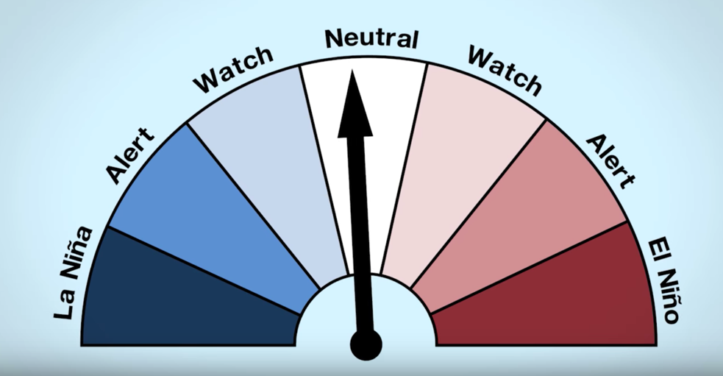
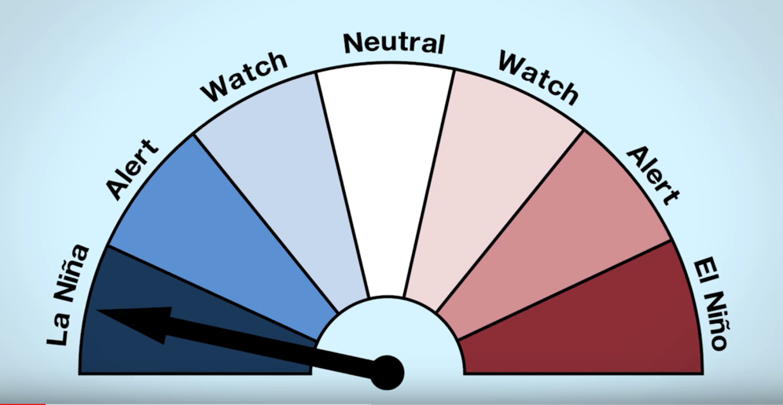
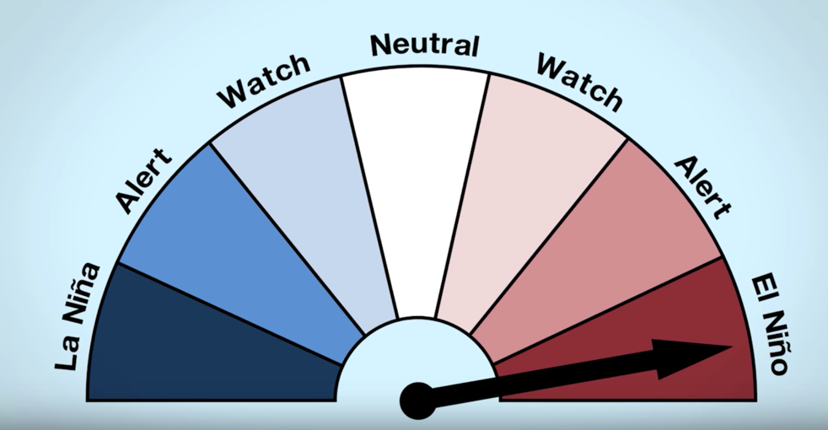
The Three Phases of ENSO
(1) El Nino: warmer than average conditions
(2) Neutral: close to average conditions
(3) La Nina: colder than average conditions
      El Niño–Southern Oscillation (ENSO)
      (pronounced “en-so”)
a single climate phenomenon: requires certain changes in both the ocean and the atmosphere
Notes:
El Nino and La Nina are opposite phases
Swings back and forth between these two opp phases every 3-7 years.
Naturally occurring phenomenon.

Slide 11
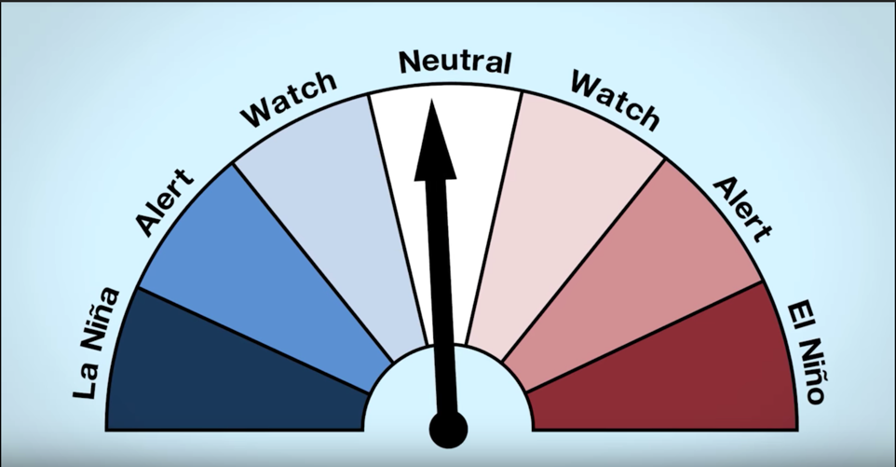
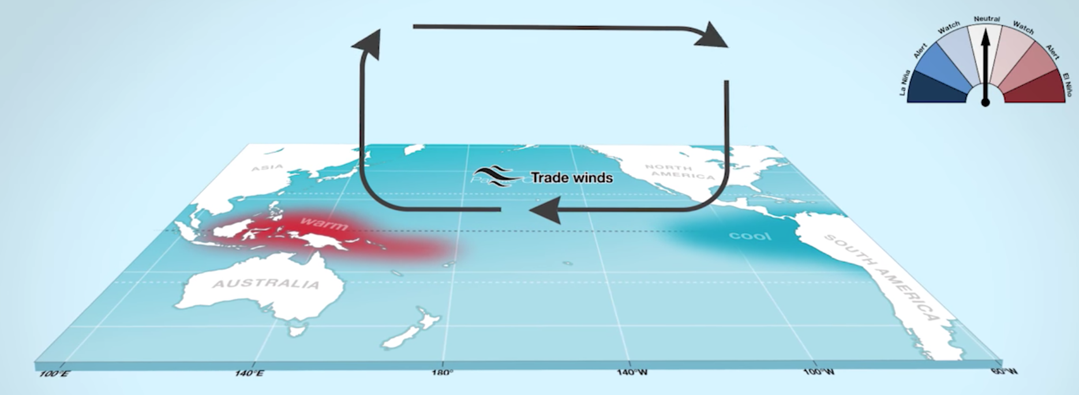
The neutral Phase
Normal conditions: Trade winds blow east to west, warm water along equator pushed towards Indonesia
Notes:
El Nino and La Nina are opposite phases
Swings back and forth between these two opp phases every 3-7 years.
Naturally occurring phenomena

Slide 12
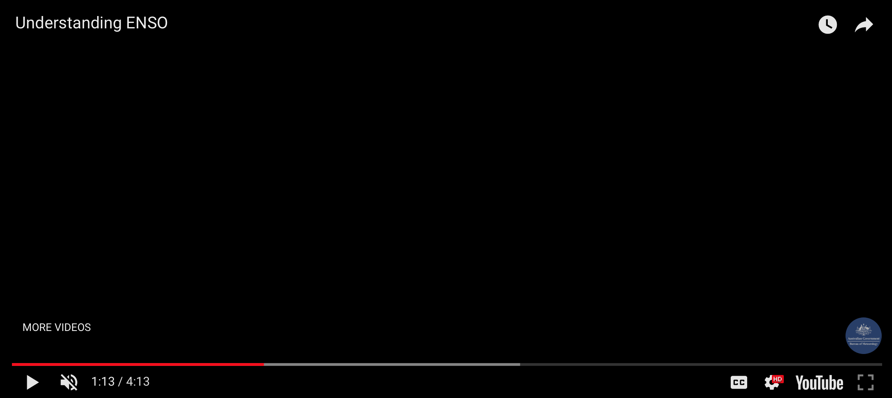
Notes:
So far, we have the learned what is happening and where? Now, let’s look at how it all happens.

Slide 13

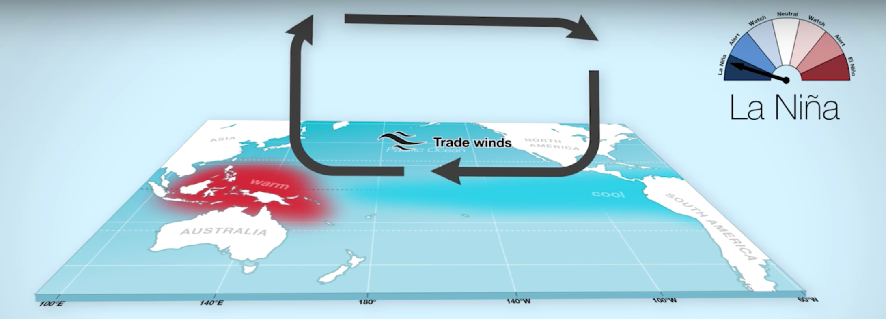
The la nina Phase
Ocean: colder than average SST conditions
Wind: strengthen, ‘trade winds on overdrive’
Cloud/Precipitation: More clouds/rain in
Indo-Pacific, less in CA
Notes:
El Nino and La Nina are opposite phases
Swings back and forth between these two opp phases every 3-7 years.
Naturally occurring phenomena

Slide 14
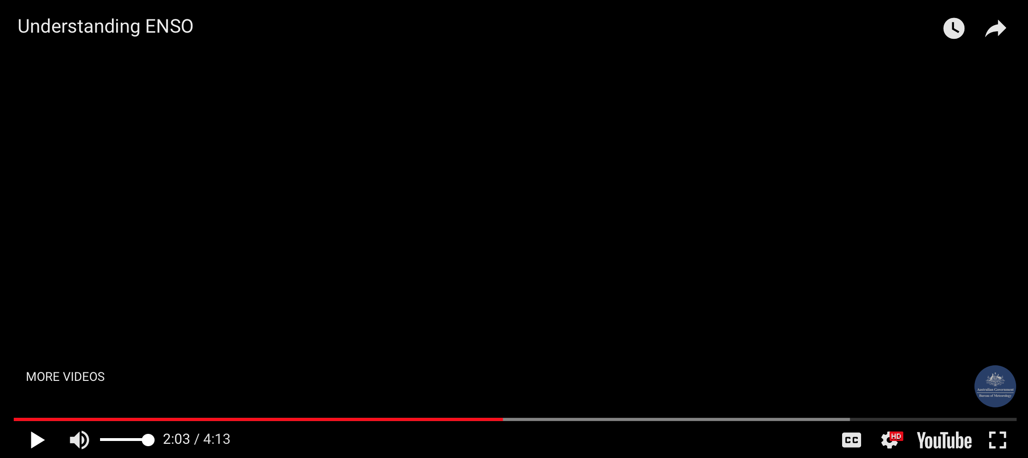
Notes:
So far, we have the learned what is happening and where? Now, let’s look at how it all happens.

Slide 15
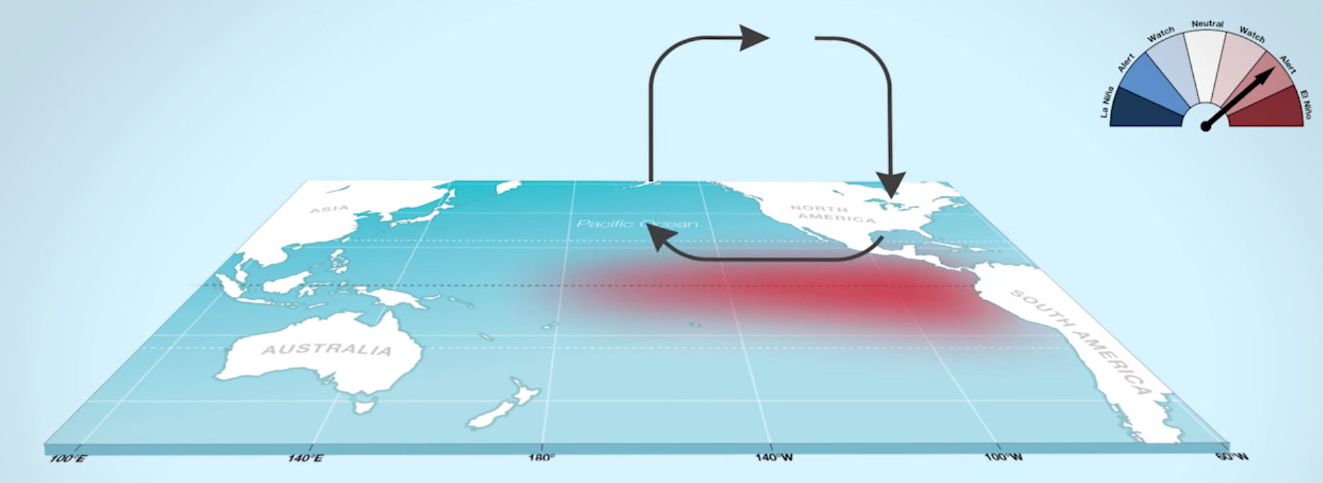
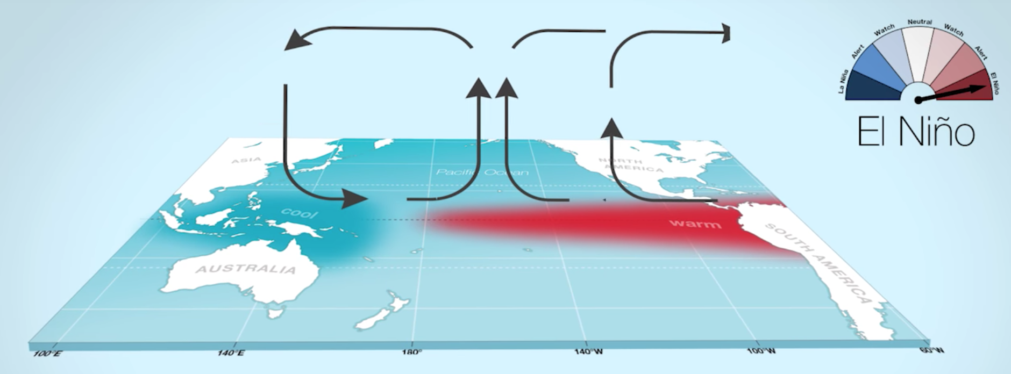
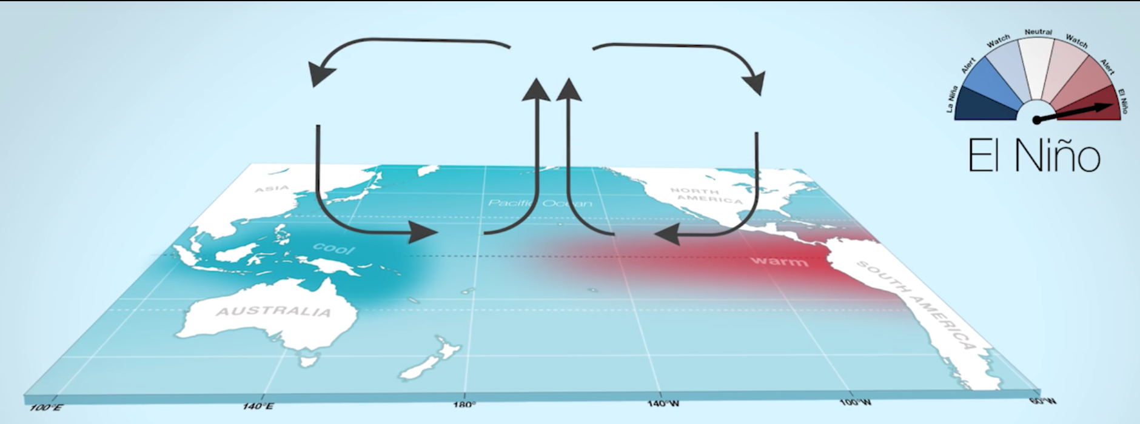
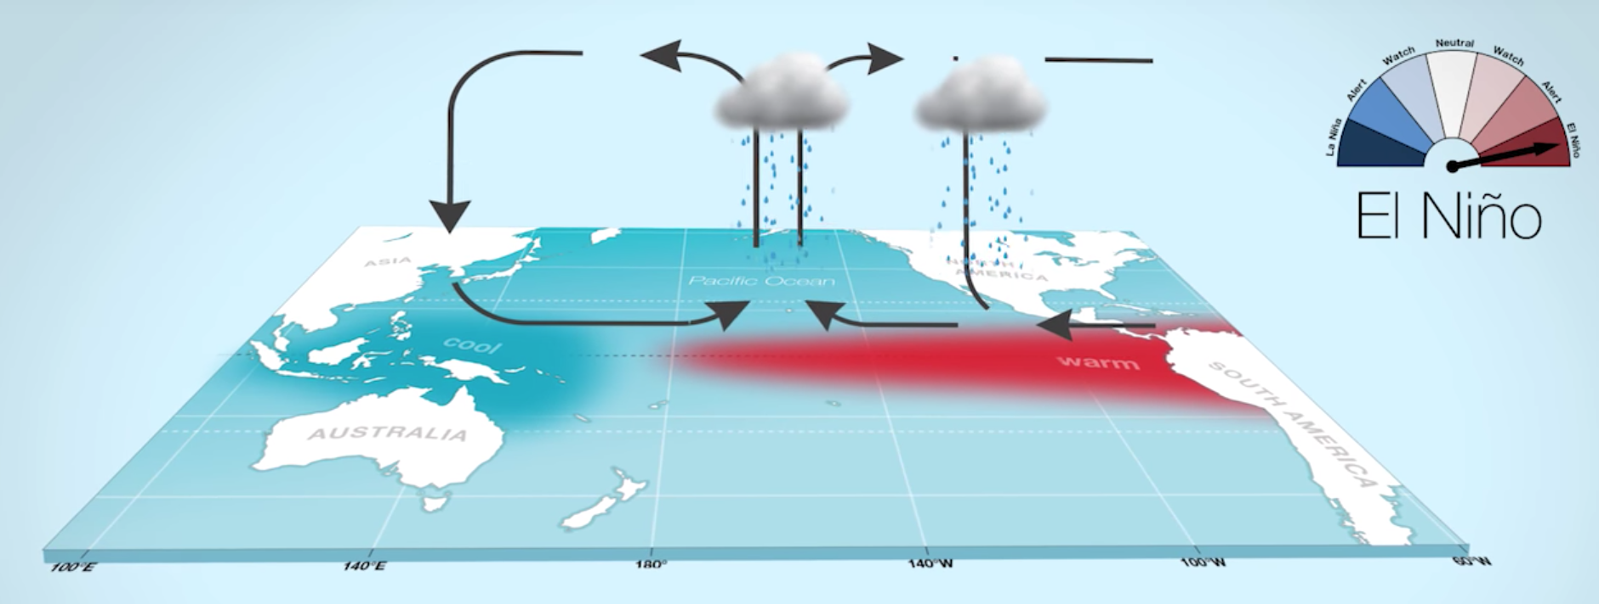
The el nino phase
Ocean: warmer than average SST conditions
Wind: weaken, may reverse, blowing from west to east
Cloud/Precipitation: Less clouds/rain in
Indo-Pacific, more in CA
Notes:
El Nino and La Nina are opposite phases
Swings back and forth between these two opp phases every 3-7 years.
Naturally occurring phenomena

Slide 16
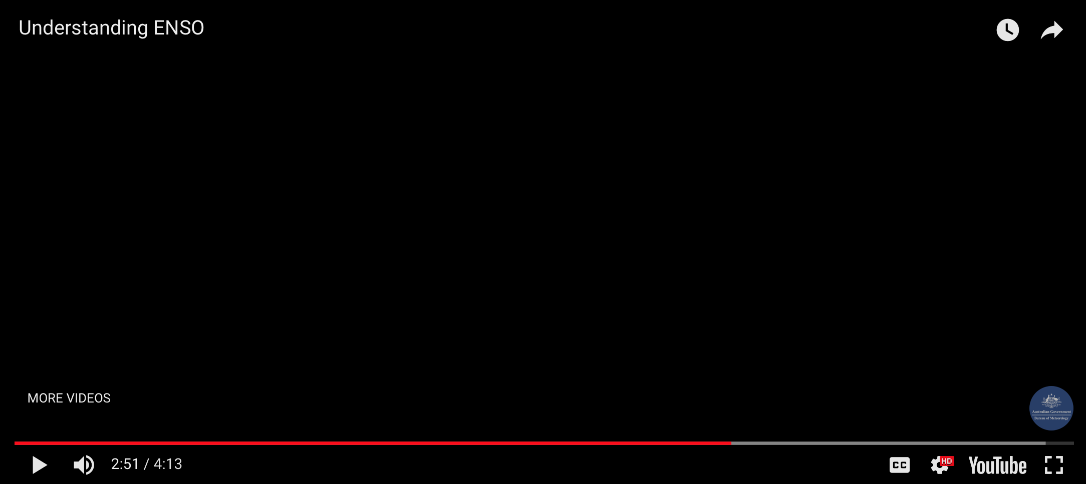
Notes:
So far, we have the learned what is happening and where? Now, let’s look at how it all happens.

Slide 17
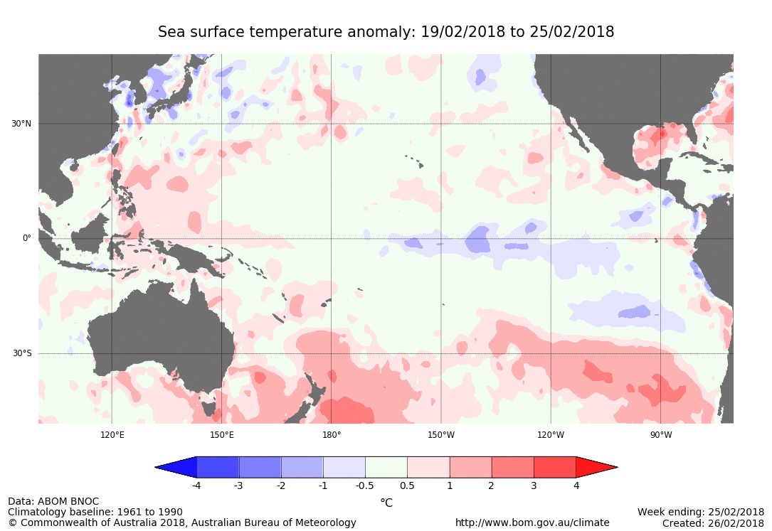
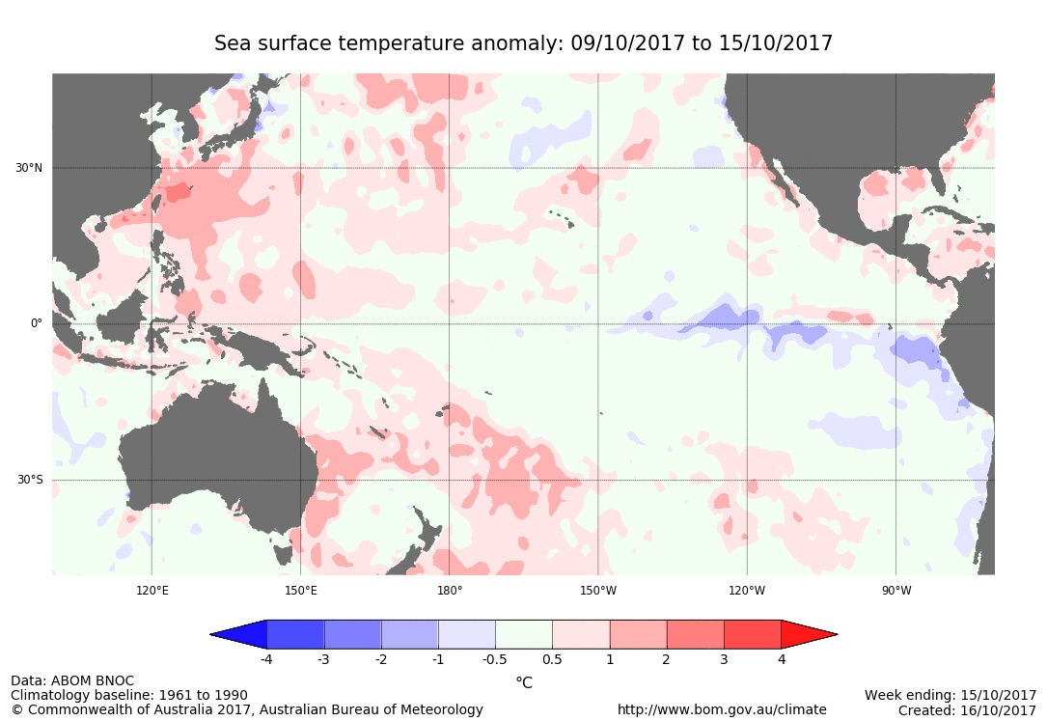

Use the data map to determine which phase we are in right now
Date = dd/mm/yyyy
Notes:
Add question

Slide 18
A weak La Nina for winter 2017-2018
Mar 2017 | Apr | May | Jun | Jul | Aug | Sep | Oct | Nov | Dec | Jan 2018 | Feb 2018 | Mar 2018
Neutral conditions
La Nina: winter 2017-2018
La Nina peetering out
Current Conditions: Since Oct 2017, we’ve had a weak La Nina. Ocean Temps ~0.5 to 1.0 below average in the east-central Pacific; stronger trade winds, more rain over Indonesia
ENSO Forecast: 55% chance that conditions will return to neutral by the March-May season.
Notes:
Our second La Niña year in a row is in full swing now, and is forecast to last through the winter. In November, the average surface water temperature in the Niño3.4 region of the central Pacific Ocean was about 1.0°C cooler than the long-term average. A “double-dip” La Niña is not uncommon—seven La Niña winters in the 1950-present historical record followed La Niña the previous winter: 1955, 1971, 1974, 1984, 1999, 2008, and 2011. In fact, two years, 1975 and 2000, were third-year La Niñas. Only four years, 1964, 1988, 1995, and 2005, were single-year La Niñas.
Monthly sea surface temperature in the Niño 3.4 region of the tropical Pacific compared to the long-term average for all multi-year La Niñas since 1950, showing how 2016-17 (blue line) compares to other events. Multi-year La Niña events are defined as at least 2 years in a row where the La Niña criteria are met. Both continuous events, when the Oceanic Niño Index remained below -0.5°C, and years when the ONI warmed mid-year before again cooling, are included here. For three-year events, both years 1-2 and 2-3 are shown. Climate.gov graph based on ERSSTv5 temperature data.
This graph illustrates something interesting about our current La Niña. During multi-year La Niñas, the surface temperature in the Niño3.4 region often moves closer to average after the first winter, before cooling again to get back into La Niña territory for the second winter. However, this is the first time on record the surface temperature has been warmer than average for a period before returning to La Niña conditions.
Eye of newt and toe of frog
Also, there are continuing signs that the atmosphere is responding to the cooler-than-average surface waters with a strengthened Walker Circulation. Evidence of the atmospheric response is provided by fewer clouds and less rain over the central Pacific and more rainfall than average over Indonesia. Stronger-than-average near-surface trade winds (the east-to-west winds along the equator) and upper-level winds were also observed during November.
Speaking of the atmospheric response… as we’ve discussed many times before in this space, ENSO (El Niño/Southern Oscillation) is a coupled ocean-atmosphere system. Meaning, the changes in the ocean affect the atmospheric circulation, and the atmospheric circulation affects the ocean, in a feedback loop. In the case of La Niña, the cooler-than-average waters in the central and eastern Pacific lead to stronger east-to-west surface winds. Those winds in turn help to cool the surface further and to keep warmer water trapped farther to the west, in the region of Indonesia. This is why ENSO is a system (a charm of power and trouble?) and not just a bunch of odds-and-ends (wool of bat and tongue of dog?).
One nice way to visualize the strength of the feedback between the ocean and the atmosphere is to analyze the relationship between the ocean surface warming/cooling and the changes in wind stress. The wind stress is essentially the force that the wind exerts on the ocean surface. When wind blows over water, it drags on the water. The amount of wind stress is a combination of the speed of the wind, the height of the ocean surface waves, and the air density.
During La Niña, the wind stress is usually stronger than average, mostly due to the faster near-surface winds. If the wind stress is stronger, the ocean-atmosphere coupling is also stronger, leading to more cooling of the ocean surface. Recently, the wind stress has been reinforcing the cooler central and eastern Pacific surface, telling us that La Niña conditions are solidly in place.
Toil and trouble?
La Niña is expected to affect global weather patterns this winter. As I mentioned above, the stronger Walker Circulation means there is more convection (rising air, clouds, and storms) over Indonesia and the far western Pacific, and even less than average over the central Pacific.
In addition, warm air that rises along the equator travels toward the poles and descends in the mid-latitudes, in a pattern called the Hadley Circulation; the descending air fuels the subtropical jet stream. During La Niña, with more convection in the far west Pacific and less in the central Pacific, the subtropical jet stream is retracted to the west. The retracted jet means fewer storms reach the west coast of the United States, tending to leave the southern tier of the country warm and dry. For more details on how La Niña affects the circulation, check out Tom’s great post.

Slide 19
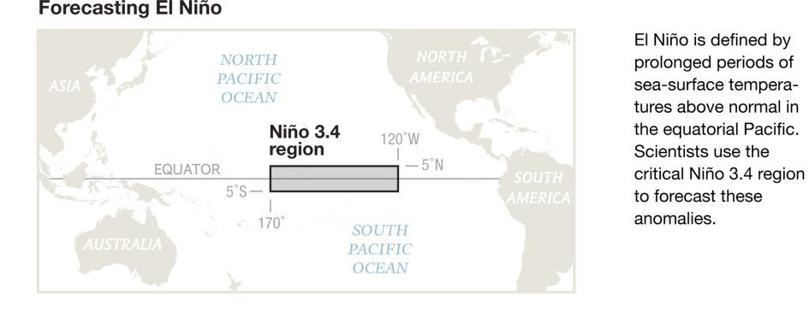
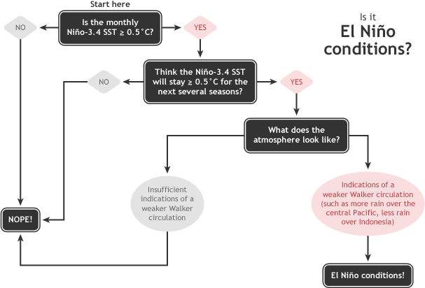
How is enso forecasted?
Summary of decision process in determining El Niño conditions. Figure by Glen Becker and Fiona Martin.
https://www.climate.gov

Slide 20
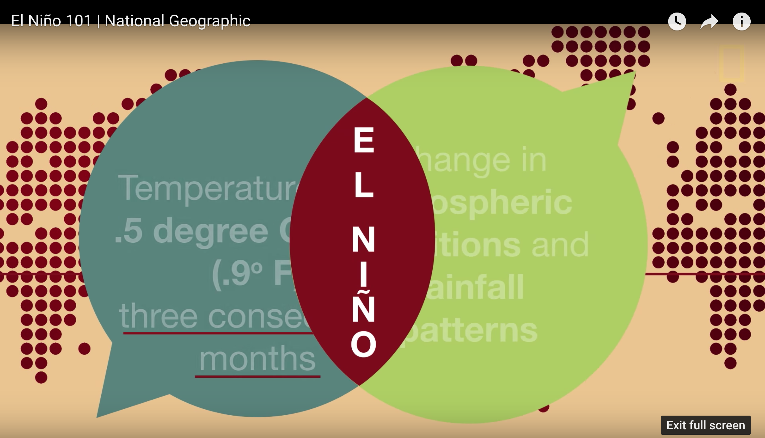
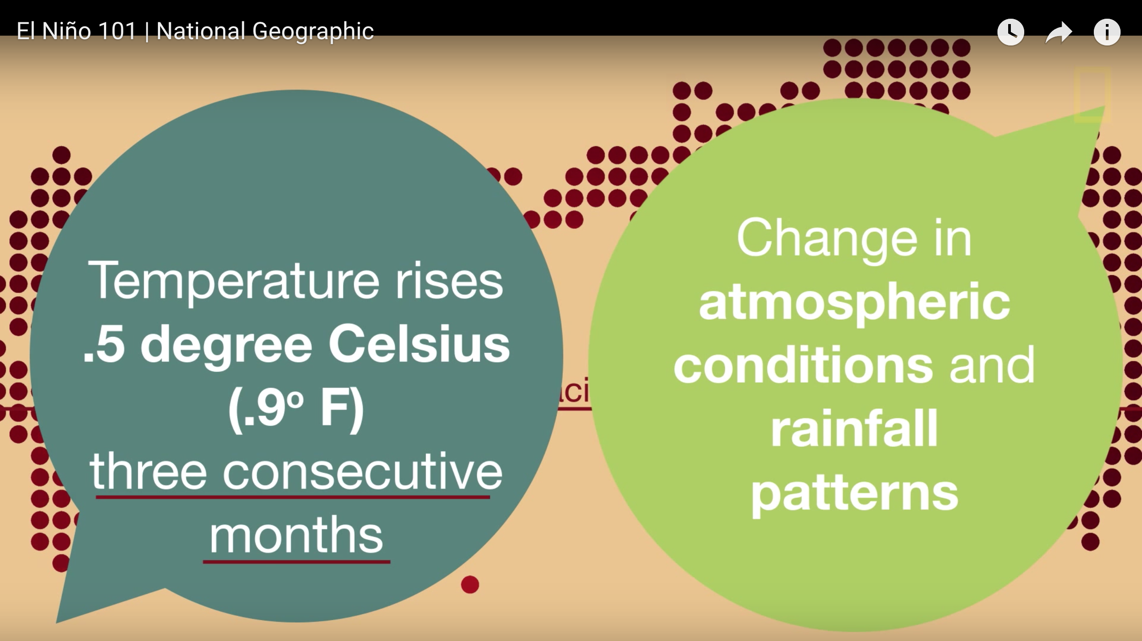

Slide 21
What’s typical?
Mar 2017 | Apr | May | Jun | Jul | Aug | Sep | Oct | Nov | Dec | Jan 2018 | Feb | Mar
ENSO conditions develop
Peak intensity in winter
Life Cycle of ENSO:
9-12 months
Develop in spring
Intensity peaks in winter
Fast Facts:
Rare for El Nino to last longer than a year
40% of El Nino events are followed by La Nina
Half of all La Ninas have lasted for 2-3 years
Notes:
El Niño and La Niña episodes typically last 9-12 months. They both tend to develop during the spring (March-June), reach peak intensity during the late autumn or winter (November-February), and then weaken during the spring or early summer (March-June).
Both El Niño and La Niña can last more than a year, but it is rare for El Niño events to last longer than a year or so, while it is common for La Niña to last for two years or more. The longest El Nino in the modern record lasted 18 months, while the longest la Niña lasted 33 months. Scientists aren’t sure why the duration of the two types of events can be so different.

Slide 22
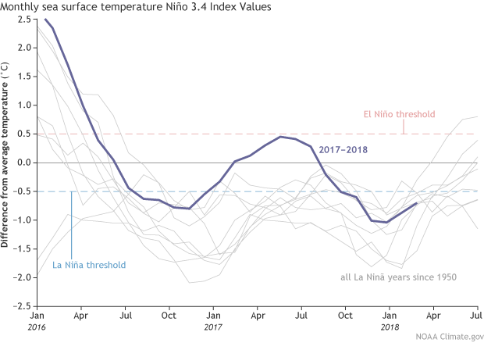
ENSO Events of the Past 3 Years.
Did this La Nina last for 2 years?
Notes:
Monthly SST at region 3.4. Start with Jan 2018, move backwards
Yes But ….. this is the first time on record the surface temperature has been warmer than average for a period before returning to la niña conditions. Typically, the surface temperature in the Niño3.4 region often moves closer to average after the first winter, before cooling again to get back into La Niña territory for the second winter.
Two consecutive weak La Nina, preceded by a strong El Nino

Slide 23
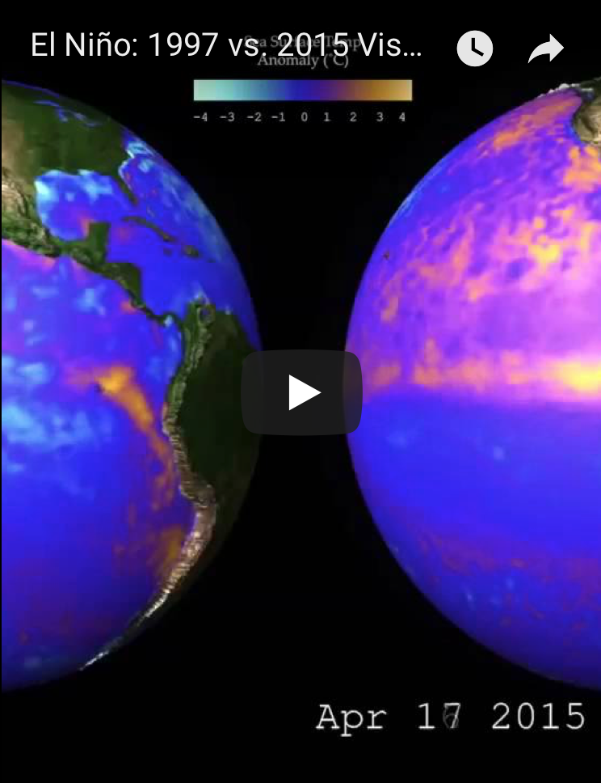
The ‘Godzilla’ el nino of 2015-2016
Dear El Nino, what happened to the rain I was promised? 😢🤔 California
El Nino
Notes:
There is no normal, and this monster El Nino, while still a monster, did not have the typical effects. Why? El Nino is not the only thing that influences the atmosphere. But it is the most predictable.
The warmth in the tropical Pacific related to El Niño fuels a more southward-shifted, eastward-extended Pacific jet stream. You can see this feature in the upper left panel above, which shows strong, anomalous winds flowing from west-to-east over the North Pacific Ocean. The jet helps to drive moisture and precipitation into California. For the December 2015 and January 2016 average (top right panel), we also can see an eastward expansion of the Pacific jet stream and wetter conditions prevailed over the northern half of California and the Pacific Northwest

Slide 24
recap of main points
- ENSO is one of the most important climate phenomena on Earth.
- El Nino and La Nina are opposite phases
- Scientists can predict ENSO events
- Last two years, we’ve had consecutive weak La Ninas.
- The Godzilla El Nino of 2015-2016 was one of strongest on record. Impacts were not typical.
Notes:
Can change the global atmospheric circulation, which in turn, influences temperature and precipitation across the globe.
El Nino being the warm, La Nina being the cool
This index measures SST anomlies that last in the region for more than 5 months.

Slide 25

Data in the Classroom
02
Brief overview

Slide 26
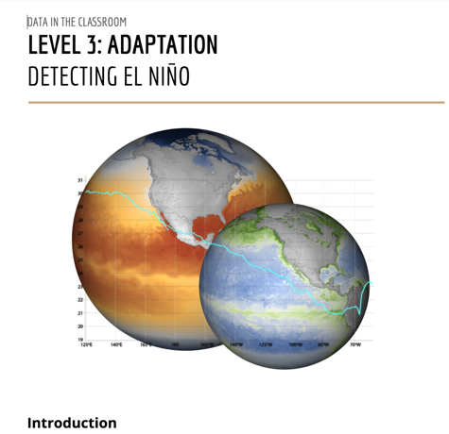
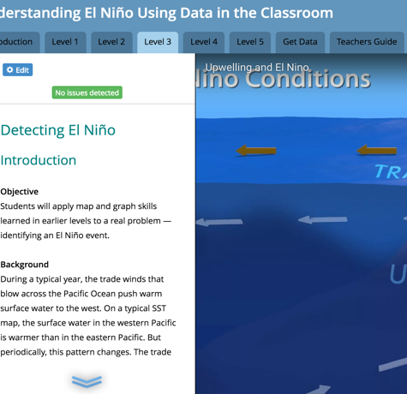
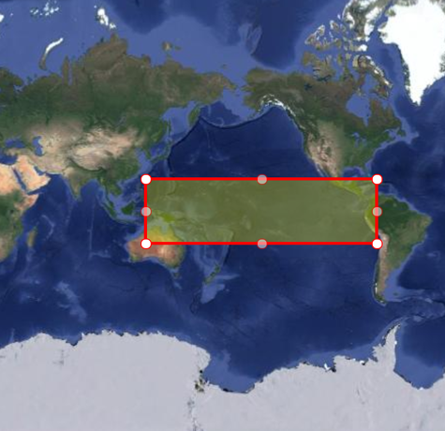

What is data in the Classroom? dataintheclassroom.noaa.gov
Currently 5 MODULES
El Niño
Sea Level
Coral Bleaching
Water Quality
Ocean Acidification
Teacher’s Guide
  Lesson plans & student worksheets
Web-based Student Activities
Data Tools
  Query tools for the creation of maps and graphs
Website
  Informational hub for teachers and educators
Resources for Data in the Classroom modules
Notes:
Designed for MS classrooms, primarily. OA for highschool. Though, teachers from elem-college are accessing and using these modules.

Slide 27
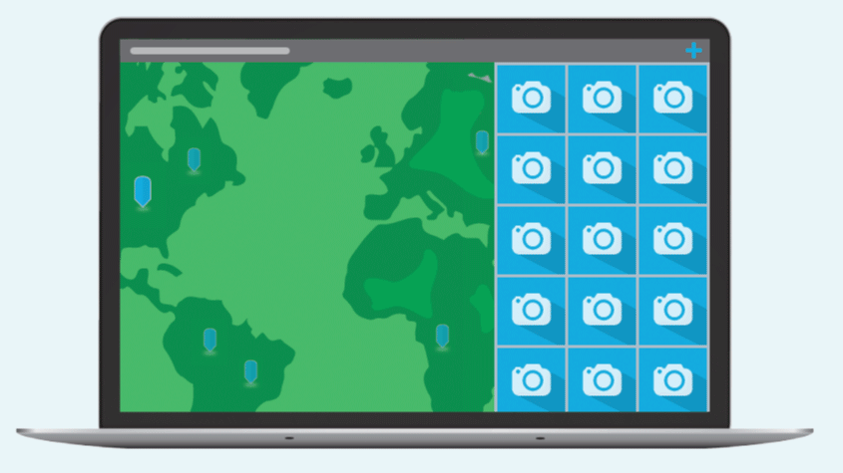

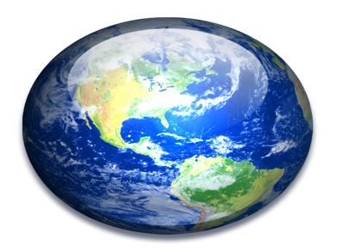
Online learning platform for students
  Classroom
  Activities
  Online Data Exploration Tools
Esri’s Story Maps: tool to engage students in a story, like El Niño, while harnessing the power of data – using maps, data visualizations and data query tools.
  Visualizations
Notes:
The classroom activities and pencil and paper worksheets that use to be available in the Teacher Guides have now been moved online. One benefit, students can move through at their own pace. Ability to interact has increased. The activities and data stories (in the side bar) are paired with the data tools, data vidualizations, photos and multimedia components in the window.
The platform for the online student activities: The Visualization Lab has implemented a series of Esri services within its web architecture. These include ArcServer for organizing high resolution image tiles in space and time, and Portal for developing web maps and applications. One of these applications is Esri’s Story Maps, which have a series of templates that are easily configured and customized for a variety of purposes. Here we can see several out-of-the-box layouts.
simple, mobile ready, easily customizable

Slide 28
Pedagogy
Invention: Students design their own
investigation.
Levels of
scaled
interaction
4 Interactivity: Students will access and interpret data to
investigate a question.
Adaptation: Students will apply data skills to examine a question
related to a real ‘data story’
2 Adoption: Teacher-directed activity that applies pre-existing models and
provides practice reading data.
1 Entry: Teacher-led discussion and activity. Basic data & graph interpretation

Slide 29

The El Nino Module and Data Tools
    Explore the online platform for students
03

Slide 30
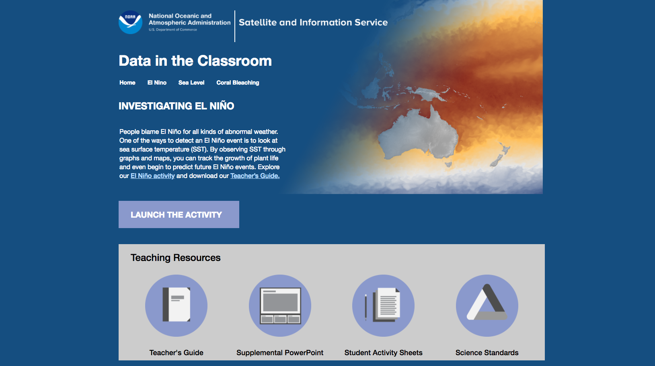

Slide 31
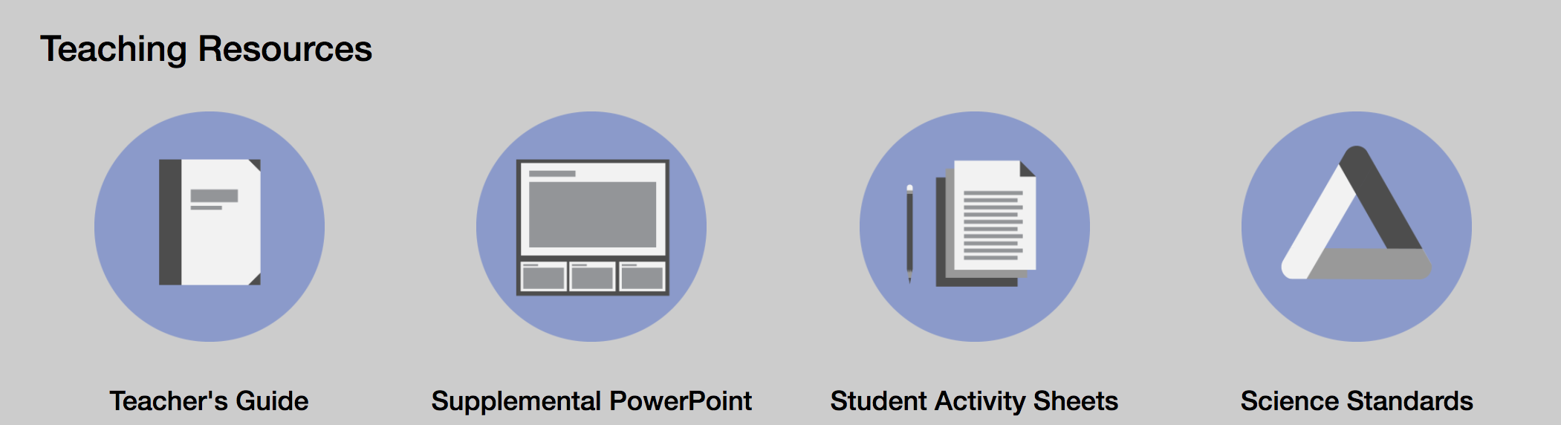
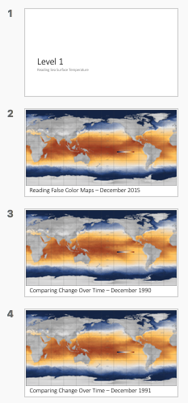
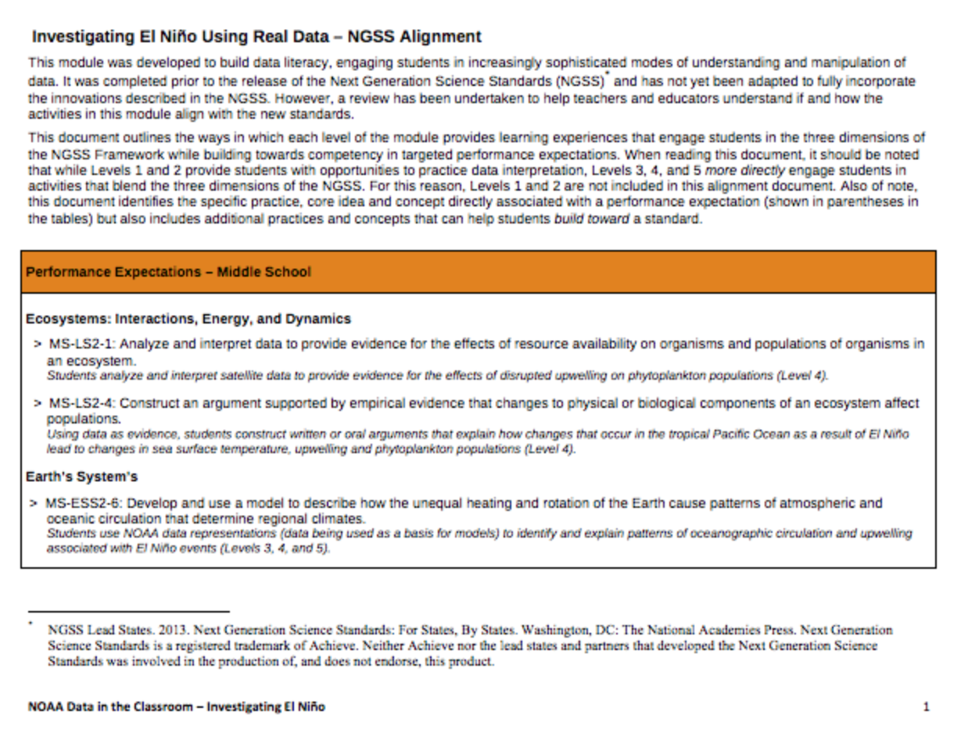
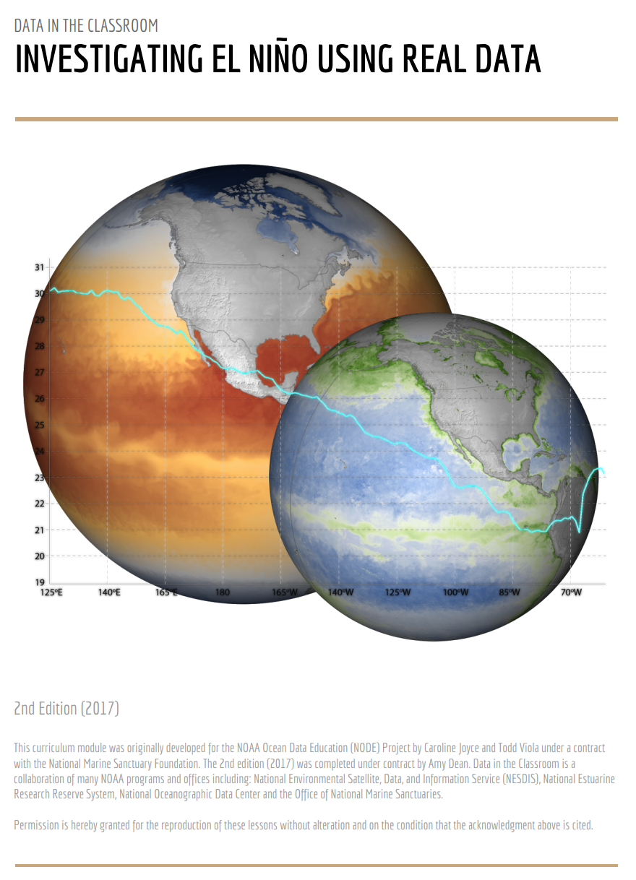
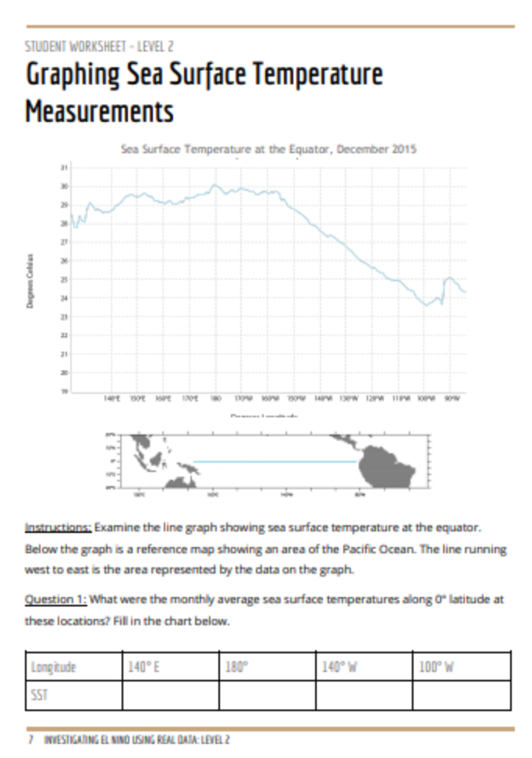

Slide 33
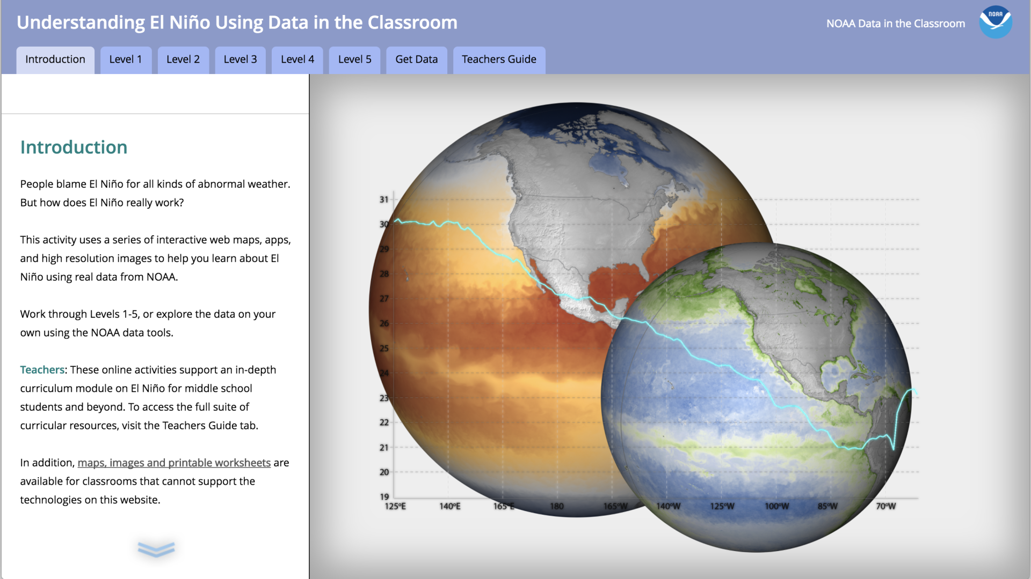
Lesson plans
Access to data tools
Student Activities

Slide 34
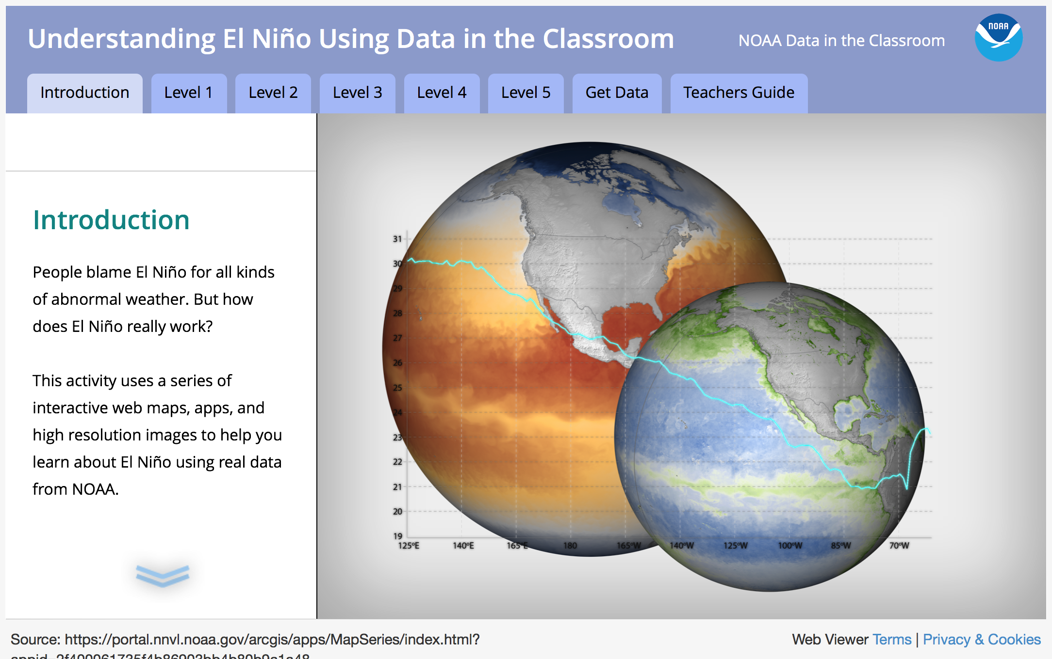

Slide 35
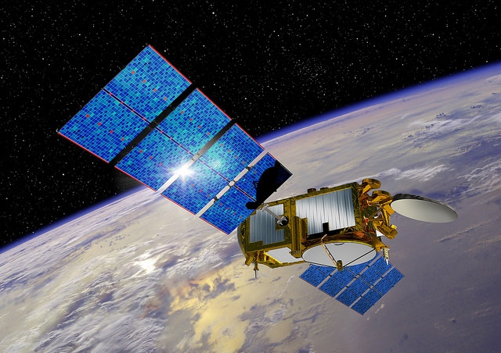
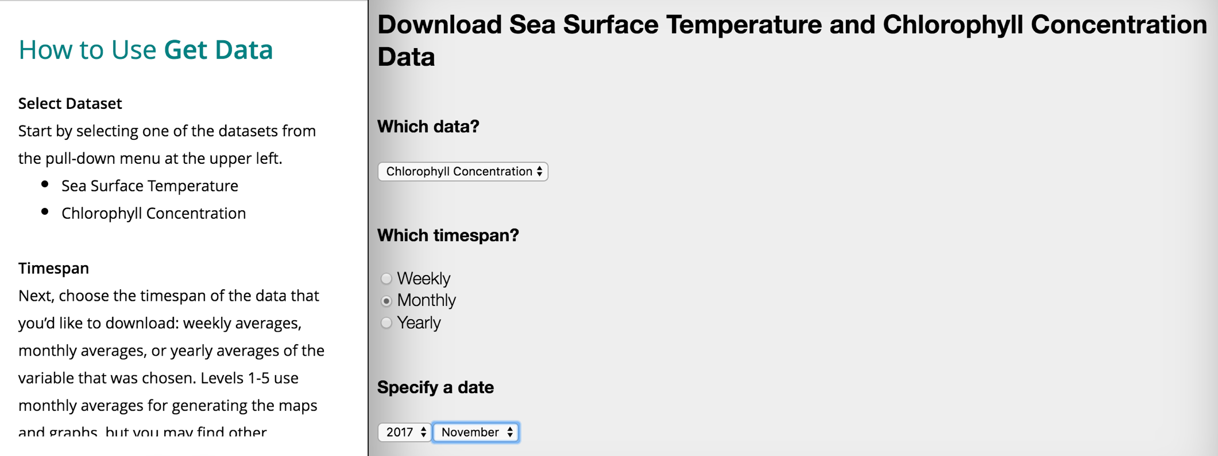
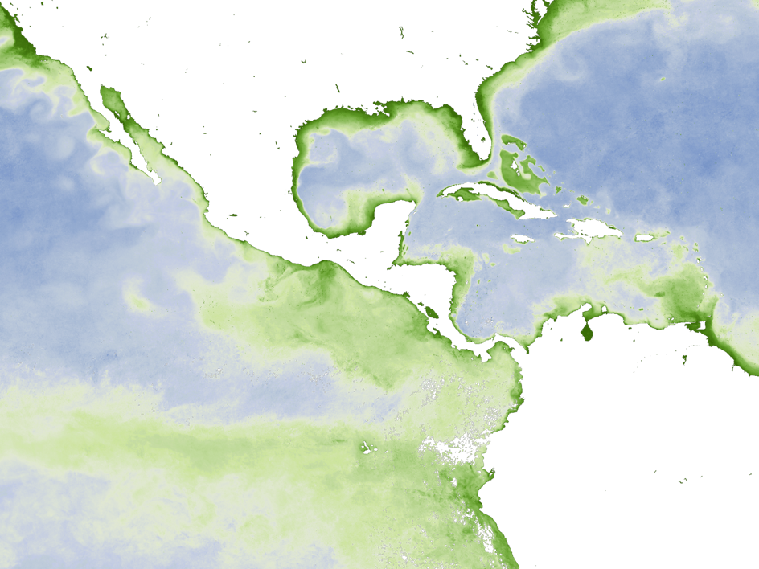
Data exploration tools
Brought to you by ….. NESDIS
National Environmental Satellite,
Data and Information Service
Two types of online data tools:
Sea Surface Temperature (1982 – current)
Chlorophyll Concentration (2002 – current)
Yes, you can download data. But can also create data maps like the one below.
Notes:
online maps and data export.

Slide 36
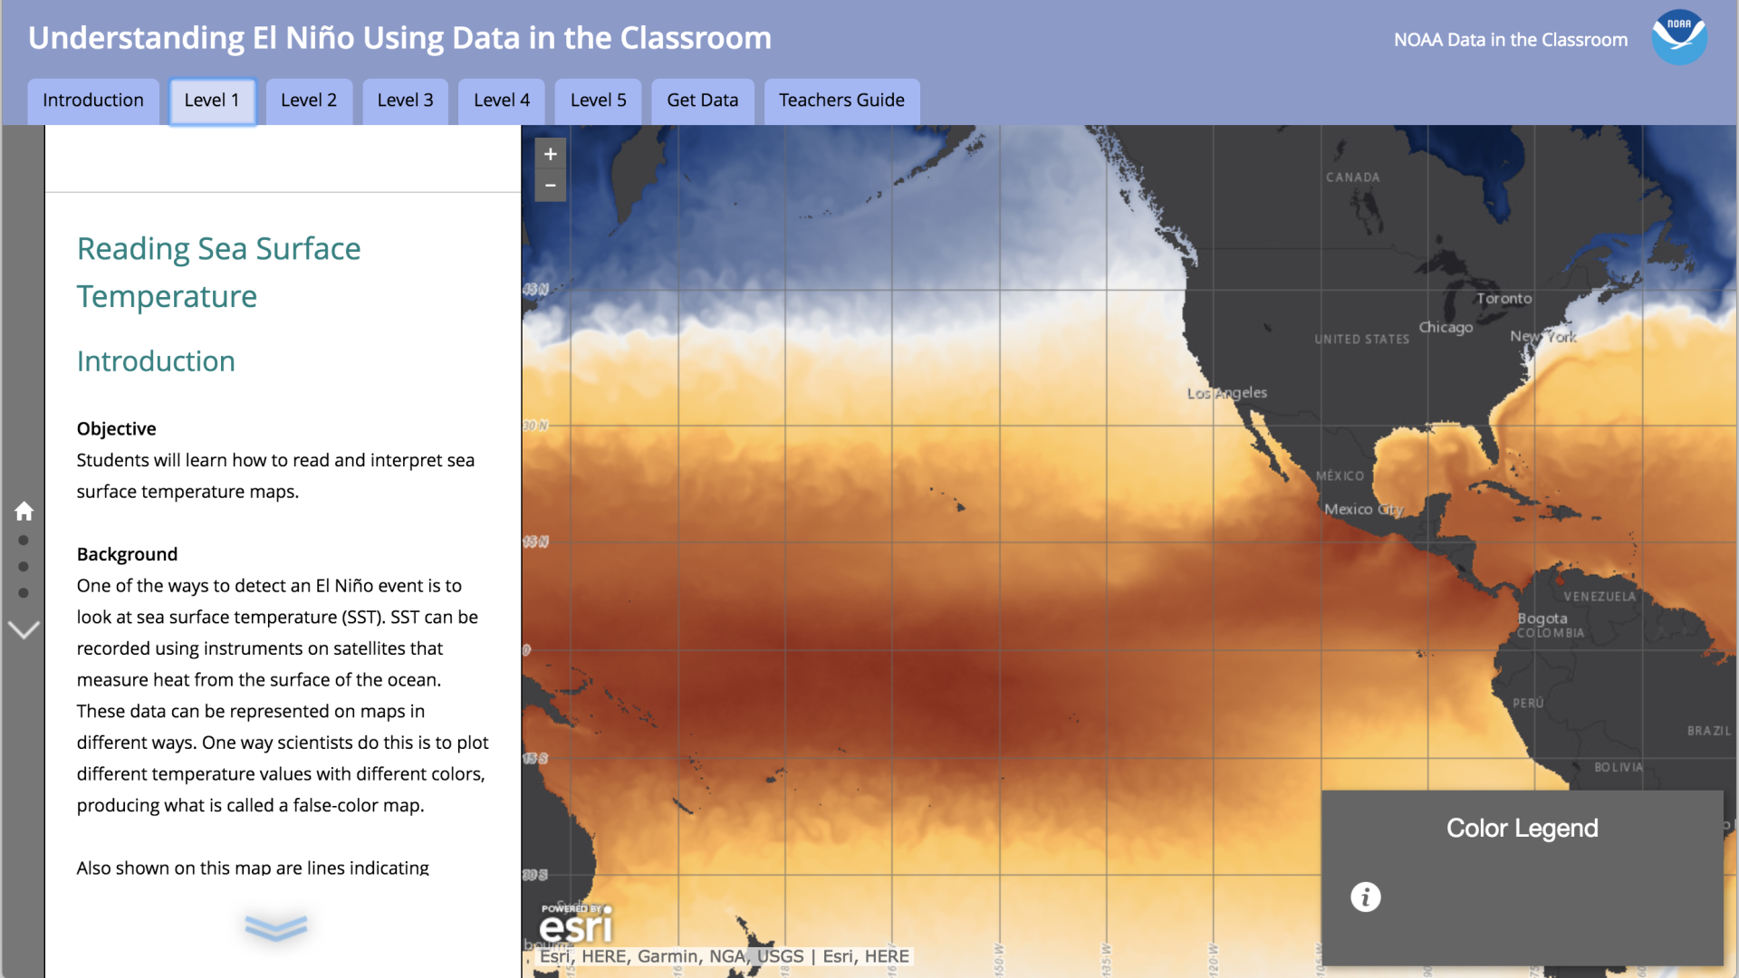
Notes:
Learn that data can be represented on maps.

Slide 37
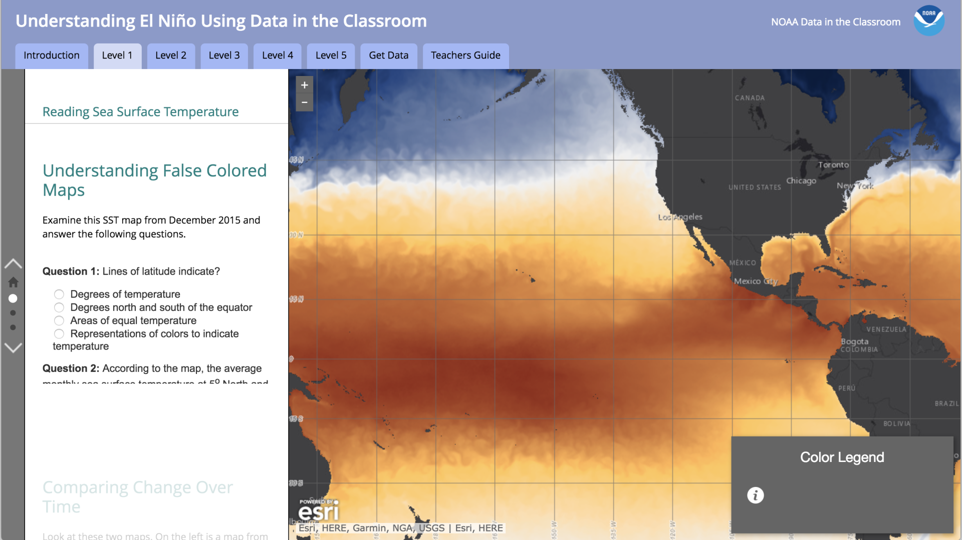
Notes:
Learn how to read a SST false-color map. Questions ensure students can correctly read map – maps are interactive, can be manipulated.

Slide 38
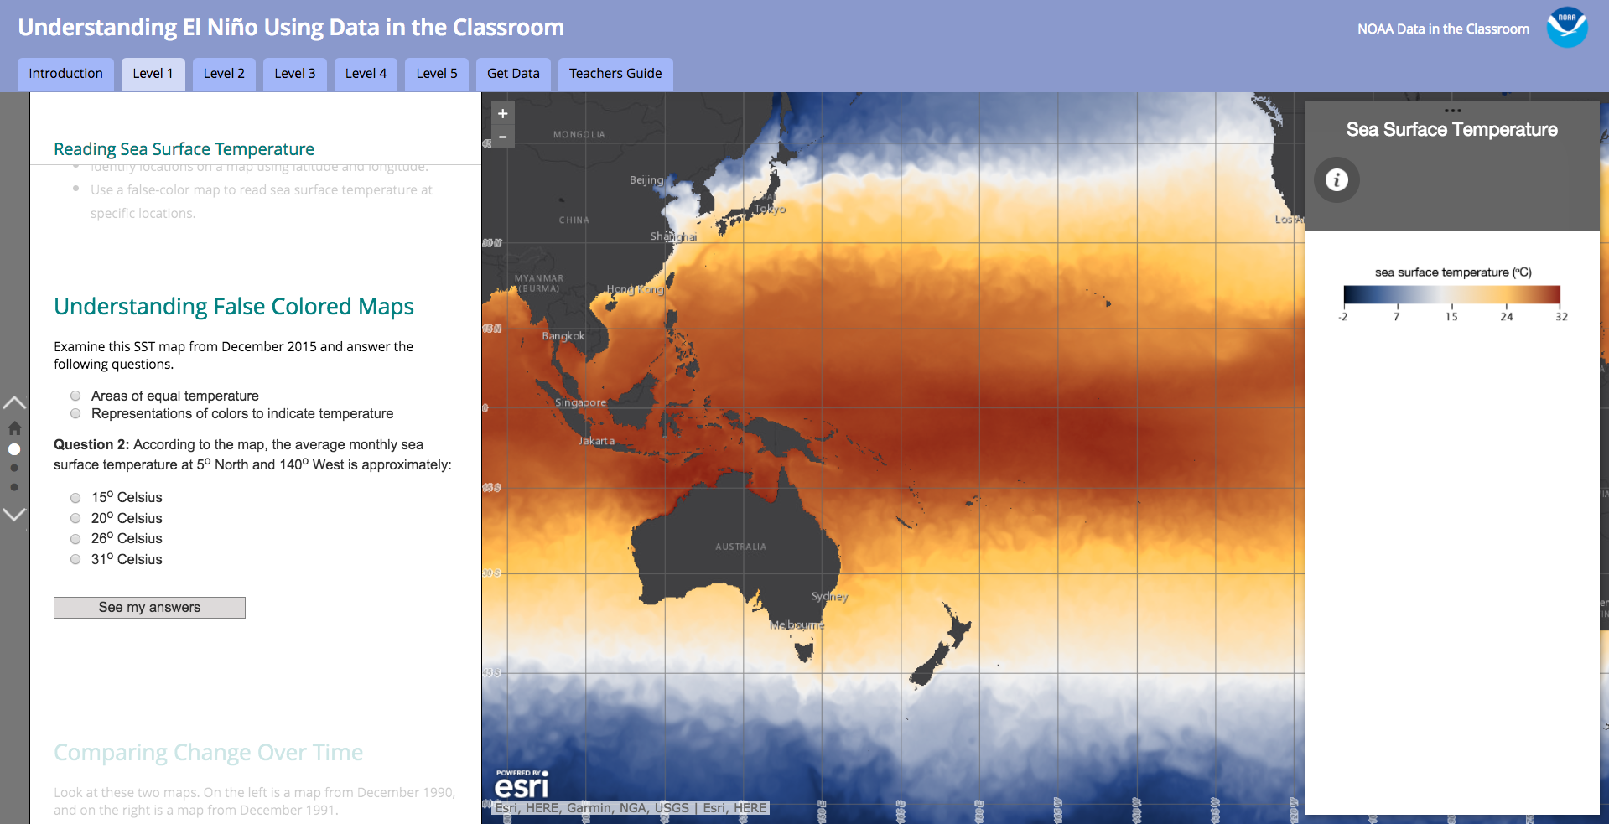
Notes:
In this lesson, students are learning how to read and interpret SST data using a False Color Map.
Explain where data comes from and how maps are generated
Satellites are amazing tools for observing the vast ocean that surrounds out planet. They are not snapshots from space though. Don’t show true color. Rather colors represent data taken by satellites.
What do they show?
Can think of these maps like viewing the temp of the ocean’s skin, the temperature of the top millimeter of the ocean's surface. Scientists monitor sea surface temperature because the ocean's warmth influences Earth's climate system in many different ways. Even seemingly small changes in ocean surface temperatures can have huge impacts on weather, oceanic and atmospheric current patterns, and for our purposes, understanding how to interpret these maps will help known as "El Niño," alters rainfall patterns around the globe, causing heavy rainfall in the southern United States and severe drought in Australia, Indonesia, and southern Asia. https://neo.sci.gsfc.nasa.gov/view.php?datasetId=MYD28M
How is the data collected? Sensors that are mounted on satellites measure the amount of thermal infrared radiation given off by the surface of the ocean. Researchers then calculate the SST data from the radiation data to produce a false color image. Image is false color – bc the colors you see on the map are representations of wavelengths not visible to the human eye. http://media.nationalgeographic.org/assets/file/MW2_How_Warm_Is_Ocean.pdf
There are a collection of satellites up there that do this, managed by NASA and NOAA and others. The instruments aboard these satellites accurate to within half a degree Celsius.
Go over Queston 2: point out that these maps are different than the ones we looked at at the beginning of the webinar. Those maps showed SST anomalies, or departure from the average. These show the actual temp, in degrees C.

Slide 39

Notes:
The activities in L2 challenge students to explore the same data on graph (along a single line of latitude) – and connect data represented on a maps with that on a graph. Depending on the age of the students you work with, this may be really easy or fairly challenging.

Slide 40


28
30
Notes:
What is a transect
In this case, we’re looking at a false color map for Dec 2010, which shows SST values across the ocean
Below is a graph of SST data from Dec 2010, but just looking at the exact values along the equator.
The graph shows you how temp changes from the west edge of the Pacific, starting at about 130 degrees E to the eastern edge, ending at about 80 degrees west.
Quiz Q: How much colder is the water over in Equador in Dec (at 90 W) – than near Papau New Guinea?
So take a moment to eyeball an approximate temp at 140 degrees using the color scale.
Complete the table and students should see the the values correspond – which they should bc they represent the same data.
But they are probably not exactly the same

Slide 41

Notes:
Linked to live webpage, so that you can do quiz question 3

Slide 42

Notes:
Introduce upwelling and its connection to ENSO. Cold water is also nutrient rich, fertilizing the sunlit surface waters and resulting in intense plant plankton blooms, or phytoplankton blooms.

Slide 43

Notes:
Introduce upwelling and its connection to ENSO. Cold water is also nutrient rich, fertilizing the sunlit surface waters and resulting in intense plant plankton blooms, or phytoplankton blooms.

Slide 44


Slide 45


SST = 24 °C
The El Nino year
SST = 21 °C
The ‘normal’ year
Notes:
At 70 degrees W, the SST in graph A is about 24 degrees. In graph B, about 21 degrees. So a 3 degrees different in the east Pacific.

Slide 46
Trivia: what is this animal?

Slide 47

Notes:
Pleuroncodes planipes, sometimes called the pelagic red crab (or simply "red crab"), tuna crab or langostilla, is a species of squat lobster from the eastern Pacific Ocean.

Slide 48

Notes:
L3 and L4 brings in biological impacts related to El Nino in Pacific.
As you might imagine, one documented impact from El Ninos of the past – range expansion of ocean animals. I am going to introduce one animal, the pelagic red crab, aka tuna crab.

Slide 49

Notes:
L3 and L4 brings in biological impacts related to El Nino in Pacific.
As you might imagine, one documented impact from El Ninos of the past – range expansion of ocean animals. I am going to introduce one animal, the pelagic red crab, aka tuna crab.

Slide 50

December 2015, SST

Slide 51


December 2015
December 2014

Slide 53

Notes:
Why do we care about phytoplankton? Relationships between physical and biological processes. Connect phytoplankton to upwelling, upwelling to el nino

Slide 54

Notes:
Why do we care about phytoplankton? Relationships between physical and biological processes. Connect phytoplankton to upwelling, upwelling to el nino

Slide 55


Notes:
In this lesson, students are learning how to read and interpret chlorophyll data and connect to El Nino.
Explain where data comes from and how maps are generated.

Slide 56

Notes:
Practice using data maps to compare

Slide 57


Notes:
Link to activity and demonstrate the scroll feature, ask participants answer question 3.

Slide 58

Notes:
So now, through comparison, students should be able to identify El Nino using SST and disruption in upwelling using chlorophyll data maps. Are these two related, and if so how?

Slide 59


Slide 60


Slide 61


December 2009
December 2010

Slide 62
December 2009
*The El Nino Year
December 2010

Slide 63


Slide 64

Notes:
Students challenged to consider big picture.
Explain how to interpret graph. Point out key take homes.
Are El Ninos getting stronger or more frequent over time?

Slide 65


Slide 66


Slide 67

Wrap-up
    Module Development
    Resources for educators
04

Slide 68
Module Development
Available Online Now
In Development
In Planning
El Nino
Sea Level
Coral Bleaching
Water Quality
Ocean Acidification
Sustainable Fisheries

Slide 69

Join the Online Community
Notes:
Mention NSTA and upcoming OA webinar in October

Slide 70


Other ENSO Resources
ENSO Blog: What’s happening now and why? Focus on data & data interpretation.
El Nino Resources on CLEAN: education resources reviewed by scientists and educators.
Notes:
Blog: Can contact the authors of the blog, if you have questions. Nice feature.
CLEAN: The CLEAN Collection is a high-quality and rigorously reviewed collection of climate and energy educational resources aligned with the Climate Literacy and the Energy Literacy frameworks, and the Next Generation Science Standards.Through the peer-review process scientists and educators ensure scientific accuracy, pedagogic effectiveness, and classroom readiness for each resource.

Slide 71
Thank You!
Contact us: dataintheclassroom@noaa.gov

