Slide 1
Notes:
Welcome slide, can introduce self here.
Thanks for joining us today and being a part of the Ocean Guardian Dive Club! In the Ocean Guardian Dive Club we learn about special places in the ocean, called national marine sanctuaries, and how we can take care of them by becoming ocean guardians.
The National Oceanic and Atmospheric Administration, NOAA for short, is a part of the government that conducts science to learn more about the planet we live on. NOAA studies everything from the surface of the sun to the depths of the ocean floor and works to help people learn about the changing environment around them.

Slide 2
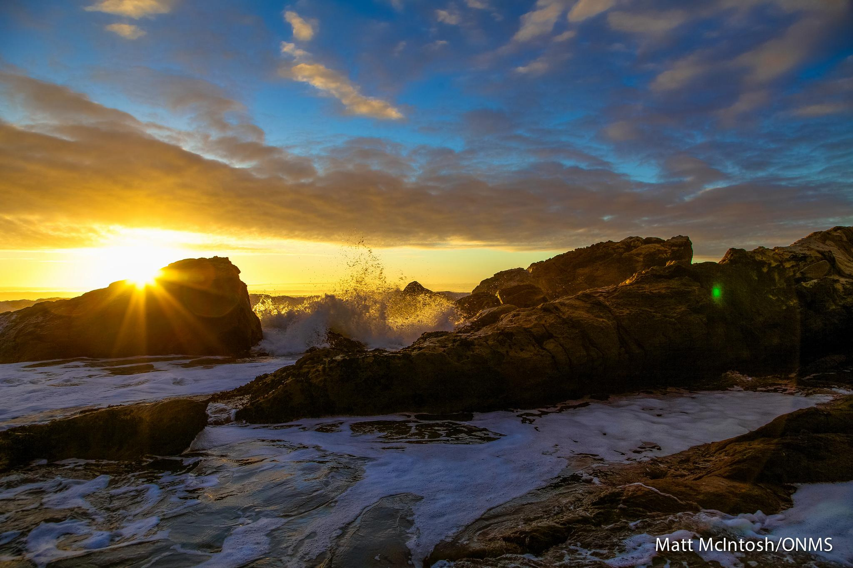
Greater Farallones National Marine Sanctuary
Notes:
Photo Credit: Matt McIntosh/NOAA

Slide 3
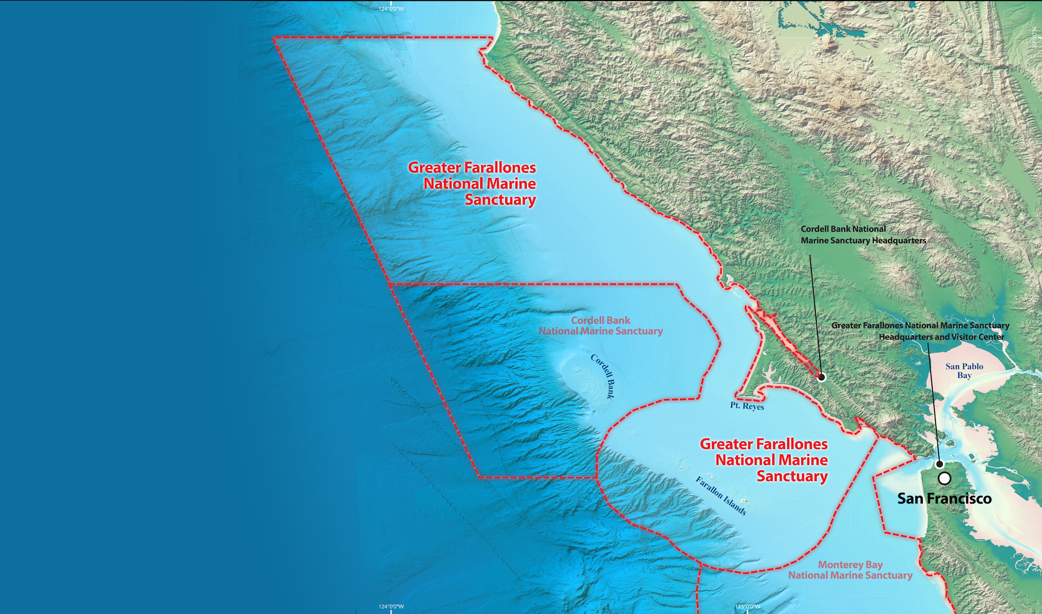
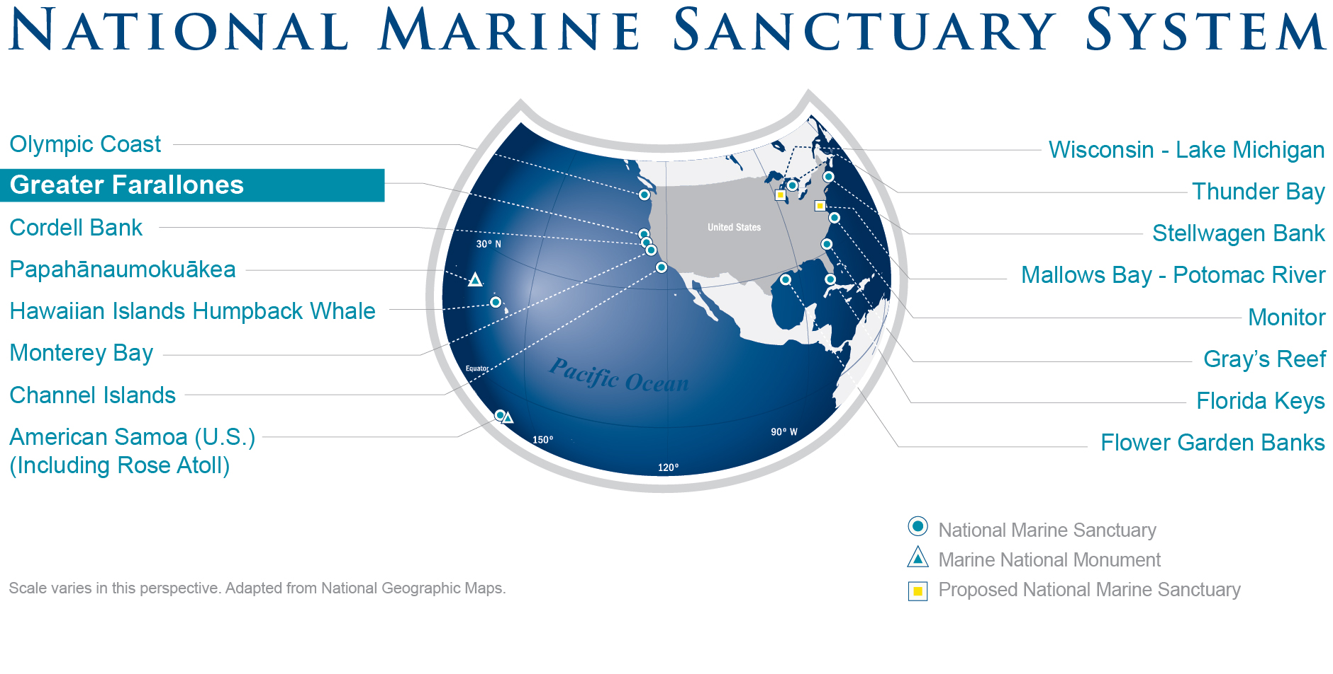
Notes:
Map 1:
The Office of National Marine Sanctuaries is a part of NOAA that protects our nation’s underwater parks– special places in the ocean and Great Lakes, so that we can all enjoy and explore the wonders of the sea.
Off the coast of San Francisco, California lies Greater Farrallones National Marine Sanctuary.
Map 2:
In 2015, Greater Farallones National Marine Sanctuary expanded to protect 3,295 square miles of the northern and central California coast.

Slide 4
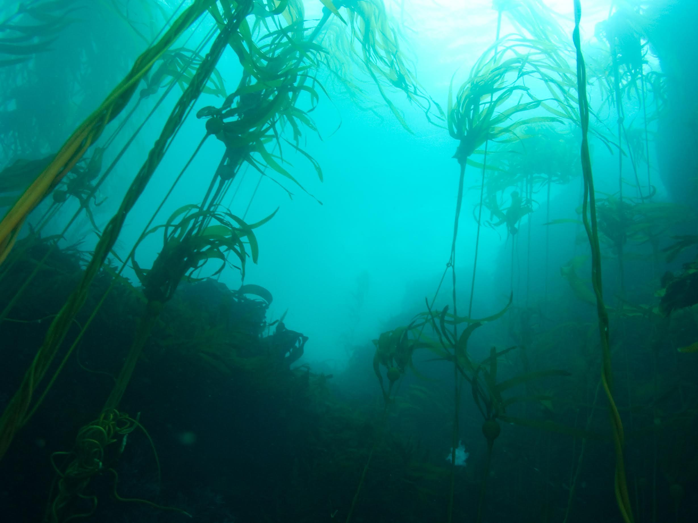
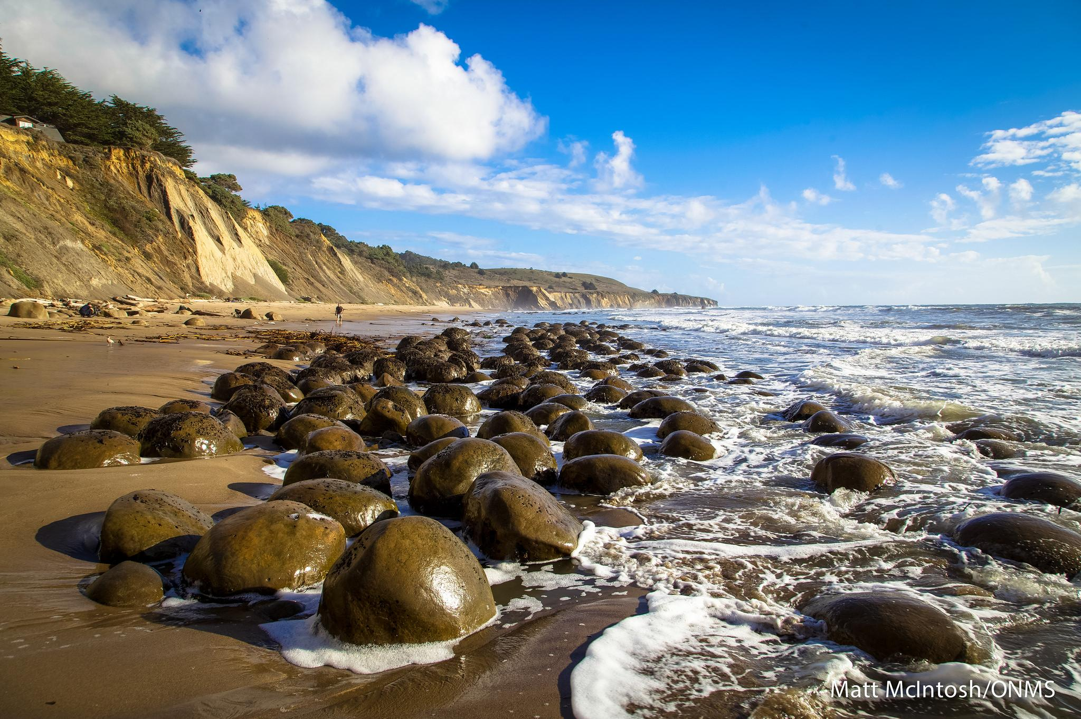
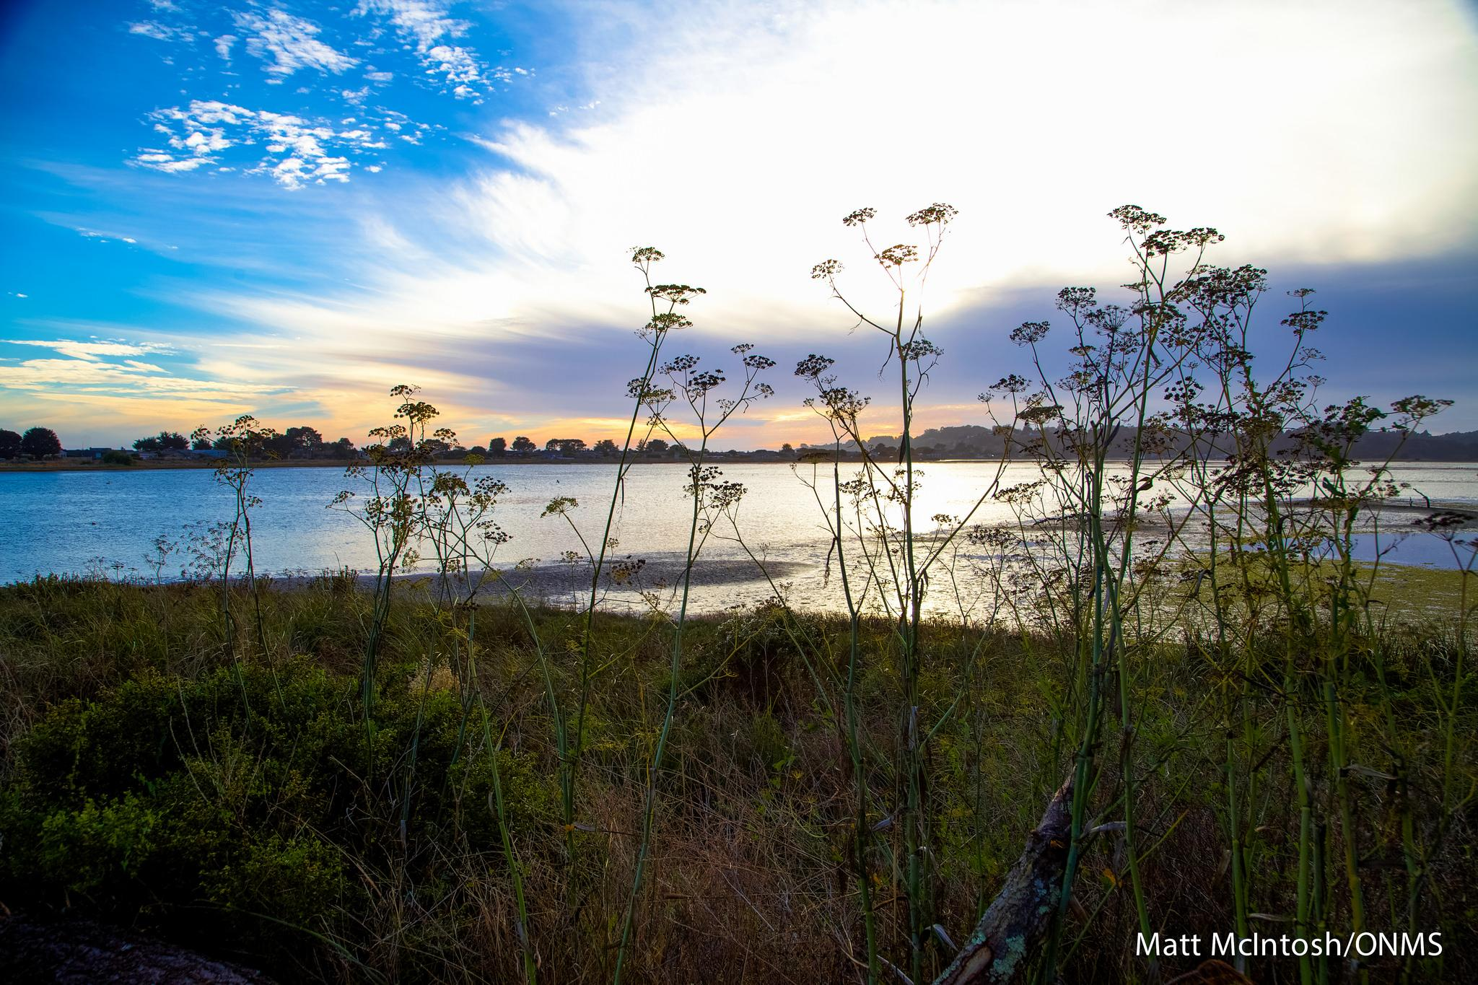
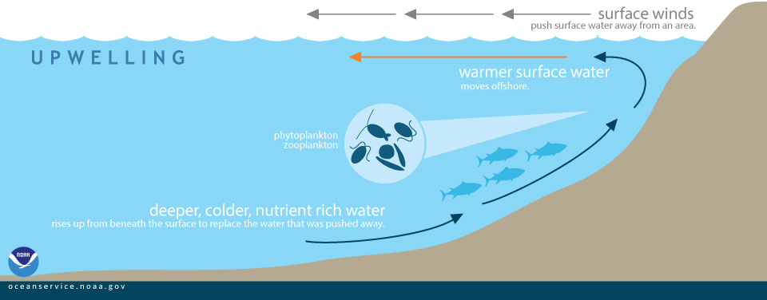
The sanctuary protects many different ocean ecosystems.
Notes:
An ecosystem is a place where all the plants and animals that live there depend on each other to survive. Greater Farallones National Marine Sanctuary is part of the California Current ecosystem. The water here is rich with nutrients because of upwelling– the process when cold water from deep in the ocean rises to the surface– and supports many living things. This sanctuary protects smaller ecosystems including kelp forests, beaches, rocky shores, and lagoons.
Photo Credit: (clockwise):
Bull Kelp-- Jared Figurski/UCSC
Rocky Shore-- Matt McIntosh/NOAA
Lagoon-- Matt McIntosh/NOAA

Slide 5
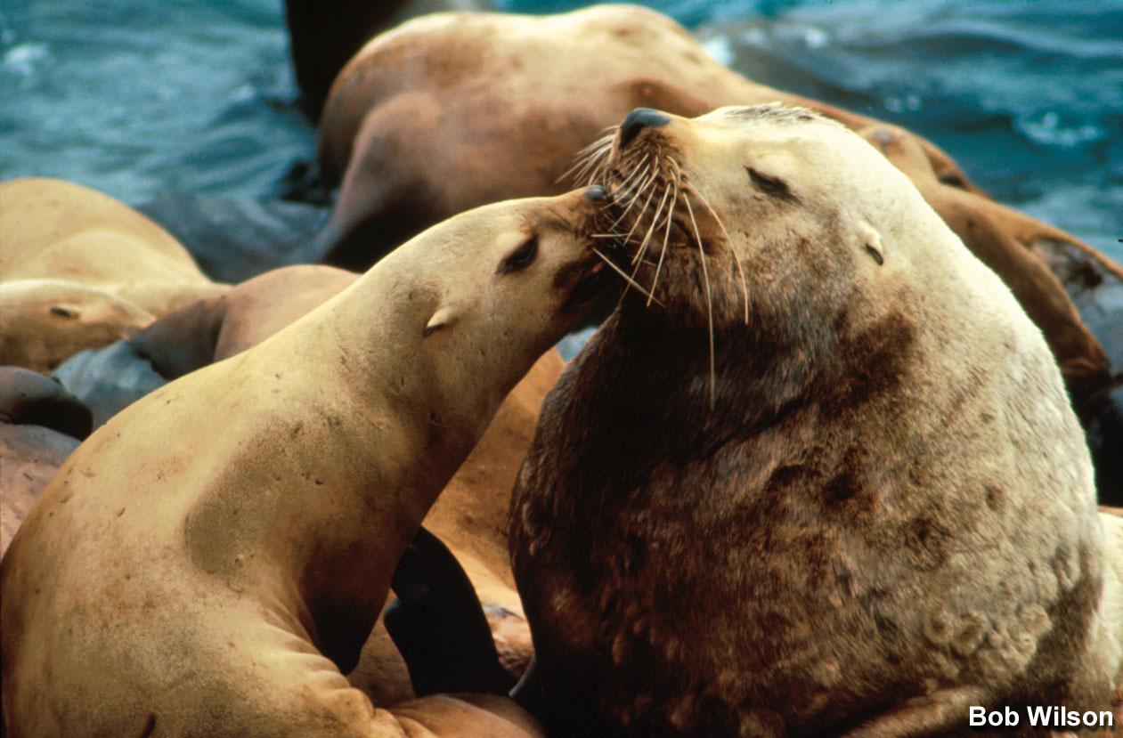
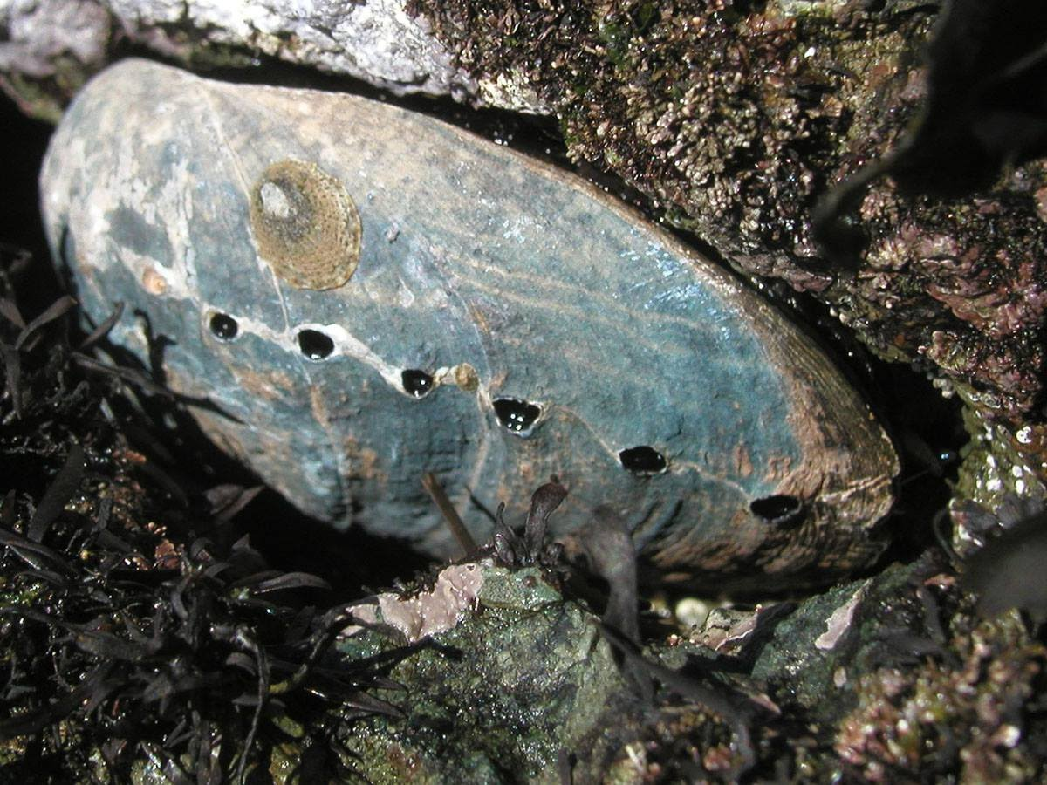
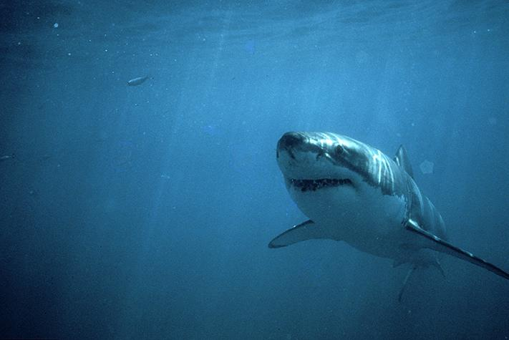
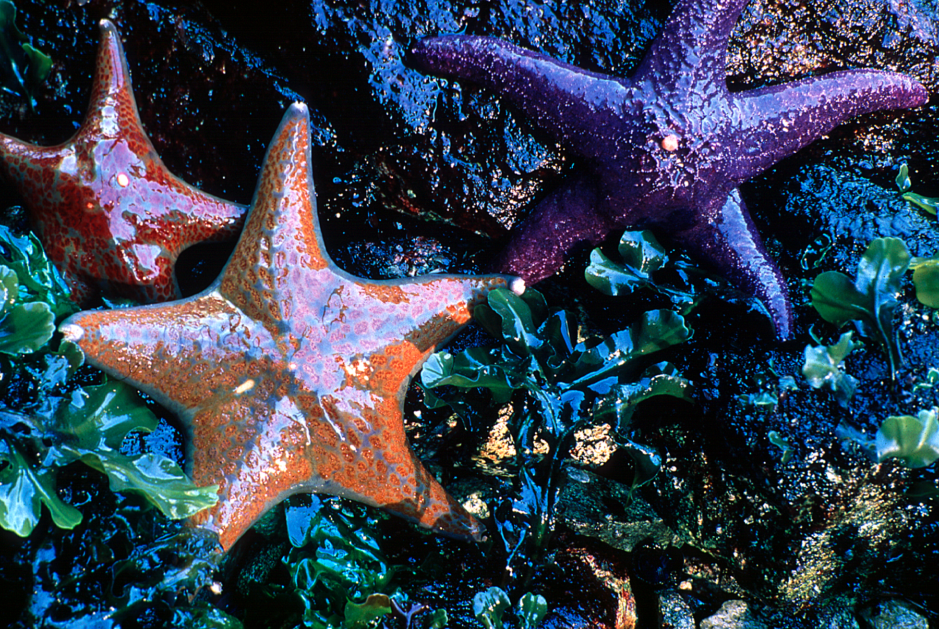
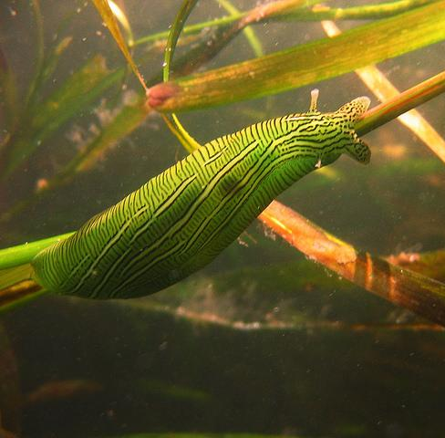
And these ecosystems support many varieties of marine life.
Notes:
In these ecosystems, many diverse marine life live. The sanctuary supports 36 marine mammal species and one of the most significant white shark populations on the planet. The sanctuary is also home to blue, gray, and humpback whales; seals and sea lions; dolphins; and more than 250,000 seabirds, not to mention many fishes and plants. Ecosystems are fragile and even a little change can make a big impact.
Photo Credits (clockwise):
Brown Pelican– Matt McIntosh/NOAA
Conestoga Bow w/octopus-- NOAA
Abalone– Steve Lonhart/NOAA
Taylor’s Sea Hare-- Jennifer Stock/NOAA
Sea Stars– Joe Heath
Great white-- Steven K. Webster/Monterey Bay Aquarium
Steller Sea Lions– Robert J. Wilson

Slide 6
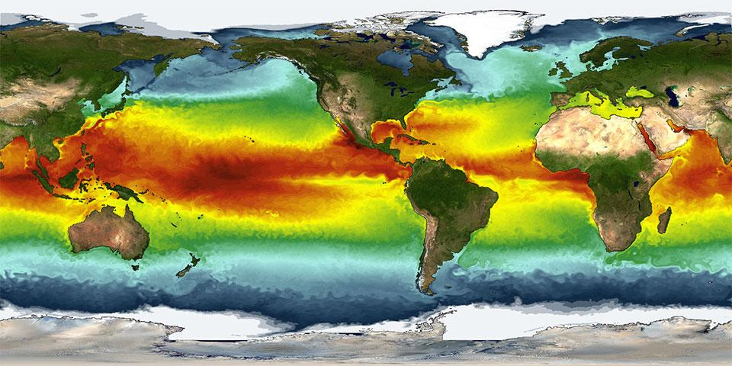
Sea surface temperature is the water temperature close to the ocean’s surface.
Scientists record sea surface temperature to better understand what is happening in the ocean.
Notes:
Sea surface temperature is the water temperature close to the ocean’s surface. Each ecosystem is healthiest within a specific range of sea surface temperatures. If the temperatures change too much the ecosystem will not be healthy.
Resource: http://oceanservice.noaa.gov/facts/sea-surface-temperature.html
Photo Credit: NOAA

Slide 7
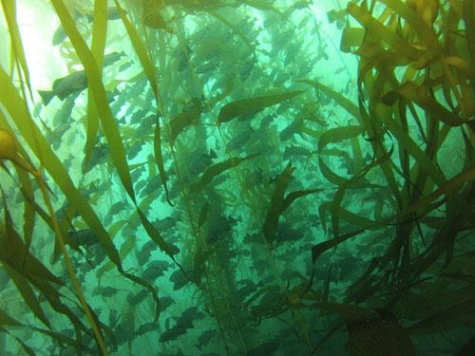
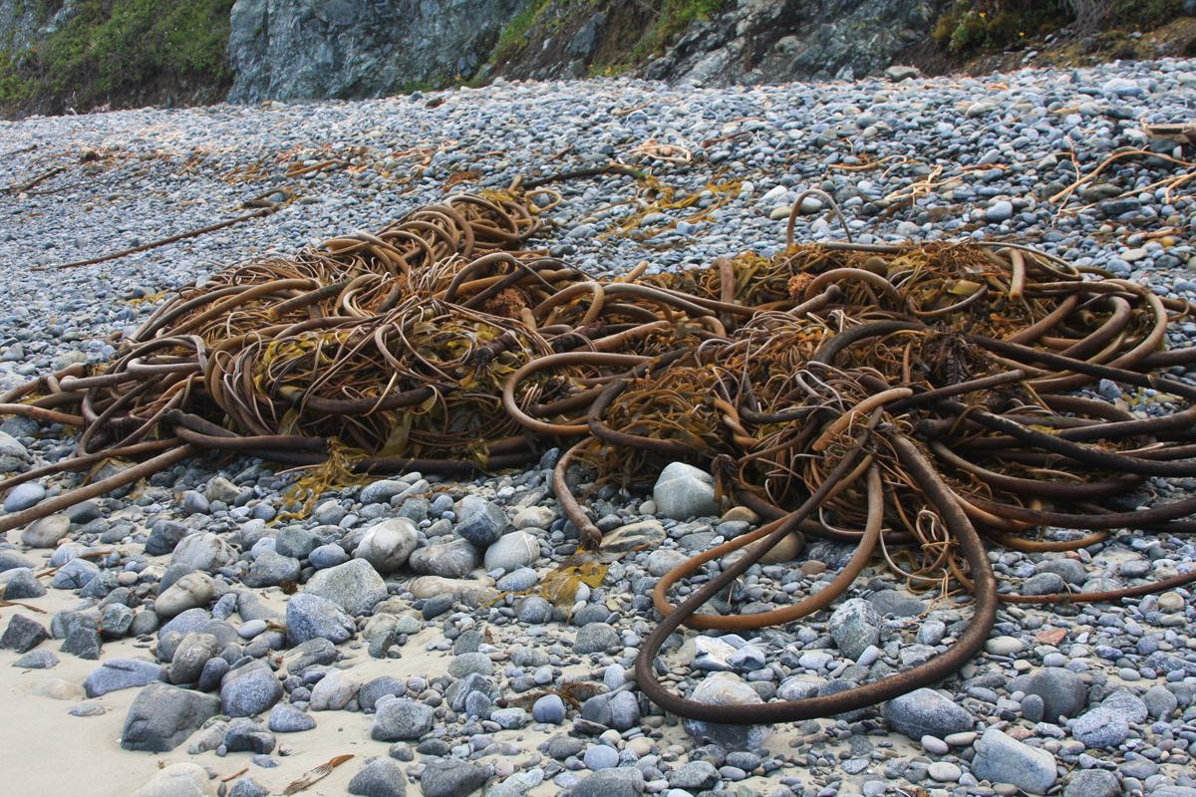
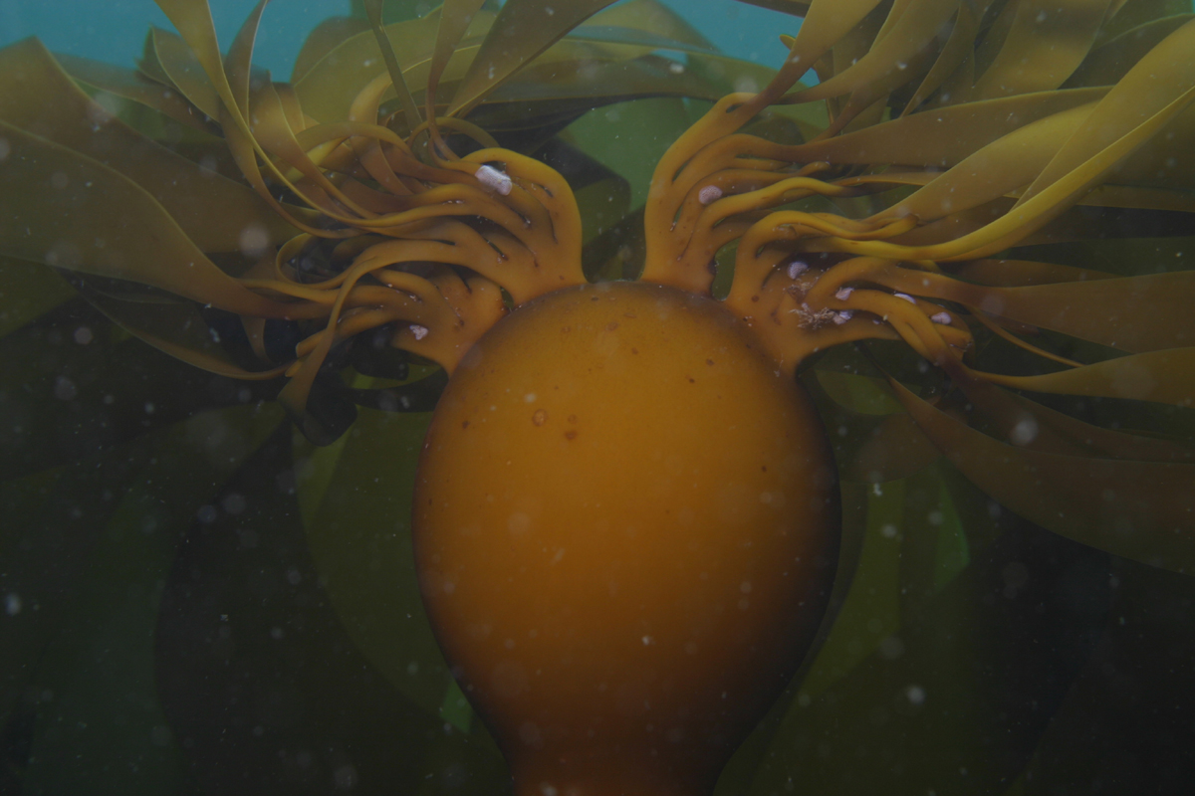
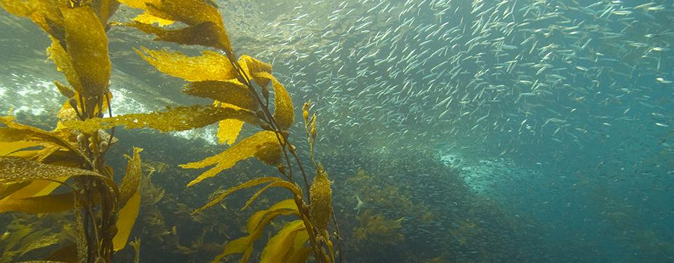
Kelp forests grow mostly on the Pacific coast, from Alaska and Canada all the way to Baja, California.
Notes:
Kelp forests are one of the important ecosystems within Greater Farallones National Marine Sanctuary. Kelp forests grow mostly on the Pacific coast, from Alaska and Canada to the waters of Baja, California. Kelp forests are similar to rainforests, as they have a canopy up top near the surface and several layers below. Kelp forests in Greater Farallones National Marine Sanctuary thrive in cooler water and are made up mostly of bull kelp. Many invertebrates (or creatures without backbones), fishes, marine mammals, and birds live in kelp forests.
Links: http://oceanservice.noaa.gov/facts/kelplives.html
Photo Credit (clockwise):
Steve Lonhart/NOAA
Steve Lonhart/NOAA
Steve Lonhart/NOAA
NOAA

Slide 8
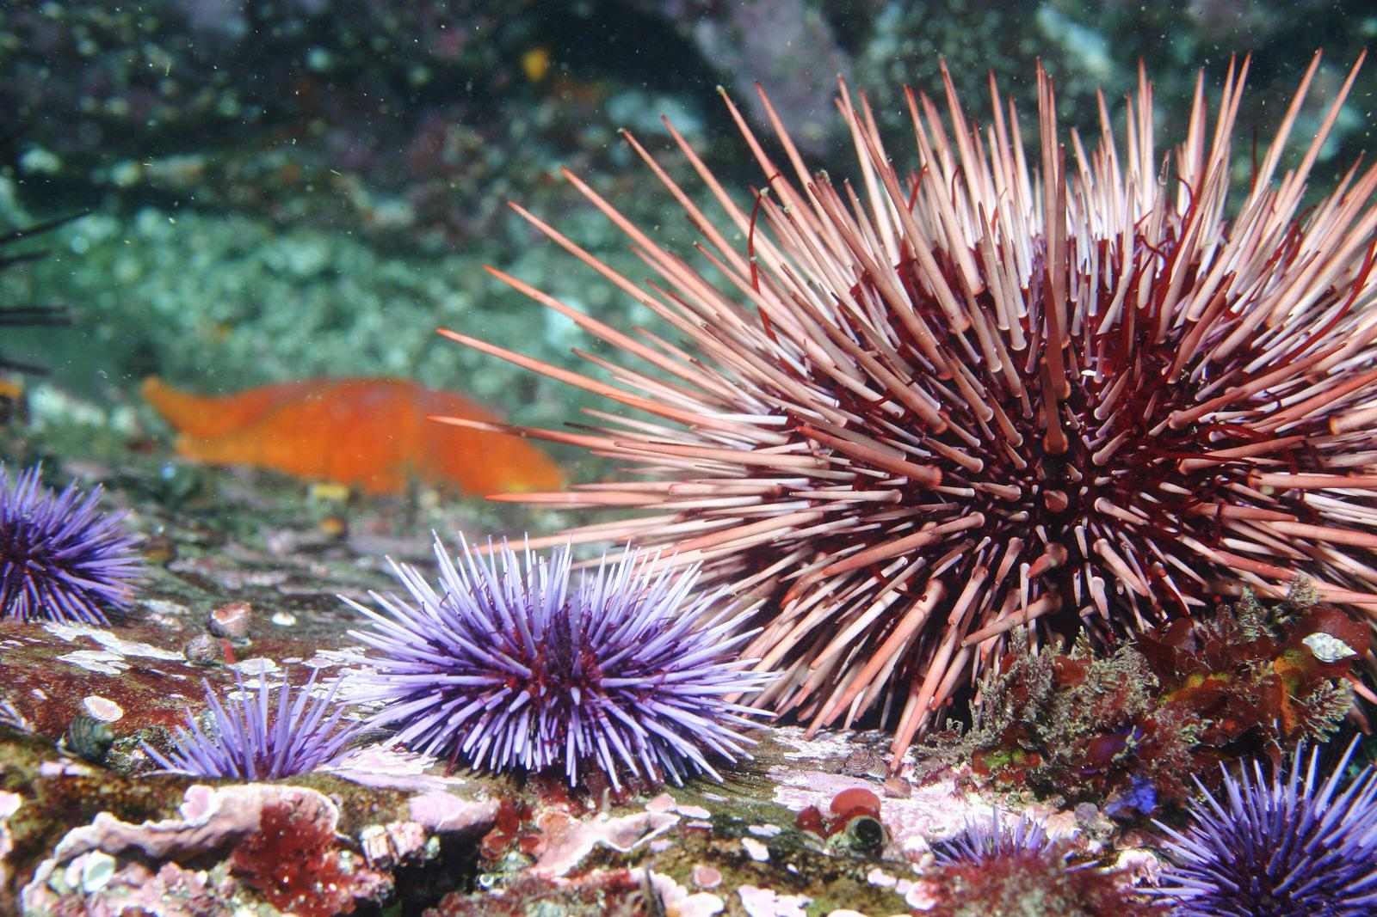
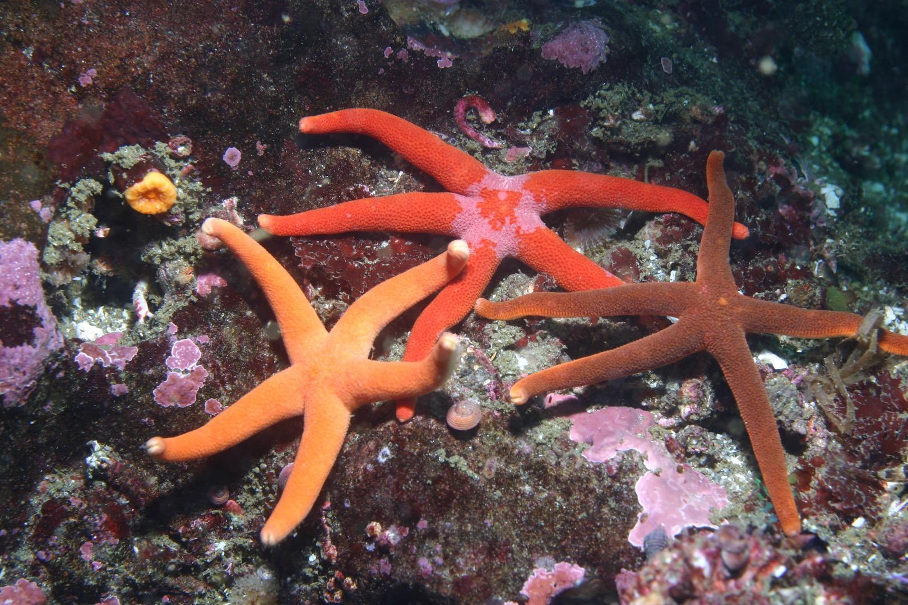
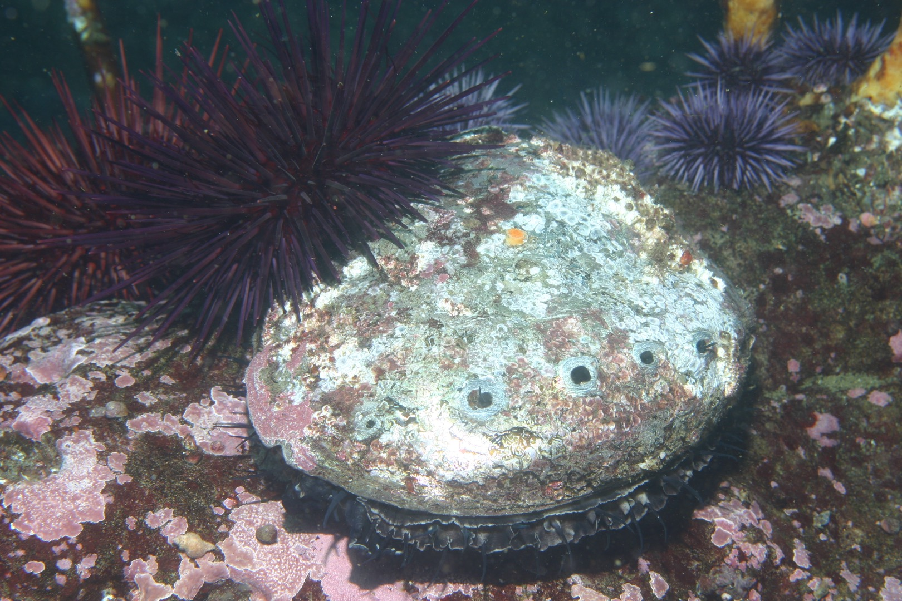
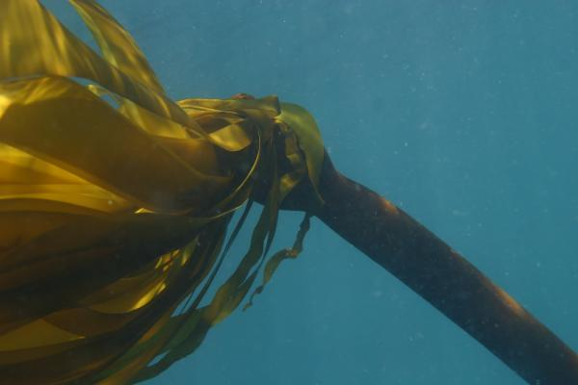
Kelp Forest Ecosystem
Notes:
All marine life in kelp forest ecosystems are interconnected. Kelp beds are home to juvenile fishes who can hide amongst kelp stalks. Kelp is also the main food source for many animals, including abalone and urchins. Both sea stars and sea urchins play critical roles in keeping this ecosystem stable. Sea urchins eat kelp. If there are too many urchins, they can destroy kelp forests. Sea stars prey on urchins and help to control the numbers of kelp grazers. This delicate balance keeps the kelp ecosystem healthy.
Photo Credits (left to right):
Urchins—Henricia Sea Stars– Steve Lonhart/NOAA MBNMS
Red Abalone– Steve Lonhart/NOAA MBNMS
Kelp Greenling– Steve Lonhart/NOAA MBNMS
Bull Kelp– Steve Lonhart/NOAA MBNMS

Slide 9
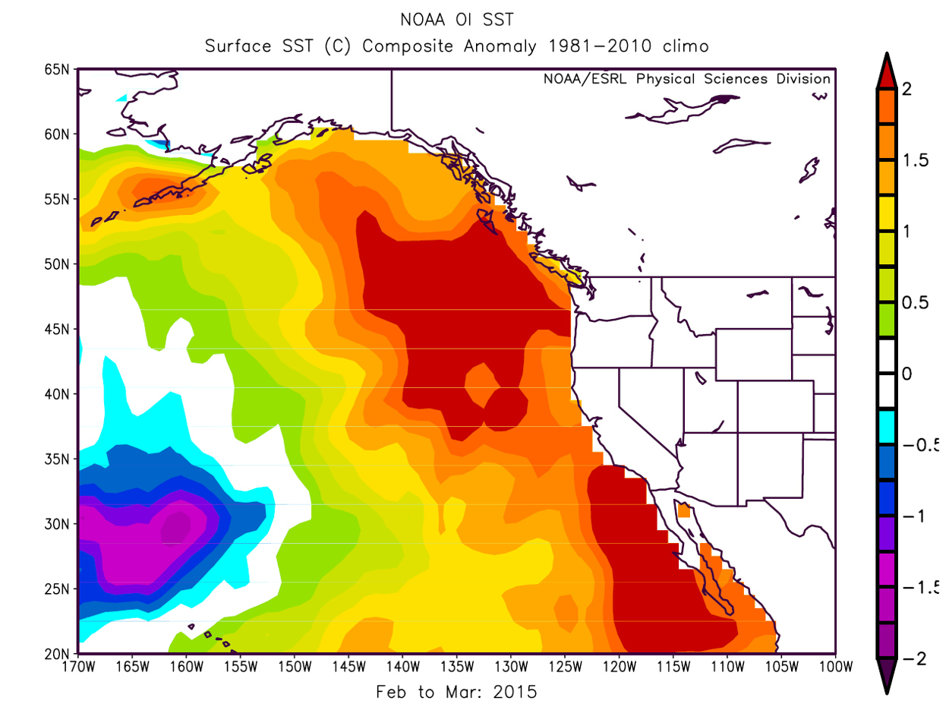
The Blob
Since 2014, the sea surface temperatures in the Pacific Ocean off the West Coast of North America have been unusually warm. Scientists are calling this warm water “The Blob.”
Notes:
Since 2014, the sea surface temperature in the Pacific Ocean off the West Coast of North American have been unusually warm. Scientists are calling this warm water “The Blob.” These warm sea surface temperatures have impacted upwelling, with less cold water (from the deeper ocean) mixing near the surface part of the ocean. The Blob is impacting the kelp forest ecosystem in Greater Farallones National Marine Sanctuary.
Resource: https://ww2.kqed.org/science/2016/10/31/the-blob-is-back-what-warm-ocean-mass-means-for-weather-wildlife/
Photo Credit: NOAA

Slide 10
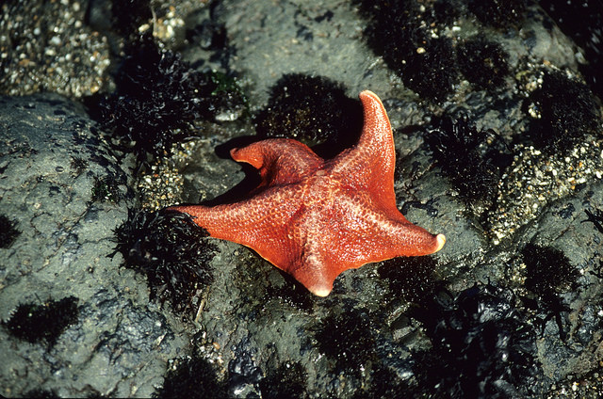
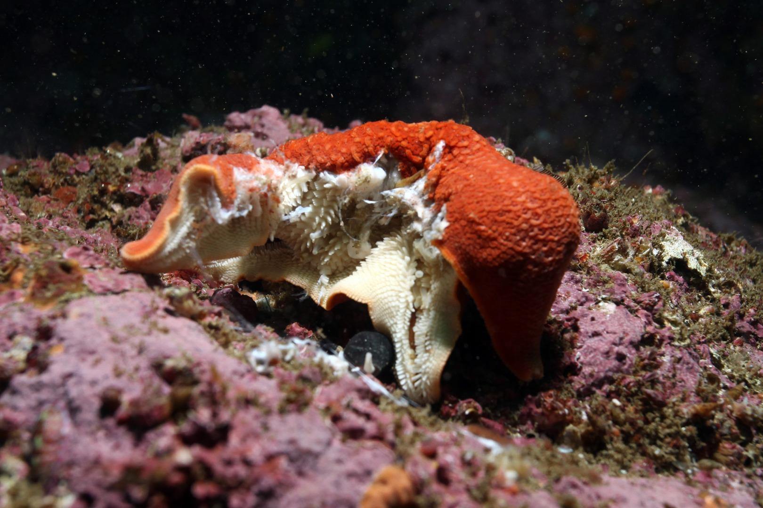
Healthy Bat Star
Bat Star with Sea Star Wasting Syndrome
Notes:
In 2013, a disease called Sea Star Wasting Syndrome hit the Pacific coast of North America. Sea stars that are infected often have lesions (or cuts) all over their bodies and loose limbs (or legs). The disease is deadly. The warm water off the West Coast of the United States, known as The Blob, is causing sea star wasting disease to spread more rapidly. This in turn affects the kelp forest and purple urchin populations.
Photo Credits (clockwise):
Healthy Bat Star–Dwayne Meadows/NOAA
Wasting Bat Star– Chad King/NOAA

Slide 11
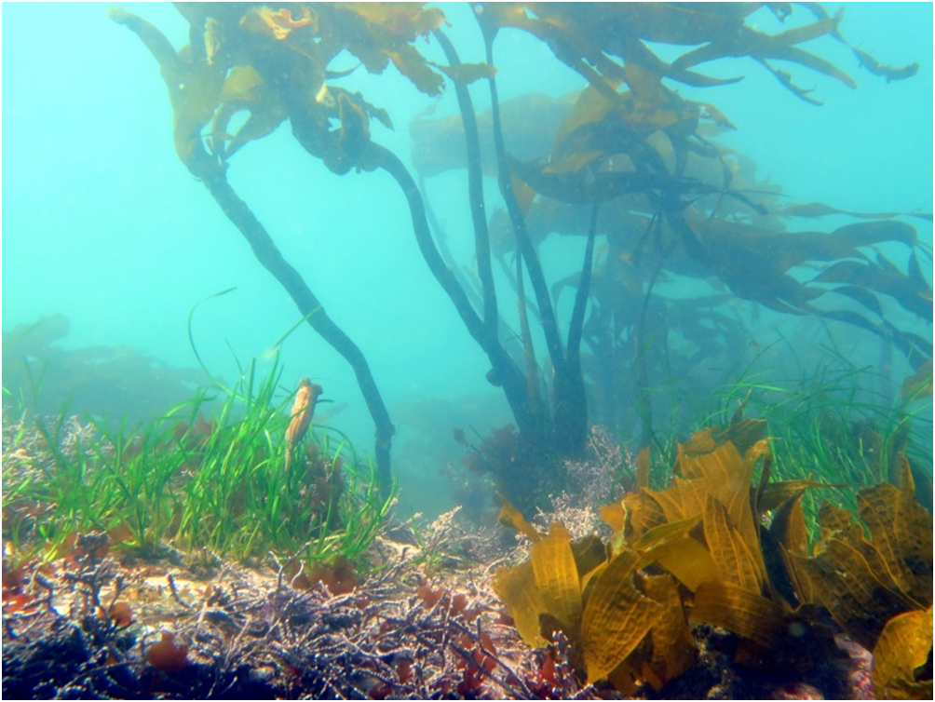
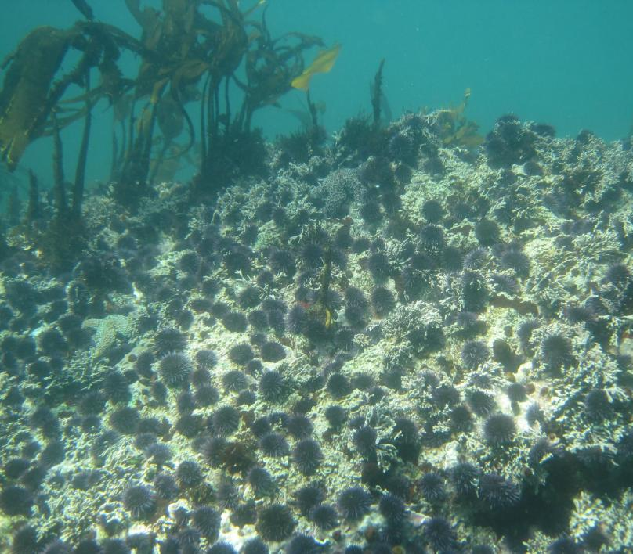
Watch Video:
https://vimeo.com/45156320
healthy kelp forest
urchin barren
Notes:
Northern California kelp forests have seen a drastic decline (86-97%) since 2014. The purple urchin population has increased due to changing ocean conditions and the impacts of sea star wasting syndrome. With many of the sea stars, a key predator for urchins, gone, scientists are seeing 60 times more purple urchins than they ever have in the past. This is turning kelp forests to urchin barrens.
Watch Video: https://vimeo.com/45156320
Photo Credits:
Healthy Kelp Forest – L. Rogers-Bennett/CDFW
Urchin Barren – Steve Lohnhart/NOAA

Slide 12
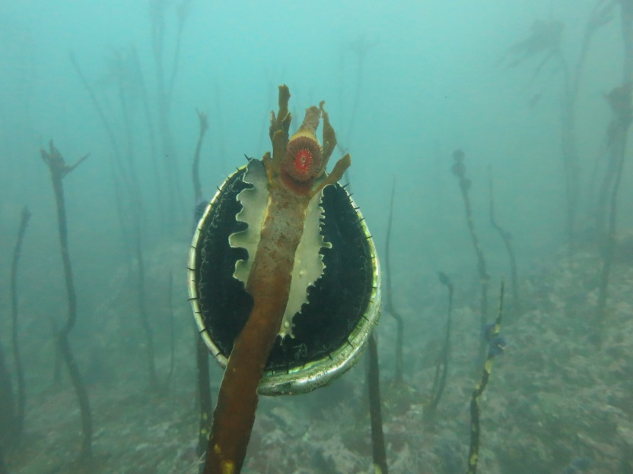
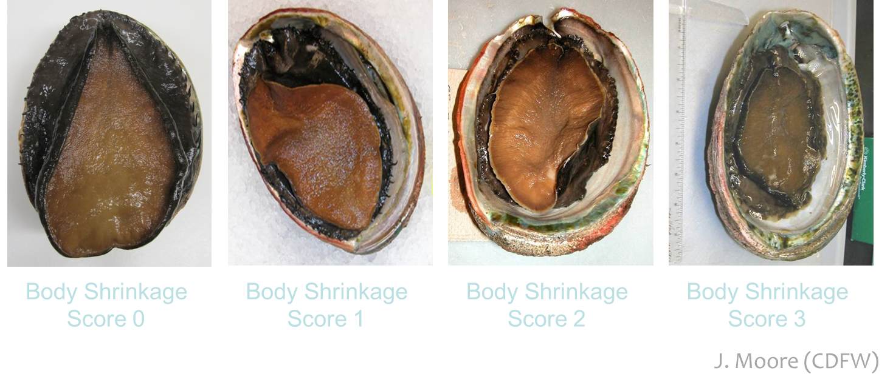
Abalone eat kelp. As kelp forests disappear, because of the increased purple urchin population, abalone are starving.
K. Joe (CDFW)
Notes:
As kelp forests disappear we are seeing a decline in the recreational red abalone and commercial red urchin fisheries. This impacts humans because both of these species are sold for food in northern California, and fishermen catch them for their livelihoods.
Abalone and sea urchins are both herbivores (or plant eaters) and depend on healthy kelp ecosystems for both food and shelter. Due to the recent loss of kelp, many abalone and red urchins are starving, which is causing them to exhibit some very unusual behaviors. Scientists in California have documented abalone climbing stalks in search of kelp blades (see photo top left) and small abalone leaving rocky crevices they hide in for safety in search of food. The red abalone and red urchins that fishers are harvesting are smaller and less healthy than usual.
Photo Credits (clockwise): Abalone climbing kelp-- K. Joe (CDFW), Abalone body shrinkage– J. Moore (CDFW)

Slide 13
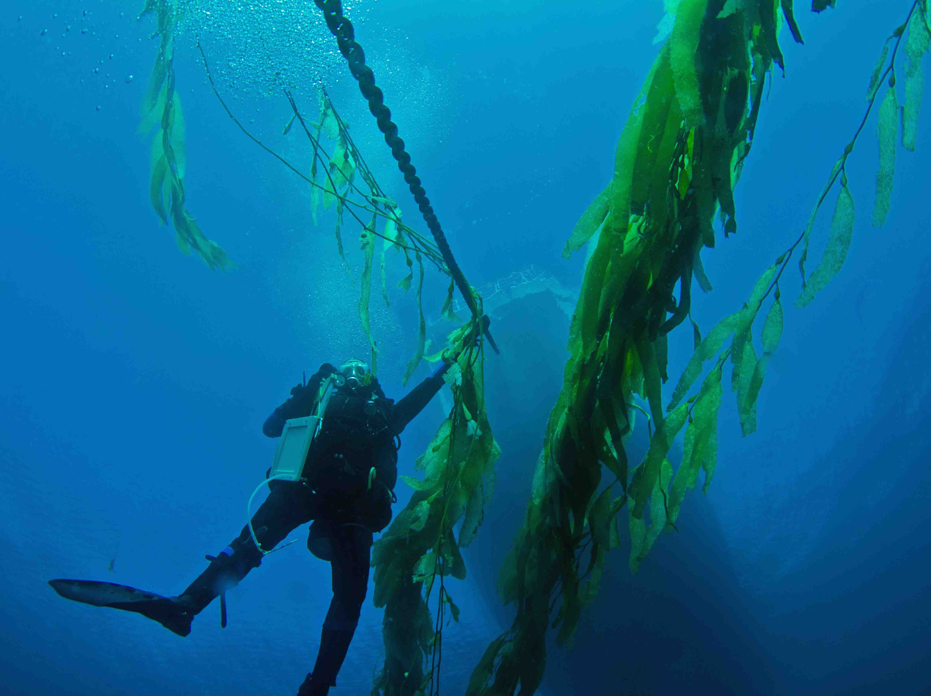
Notes:
Sanctuary scientists conduct special types of scientific scuba dives, called monitoring dives, to see how ecosystems are changing in the sanctuary. During these dives they conduct abalone and urchin surveys to better understand the health of these populations. The NOAA diver in this photo is returning to the boat after conducting an abalone survey.
Photo Credit: Adam Obaza/NOAA

Slide 14
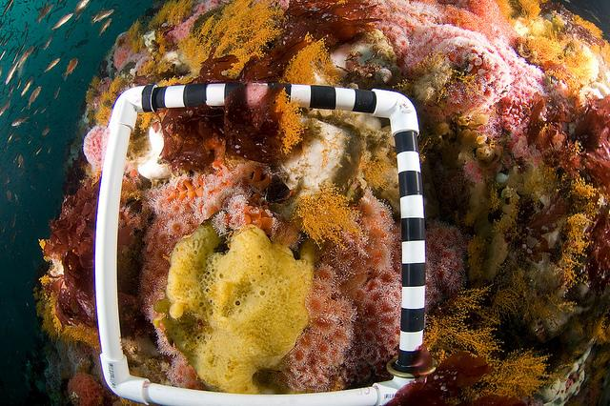
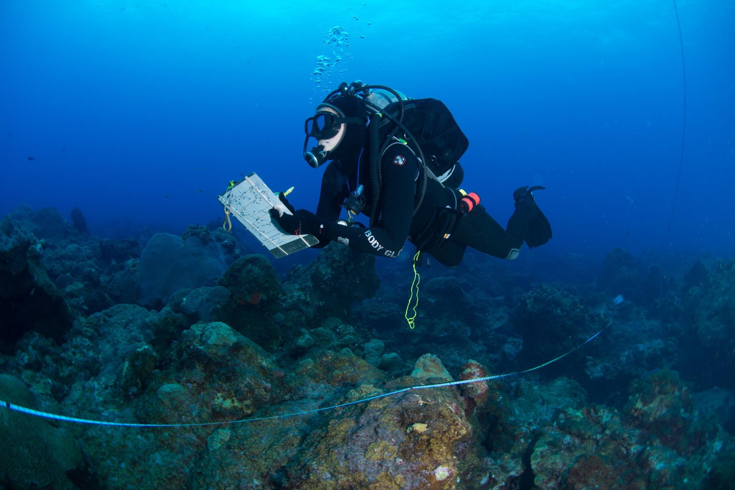
Quadrat: A framed area that contains a series of equal sized squares. Scientists record species of interest within this designated area to better understand the ecosystem.
Transect: A line that is marked at regular distances. Scientists follow this line and record what they find at each of the marked points.
Notes:
How do scientists measure urchin populations? Transects and quadrats are two tools that help scientists to understand the abundance of (or how many) creatures in a specific area. By tracking abundance in a specific location over time, scientists are better able to understand how populations may be changing.
Photo Credits (top to bottom):
Quadrat-- Joe Hoyt/NOAA
Transect-- G.P. Schmahl/NOAA

Slide 15
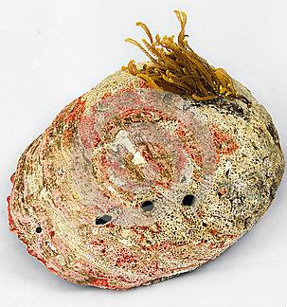
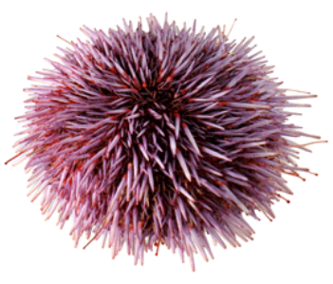
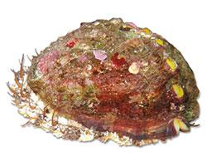
Now you try!
pinto abalone
purple urchin
How many purple urchins are in the quadrat? Pinto abalone? Red abalone?
red abalone
Notes:
Hint: When scientists conduct quadrat surveys they record any species of interest that is at least partially in the quadrat.
Question: How many purple urchins are in the quadrat? Pinto abalone? Red abalone?
Answer: 4 purple urchins, 3 pinto abalone, 1 red abalone

Slide 16
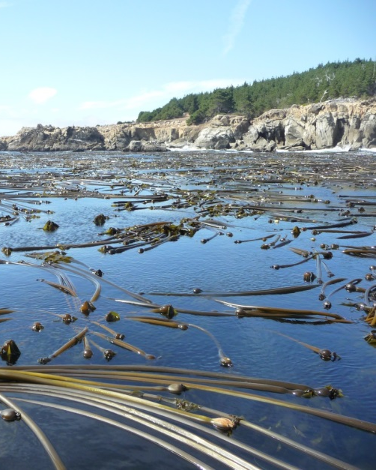
Help Report Kelp Canopy Sightings
in Marin, Sonoma, and Mendocino counties:
Find kelp floating at the surface or washed up on the beach
Take a photo
Note your location (using decimal degrees)
Report to rietta.hohman@noaa.gov
Notes:
In order to understand how kelp forest ecosystems are changing in Greater Farallones National Marine Sanctuary we need to understand where there is healthy kelp and where kelp is deteriorating. You can become a part of the solution and help to support healthy kelp forest ecosystems as well as healthy fisheries. When you are out walking along the beach you may notice kelp forests floating under the waves. One way that you can be a part of the solution is to report these findings. If you see kelp forest canopy in the sanctuary take a photo and note your location (using decimal degrees) then report this information to rietta.hohman@noaa.gov.

Slide 17
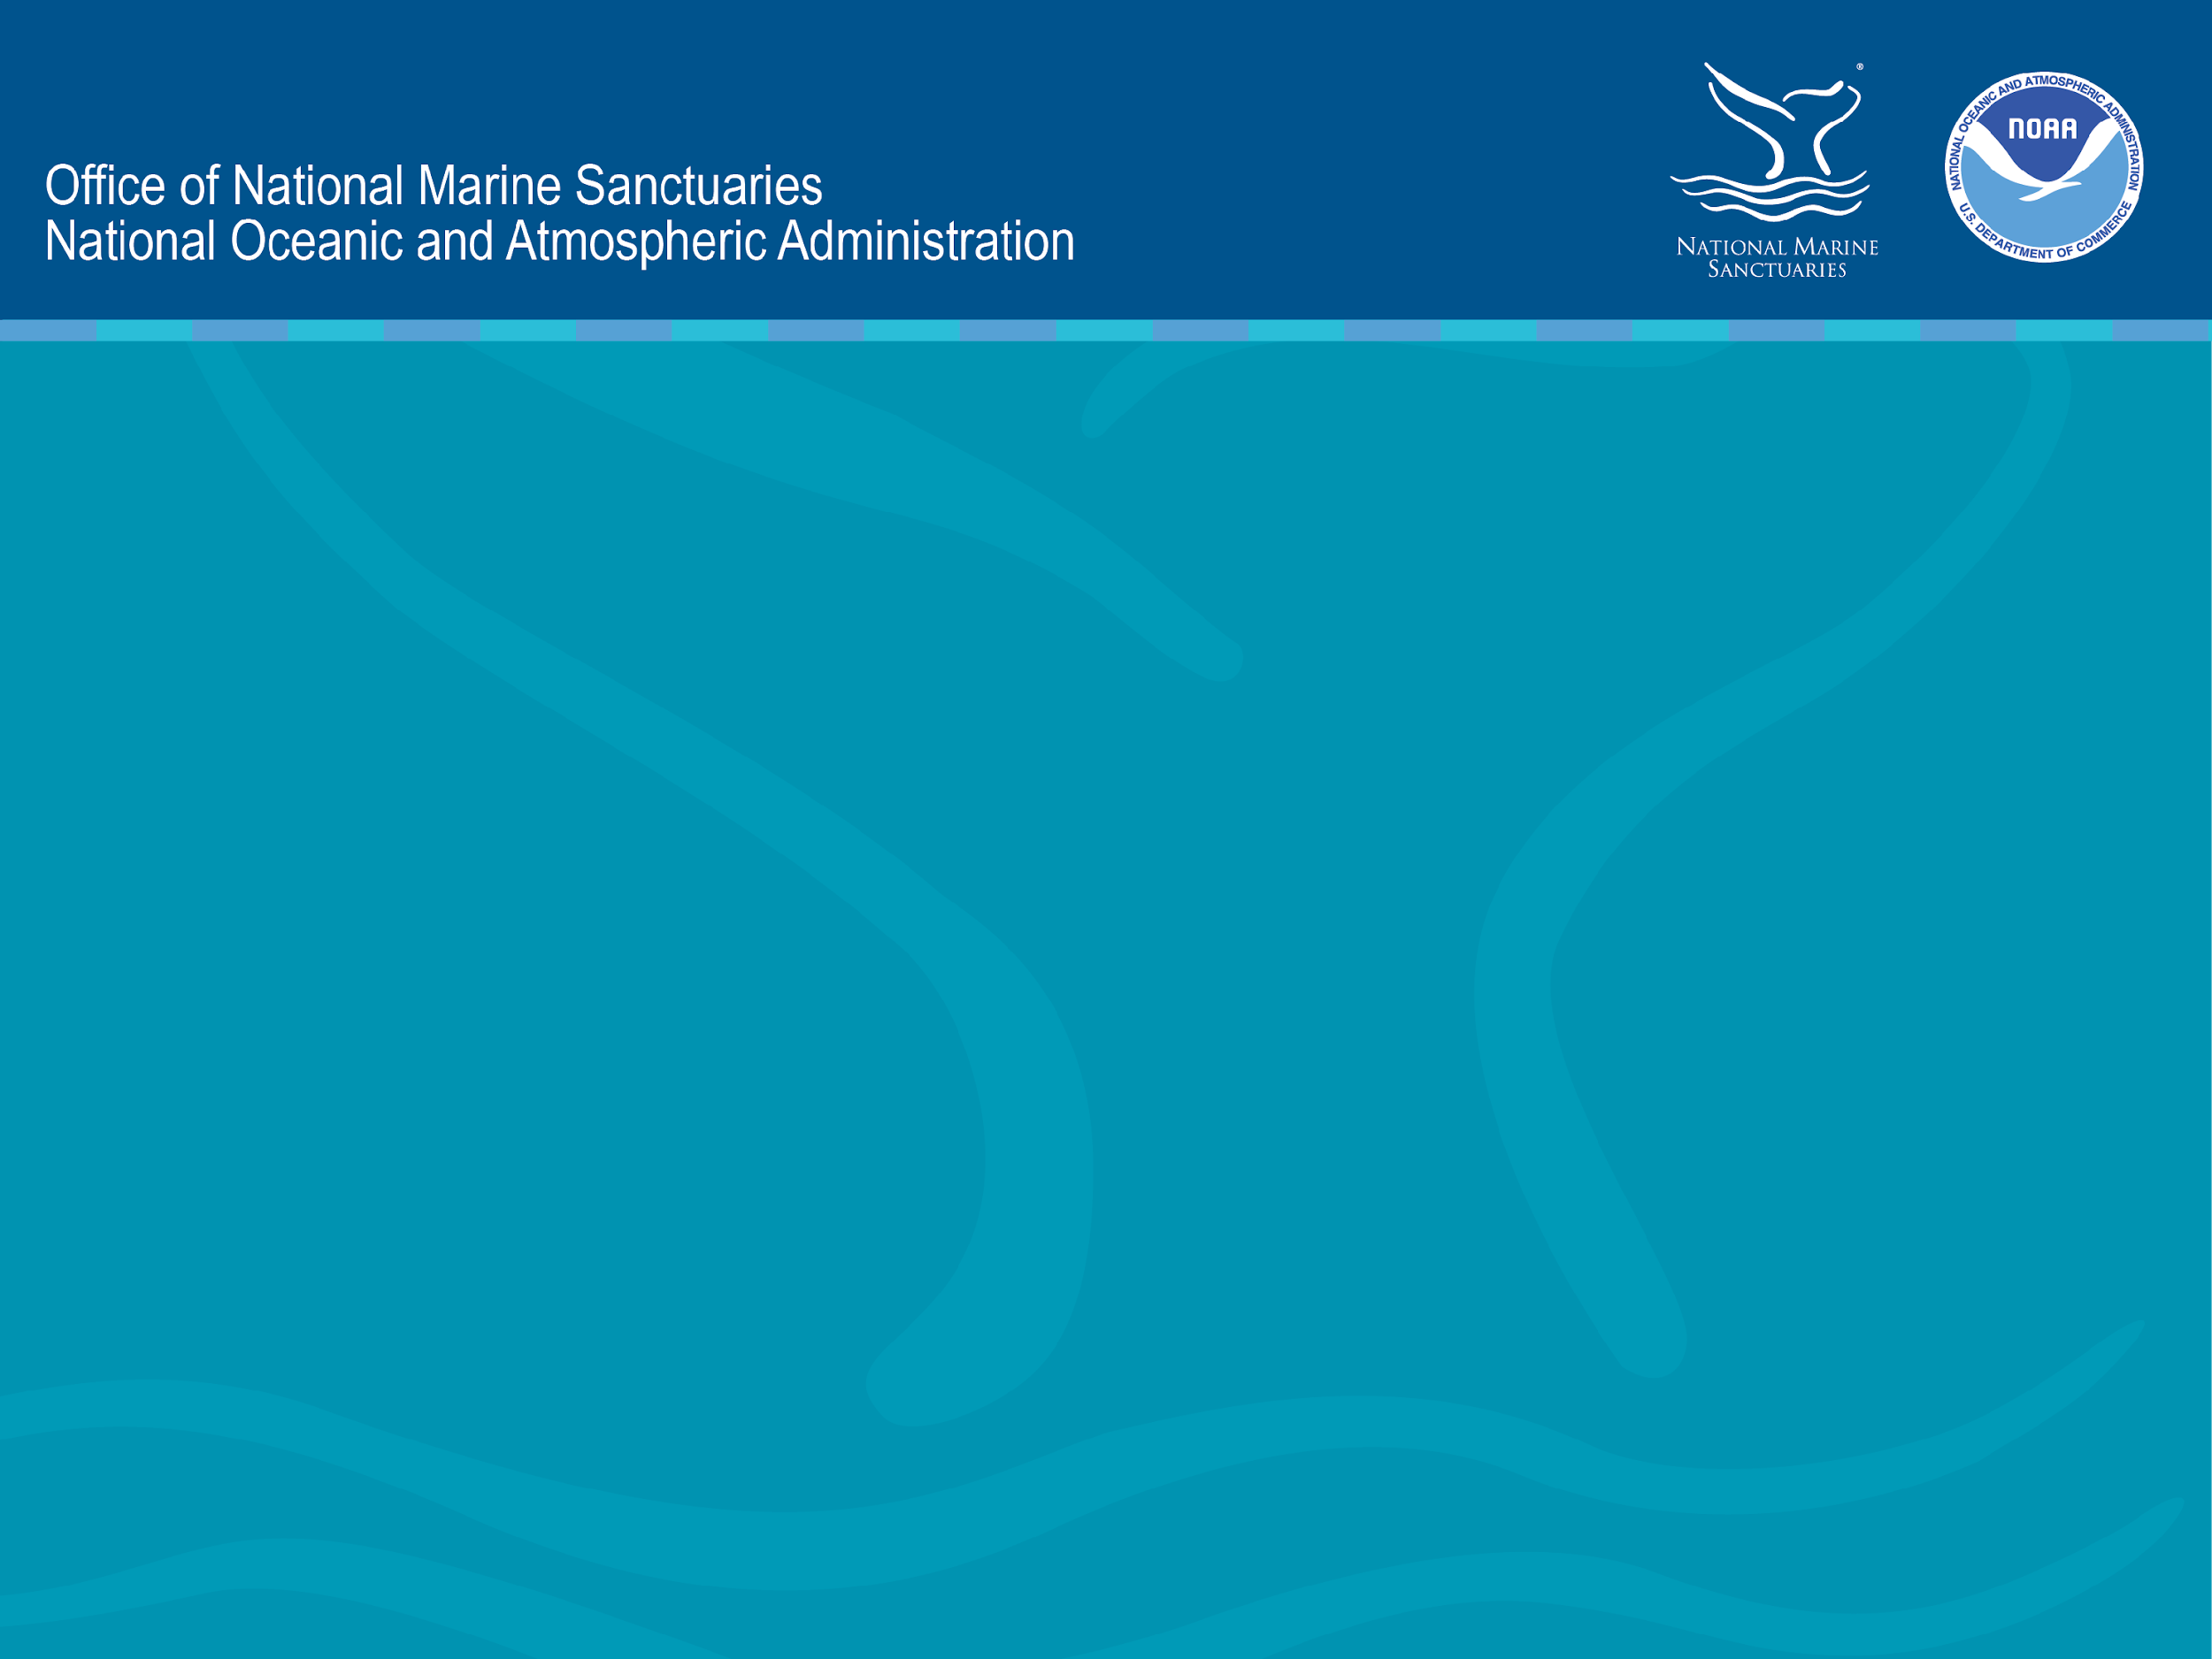
https://farallones.noaa.gov

Slide 18
Additional Video Resources
Notes:
These additional video resources are provided to give you options for scaffolding lessons to fit students of various age groups. Please review the videos prior to the lesson and decide if you would like to add them to your lesson.

Slide 19
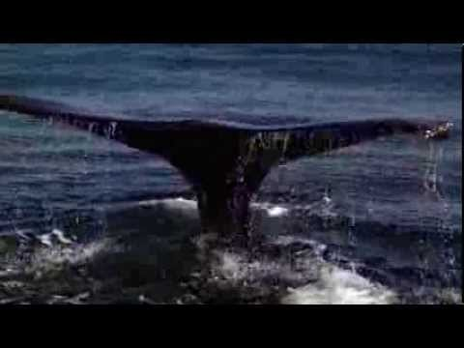
Sanctuary in the Sea: Gulf of the Farallones National Marine Sanctuary
https://www.youtube.com/watch?v=23AyKvdKCLY
Notes:
Great and exciting overview of Gulf of the Farallones National Marine Sanctuary. Note that this sanctuary changed its name, to Greater Farallones National Marine Sanctuary, when it expanded in 2015. This video is better for older students. Run time is about 18 minutes.
Video Link: https://www.youtube.com/watch?v=23AyKvdKCLY

Slide 20
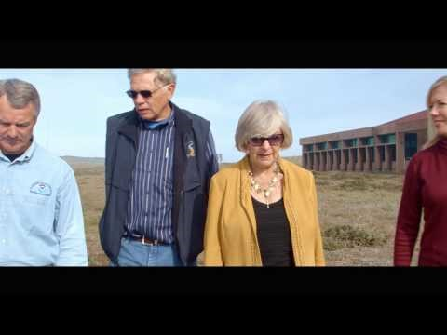
Earth Is Blue: Cordell Bank and Greater Farallones Expansion https://www.youtube.com/watch?v=rjWAa_oltVg&t=126s
Notes:
This video discusses the importance of Greater Farallones and Cordell Bank national marine sanctuaries and highlights their recent expansion.
Video link: https://www.youtube.com/watch?v=rjWAa_oltVg&t=1 26s

Slide 21
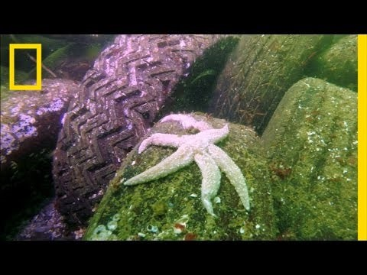
Video: Sea Star Wasting Syndrome https://www.youtube.com/watch?v=VPSFdjvES_Y
Notes:
Video Link: https://www.youtube.com/watch?v=VPSFdjvES_Y
This video explains sea star wasting syndrome and how it is affecting sea star populations. The video runs about 3.5 minutes and is appropriate for older students.

