Slide 1
Exploring Acoustic Fish Tagging

Slide 2
Gray’s Reef National Marine Sanctuary
Notes:
Instructional suggestion:
Share with students the purpose of the Ocean Guardians Dive Club: to learn about the importance national marine sanctuaries and how SCUBA skills can be used to study and protect them.

Slide 3
National Marine Sanctuaries
“America’s Ocean and Great Lakes Treasures”
Notes:
Instructional suggestion:
Use the images to lay the groundwork for the types of habitats and organisms provided protection by national marine sanctuaries. Some organisms shown include: sea turtles, whales and dolphins, sharks, and invertebrates, like corals and sea stars.
Instructor Notes:
Few places on the planet can compete with the diversity of the National Marine Sanctuary System, which protects America's most incredible natural and cultural marine resources. National marine sanctuaries are America’s ocean and Great Lakes treasures.

Slide 4
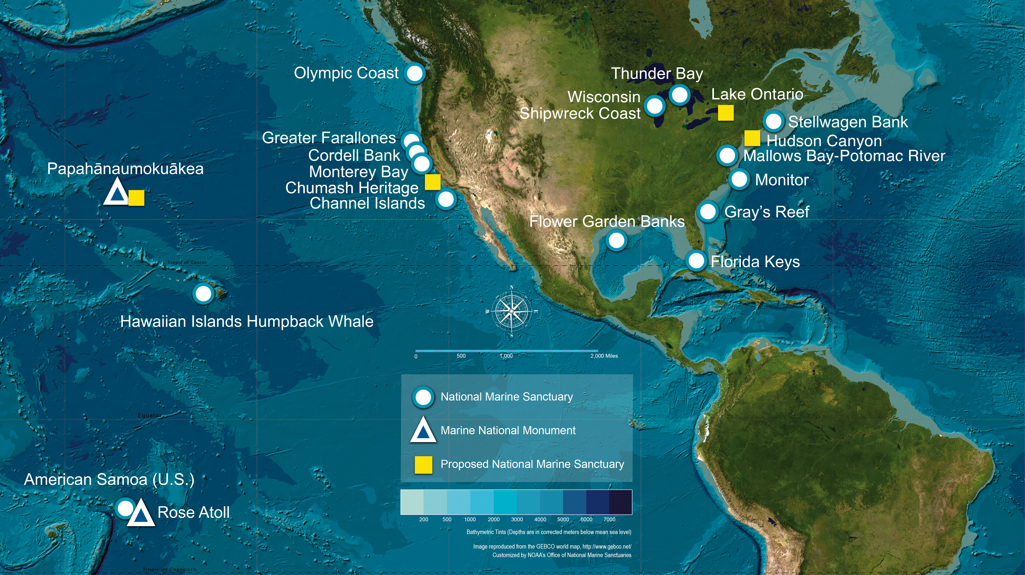
What is a national marine sanctuary? Why are they important?
A national marine sanctuary is an area that allows important ocean resources to be protected for now and future generations.
sanctuaries.noaa.gov
Notes:
Instructional suggestion:
Think-Pair-Share. Ask students to explain what they think a national marine sanctuary is and why they are important. Allow them to share their ideas with a partner and then solicit contributions from the whole group.
Instructor Notes:
The National Marine Sanctuary System encompass more than 620,000 square miles of marine and Great Lakes waters. This network of underwater areas includes a system of national marine sanctuaries and Papahānaumokuākea and Rose Atoll marine national monuments. These protected areas are on both the west and east coasts of the United States, and off Hawai’i and American Samoa. Additionally, there are protected areas within the freshwater environments of the Great Lakes.
Image: a map of national marine sanctuaries and marine national monuments in the U.S.

Slide 5
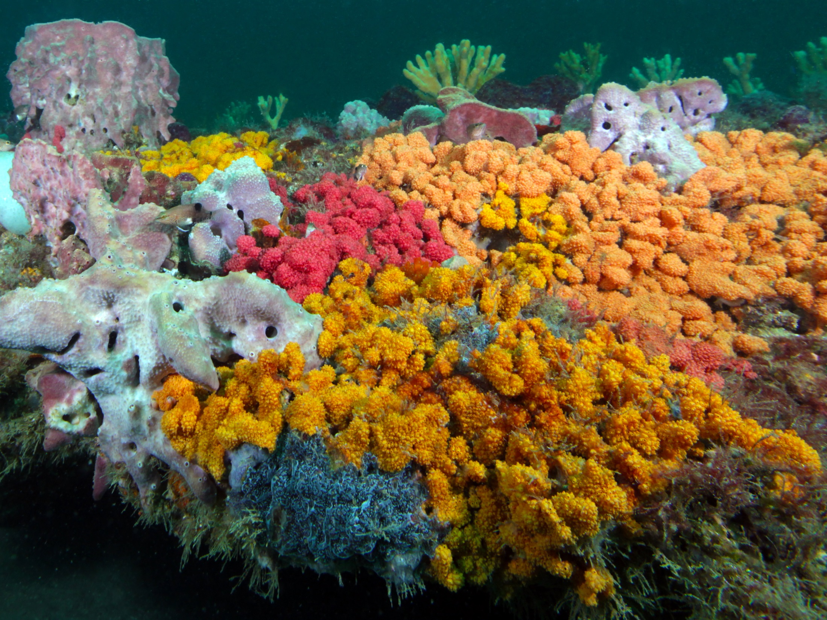
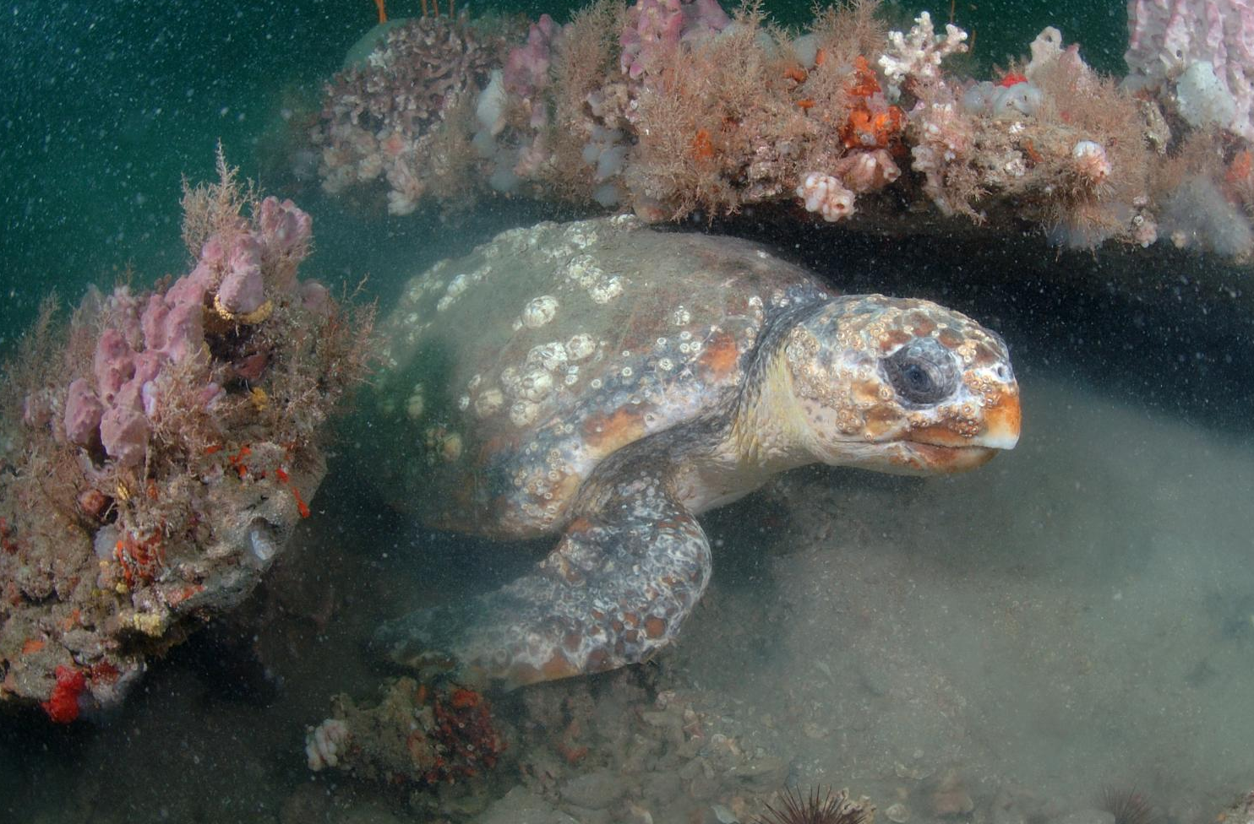
Gray’s Reef National Marine Sanctuary
What resources does Gray's Reef National Marine Sanctuary protect?
- ecosystems: live-bottom reef
- organisms: invertebrates, loggerhead sea turtles, North Atlantic right whales, many fish
- other resources: recreational and commercial fisheries, important research area
Notes:
Instructional suggestion:
Ask students to propose some types of resources that might be protected by the sanctuary. Possible answers include: sensitive habitats, endangered or threatened species, historical artifacts, and/or important cultural resources.
Click the image of a live-bottom reef to watch a short video that showcases this important habitat.
Instructor Notes:
“Live bottom" is a term used to refer to hard or rocky seafloor that provides habitat for high invertebrate abundance and diversity, including many species of sea squirts, sponges, and soft corals. Live-bottom reefs support more than 70% of the region’s offshore fisheries. Gray’s Reef National Marine Sanctuary provides protection to one of the largest near-shore, live-bottom reefs in the southeastern United States.
The structural complexity of the rocky ledges provide habitat for many invertebrates, which, in turn, support a diverse and abundant food web, including commercially important fish species like snapper, grouper, mackerel, and sea bass. Loggerhead sea turtles, a threatened species, use Gray's Reef year-round for foraging and resting and the reef is near the only known winter calving ground for the highly endangered North Atlantic right whale. The rocky ledges and sand expanses of the sanctuary are subject to challenging environmental conditions. Survival is largely dependent on a species’ tolerance of water temperatures which range from 40℉ to 80℉ and violent undersea "sandstorms" associated with winter storms. These constantly changing conditions contribute to an incredible diversity of marine life.
Images:
Top: A live-bottom reef. Photo credit: Greg McFall/NOAA
Bottom: A loggerhead sea turtle in Gray’s Reef National Marine Sanctuary. Photo credit: Greg McFall/NOAA

Slide 6
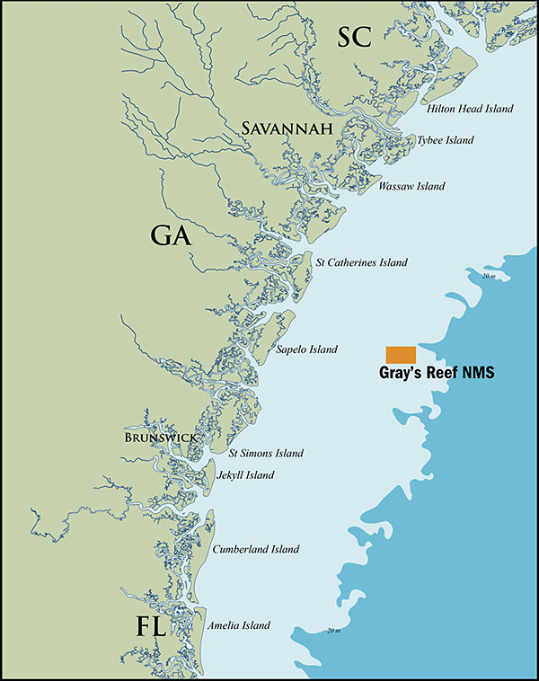
Gray’s Reef National Marine Sanctuary
Where is Gray’s Reef
National Marine Sanctuary?
Georgia’s southeast coast
located within the South Atlantic Bight
mix of temperate and tropical waters
high amount of live-bottom reef
high species diversity
Notes:
Instructional suggestion:
Click to watch a short video that showcases Gray’s Reef National Marine Sanctuary.
Instructor Notes:
Gray’s Reef National Marine Sanctuary is located 19 miles offshore of Sapelo Island, a barrier island on Georgia’s southeast coast. The sanctuary was established in 1981 and currently protects 22 mi2 of rocky ledge and seafloor habitat that supports more than 200 species of fish and 900 species of invertebrates. It is named for Milton "Sam" Gray, a biologist at the University of Georgia Marine Institute, who studied the area in the 1960's. Gray's Reef National Marine Sanctuary is currently the only marine protected area in a region called the South Atlantic Bight, a long, gradual bend in the coastline that forms a large bay between Cape Hatteras, North Carolina and Cape Canaveral, Florida. As a result of the Gulf Stream, temperate and tropical waters mix in this region, leading to high species diversity.
Images:
The location of Gray’s Reef National Marine Sanctuary. Credit: NOAA

Slide 7
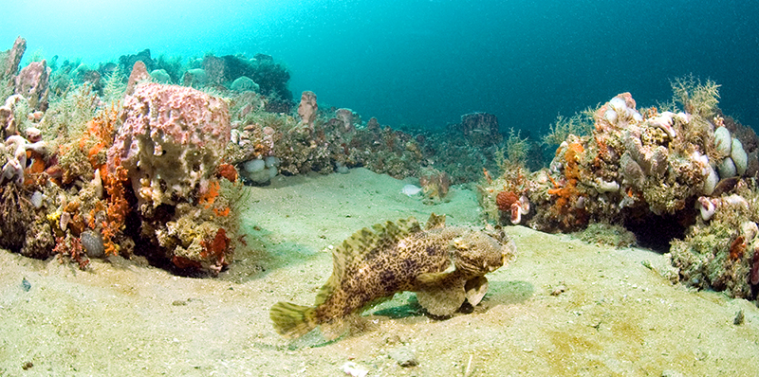
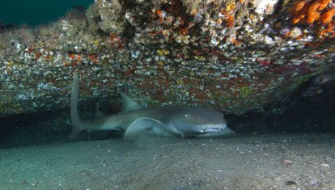
Gray’s Reef National Marine Sanctuary
A Different Kind of Reef
made of seawater cemented particles of shells, sand, and mud
at times above sea level
rocky ledges interspersed with sandy areas
at depth of 60–70 feet
Notes:
Instructional suggestion:
Click the images to view virtual dives in Gray’s Reef National Marine Monument.
https://sanctuaries.noaa.gov/vr/grays-reef/low-reef-tomtate/
https://sanctuaries.noaa.gov/vr/grays-reef/hilly-ledge/
Instructor Notes:
Gray’s Reef is not a coral reef. Instead, it is made of carbonate-cemented sandstone, formed by the consolidation and cementing of pieces of shells, sand, and mud which were originally deposited as loose grains between six and two million years ago. Some of these sediments were brought to the coast by rivers and others were probably transported to the region by ocean currents. Seawater, rich in dissolved calcium carbonate, formed the "cement" that glued the grains together. After the formation of Gray’s Reef, during the Pleistocene (approximately 2 million to 10,000 years ago), sea level fluctuated dramatically as glacial ice expanded and melted. As a result, the area that is now the sanctuary was periodically above sea level. The fossils of large Pleistocene terrestrial animals such as mammoths have been found at the reef. Today, the rocky ledges can be as tall as six feet but lie under 60 to 70 feet of water. The ledges are interspersed with sandy-bottom areas.
Images:
Top: An oyster toadfish on a sandy bottom area in Gray's Reef National Marine Sanctuary. Credit: Gray’s Reef National Marine Sanctuary
Middle: A nurse shark under a ledge. Photo credit: Greg McFall/NOAA
Bottom: An illustration of the seafloor topography at Gray’s Reef. Credit: Gray’s Reef National Marine

Slide 8
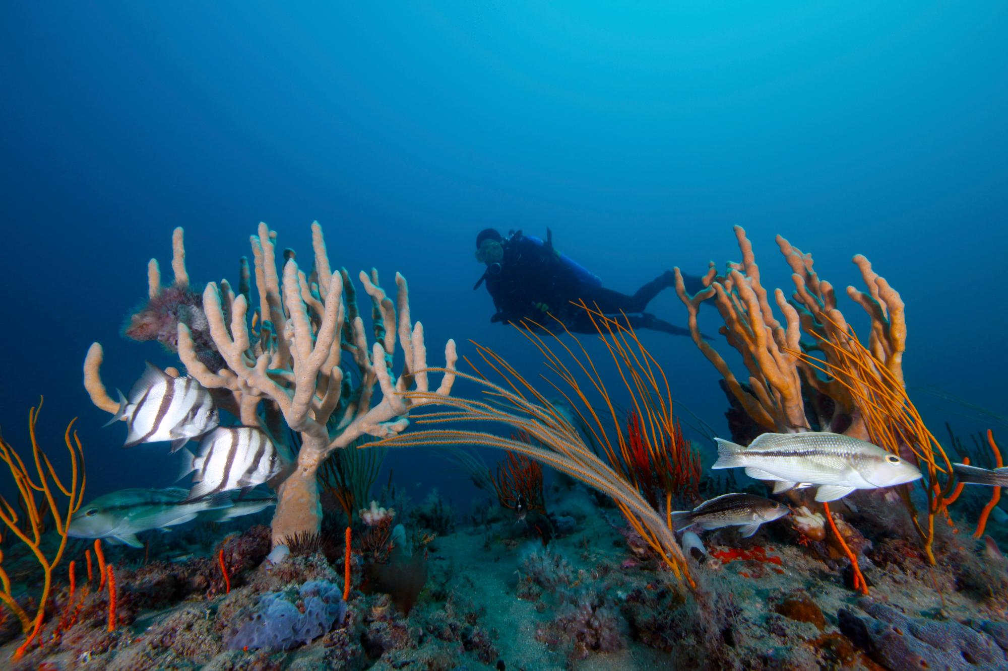
Gray’s Reef National Marine Sanctuary
Diving in Gray’s Reef National Marine Sanctuary
suited for advanced divers
variable visibility, currents, and weather
no anchoring
regulations protect North Atlantic right whales
Notes:
Instructional suggestion:
Click the image to watch a short video that highlights diving at Gray’s Reef National Marine Sanctuary. Credit: Georgia Public Broadcasting https://www.youtube.com/watch?v=gAwlqObJxLM
Instructor Notes:
Gray’s Reef is a popular destination for recreational anglers, boaters, and experienced divers. Diving in these waters is challenging as a result of rapidly changing visibility, currents, and weather. Advanced divers who dive in the sanctuary must be familiar with regulations. For example, anchoring is prohibited throughout the sanctuary to help protect the live-bottom reef. In addition, there are regulations in place to protect critically endangered North Atlantic right whales. Vessel speed restrictions are in place between November 15 and April 15, and both vessels and individuals must stay at least 500 yards away from all whales.
Advanced divers trained for the conditions are a valuable part of the sanctuary’s Team Ocean Dive Program, which enlists citizen divers to volunteer with ocean research projects. Team Ocean Divers aid in marine debris monitoring and removal, reef fish surveys, and habitat assessments.
Images:
A diver in Gray’s Reef National Marine Sanctuary. Photo: Greg McFall/NOAA

Slide 9
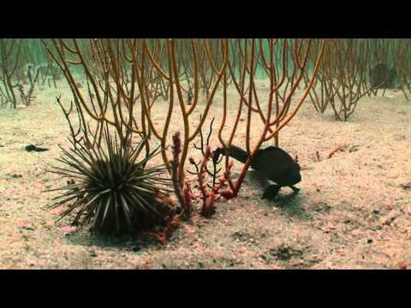
Gray’s Reef National Marine Sanctuary
Notes:
Instructional suggestion:
Click to watch a short video that introduces the acoustic fish tagging project at Gray’s Reef National Marine Sanctuary. https://www.youtube.com/watch?v=SRcKiSmKExE

Slide 10
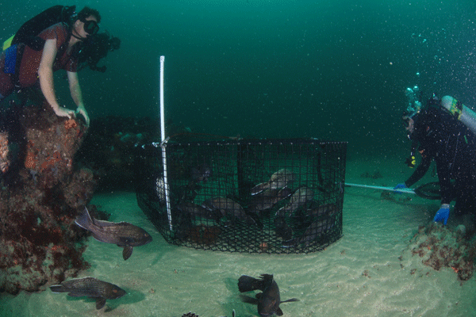
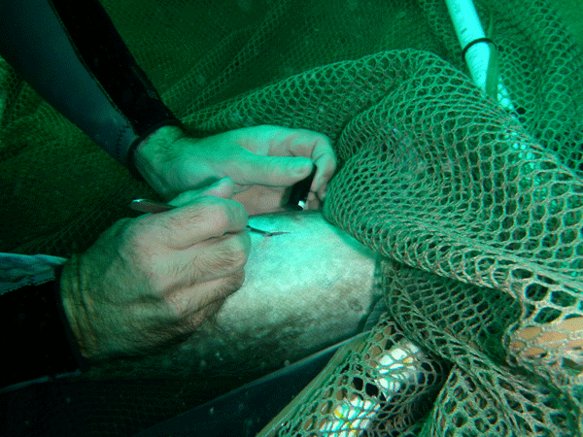
Gray’s Reef National Marine Sanctuary
Acoustic Fish Tagging Research
tracking movement of fish
caught with rod and reel or trap
fixed with internal transmitter and external tag
fish are released after being tagged
Notes:
Instructional suggestion:
Make sure students understand the definition of “acoustic”: relating to sound or the sense of hearing.
Prompt students to consider why fish move: to find mates, food, and/or shelter, and in response to environmental conditions, like water temperature.
Prompt students to consider possible reason why scientists might want to know about the movements of snapper and grouper. Possible answers include: determine species abundance and habitat preferences, ability to monitor change over time. Accept all reasoned responses
Instructor Notes:
The southern third of the sanctuary is set aside for research only. Activities in the research area are limited in order to study the impact of human activities on sanctuary marine resources and to inform future management and conservation strategies. One such research project is an acoustic telemetry program that tracks the underwater movements of economically and ecologically important marine species such as snappers and groupers. Stock assessments suggest that many snapper and grouper species are declining regionally. Tagging studies in Gray's Reef National Marine Sanctuary focus on detecting and recording the movement patterns of red snapper, two grouper species (gag and scamp), and black sea bass. These species are considered more resident species since they spend the majority of their day’s at Gray’s Reef but they may go further offshore for spawning. The tags last one to five years depending on their size.
Target species are either caught from a boat using rod and reel from or with a trap by a diver. The fish are then tagged with a small internal transmitter that is surgically implanted into their abdominal cavity and an external tag attached near the dorsal fin. Snapper and grouper are tagged underwater to prevent barotrauma. Black sea bass are not as susceptible to pressure injuries. As a result, their surgeries are conducted topside. Once brought up on hook and line, their swim bladder is deflated with a needle. After the transmitter is inserted, the fish is either taken back underwater by a diver or returned to depth using a descending device. Each internal transmitter emits a unique acoustic "ping" that allows scientists to track each individual fish. The transmitters ping at 69 kHz, which is above the threshold for human hearing. The transmitters are tracked by acoustic receivers.
Images:
Left: A diver performs surgery to insert the transmitter underwater, which is much less harmful than catching the fish with a hook and bringing the fish to the surface. Photo credit: Jamie Park
Right: Divers assess fish in a trap. Photo: Greg McFall/NOAA

Slide 11
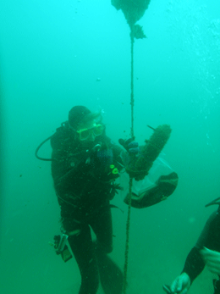
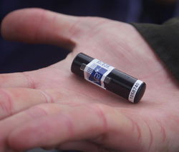
Gray’s Reef National Marine Sanctuary
Acoustic Fish Tagging Research
transmitter emits a unique acoustic "ping"
transmitters tracked by acoustic receivers
“ping” every 2 minutes
record unique signal, time, and date
Notes:
Instructional suggestion:
Click the image of the acoustic receiver (left) to take a virtual dive within the sanctuary to view receivers like the one in the image. https://sanctuaries.noaa.gov/vr/grays-reef/ledge-receiver-diver/
Ensure students understand that the transmitter sends the signal and the receiver records the information from the signal.
Instructor Notes:
Each transmitter pings at a different rate to ensure that no tags ping at the same time which would possibly prevent the receiver from detecting the ping. When the receivers detect a transmitter’s ping, the ping’s unique signal, time, and date are recorded. Detections can be made from as far as 200 meters away from the receiver. The detection range of the receiver varies with water density. Water density changes throughout the day as a result of tides, as well as with the seasons and weather conditions. The receivers are located in sandy-bottom areas, but are within a few meters of live-bottom reef area which fish use as habitat. Scientists retrieve the receivers and download the data onto a computer.
Fish move for a variety of reasons, including to find mates, food, and/or shelter, as well as in response to environmental conditions, like water temperature. The data helps scientists understand when the fish are present or absent from a study area, the habitats fish prefer, and whether those preferences change over time. Over the course of the telemetry project, over 40 fish have been tagged. Currently, 16 receivers are collecting data throughout Gray’s Reef National Marine Sanctuary.
Images:
Left: Internal Acoustic Tag / Transmitter Photo: VEMCO
Right: A diver removes acoustic receiver for data download. Photo: Jamie Park

Slide 12
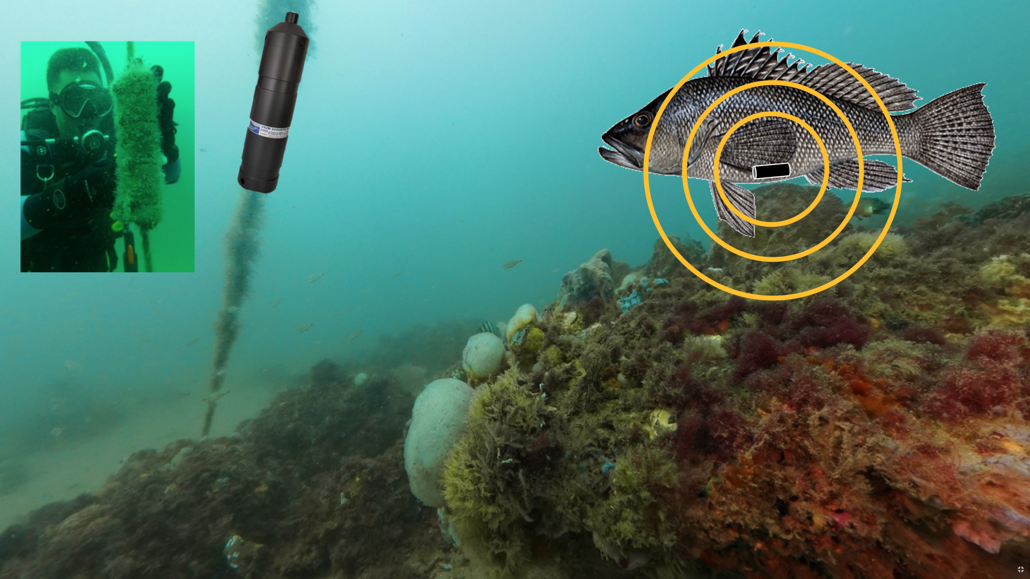
Gray’s Reef National Marine Sanctuary
Notes:
Instructor Notes:
The receivers are placed in the sand, often near rocky ledges. Each receiver line is mounted to a concrete base and two floats suspend the receiver approximately 1.5 meters off the seafloor. Each receiver is retrieved and the data downloaded approximately every 6 months.
Images:
A representation of the acoustic tagging set. Photo: NOAA

Slide 13
Gray’s Reef National Marine Sanctuary
Simulating Fish Tagging
Acoustic Receiver Data Table
Ping | Number of Detections
Notes:
Instructional suggestion:
Facilitate simulation as described in the lesson plan.

Slide 14
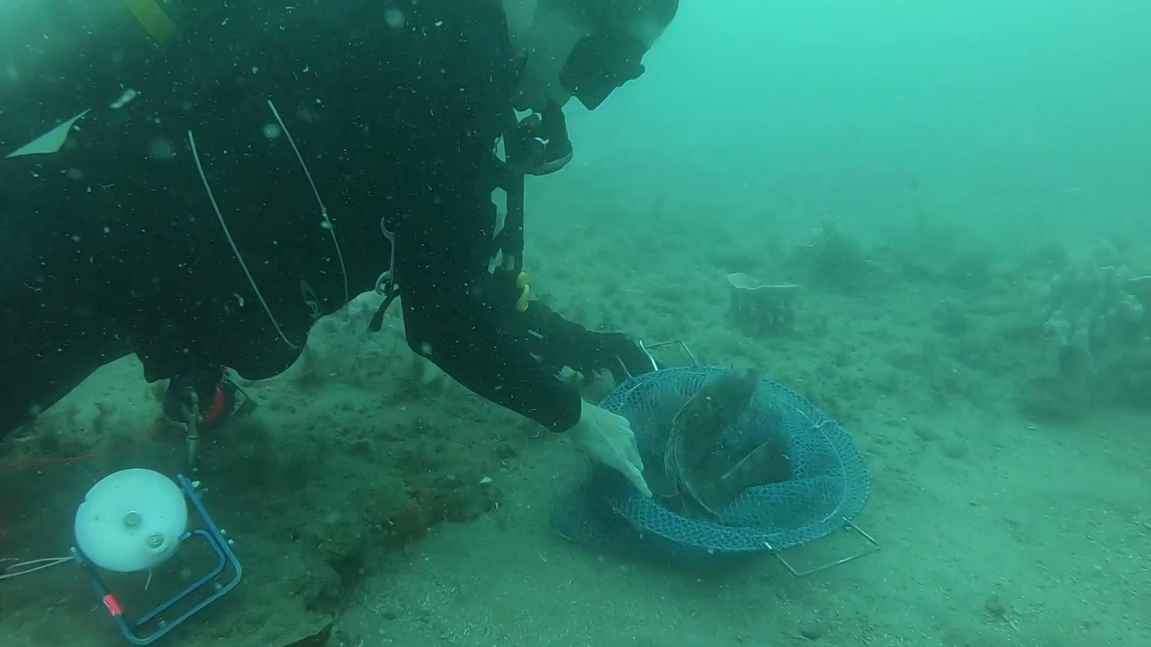
Gray’s Reef National Marine Sanctuary
Acoustic Fish Tagging Research
What do scientists learn?:
species presence/absence
habitat preferences
changes over time
Notes:
Instructional suggestion:
Click through to view a short video of the release of a tagged fish.
Image:
A diver releases a fish with an acoustic telemetry tag implanted into its abdominal cavity to track movement of the species within Gray’s Reef National Marine Sanctuary. Video Credit: Justin Miyano/NOAA

Slide 15
Gray’s Reef National Marine Sanctuary
Simulation Analysis
Fish Type | Number of Detections
Snapper
Grouper
Sea bass
Notes:
Instructional suggestion:
Use this table to analyze the result of the simulation.
Note: This table should be pre-recorded on the slate used in the pool.

Slide 16
Gray’s Reef National Marine Sanctuary
Simulation Debrief
Rank the fish types in order of most to least detections. How does the number of detections relate to abundance?
Which fish type was actually the most abundant? Is this what the data showed? If not, propose a possible explanation for your results.
How many individual fish were detected?
Notes:
Instructional suggestion:
Allow students time to discuss answers with a partner or small group. Then, discuss as a whole group.

Slide 17
Gray’s Reef National Marine Sanctuary
Simulation Debrief
Were any fish detected multiple times?
Why do you think it is important that each transmitter have a unique ping?
How does this simulation successfully model acoustic tagging?
How could this simulation be improved?
Notes:
Instructional suggestion:
Allow students time to discuss answers with a partner or small group. Then, discuss as a whole group.
Image: A fish under a ledge in Gray's Reef National Marine Sanctuary. Photo: NOAA

Slide 18
Learn more at
graysreef.noaa.gov/

