Slide 1
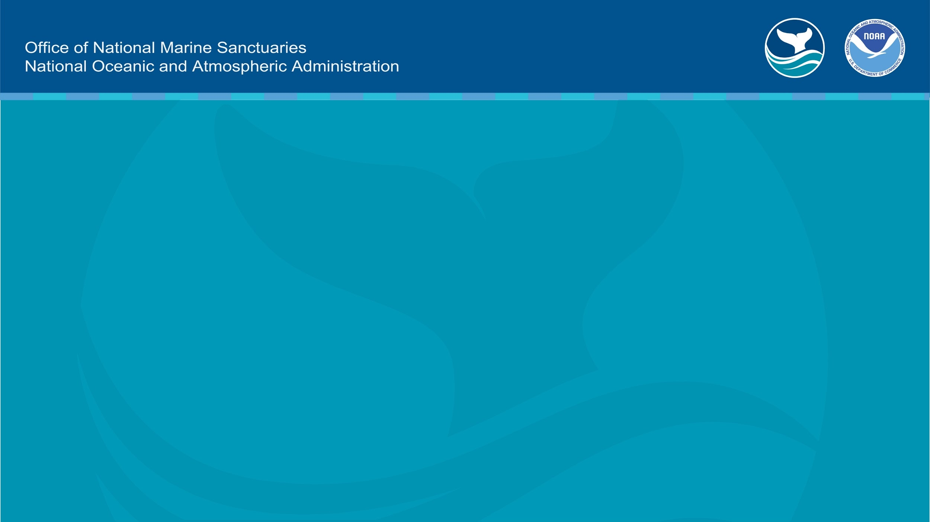
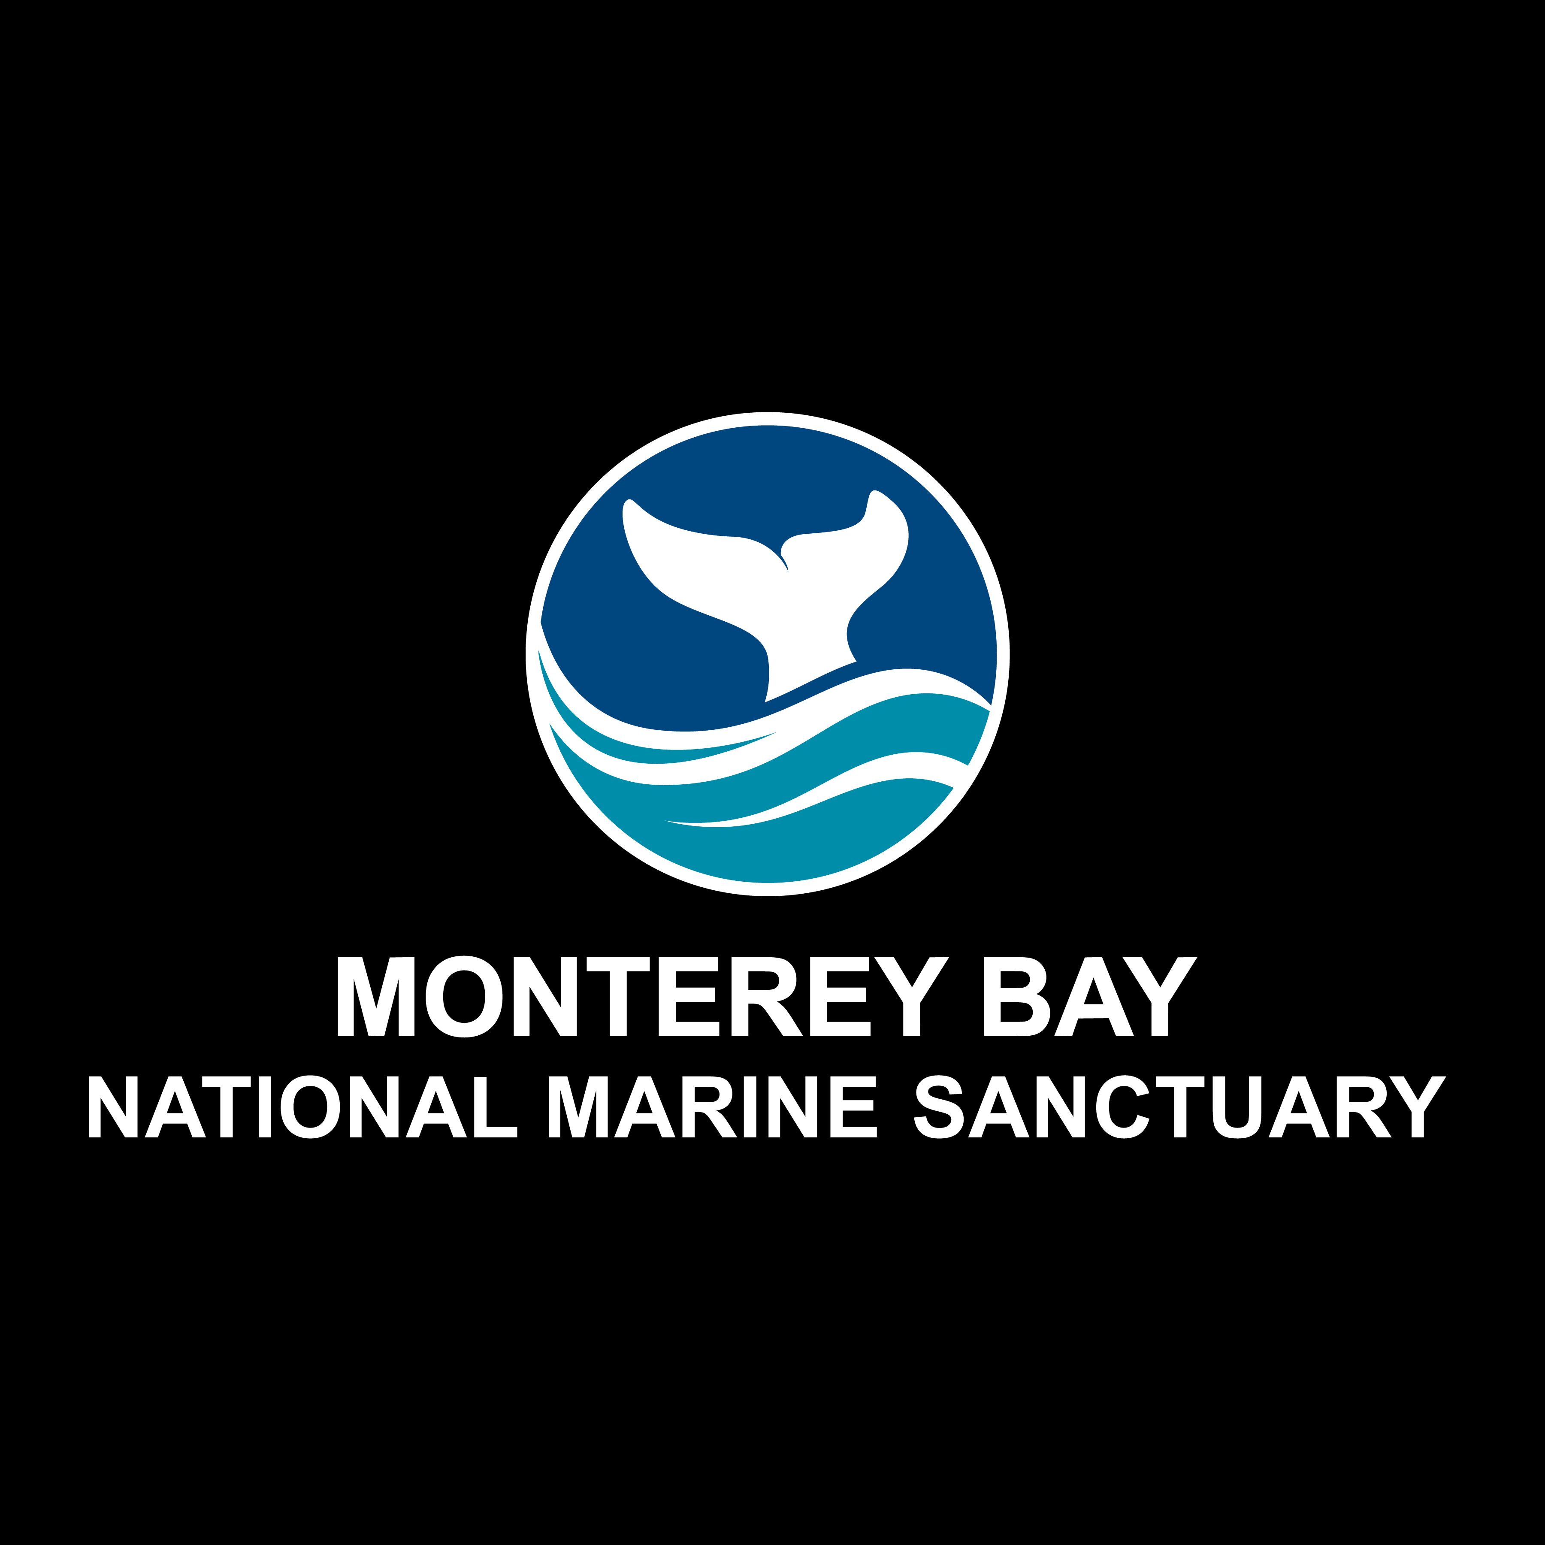
Ocean Acidification and Impact to Dungeness Crabs

Slide 2


Monterey Bay National Marine Sanctuary
Notes:
Instructional suggestion:
Share with students the purpose of the NOAA Ocean Guardian Dive Club: to learn about the importance national marine sanctuaries and how SCUBA skills can be used to study and protect them.

Slide 3
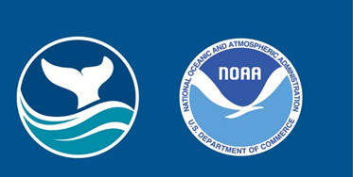
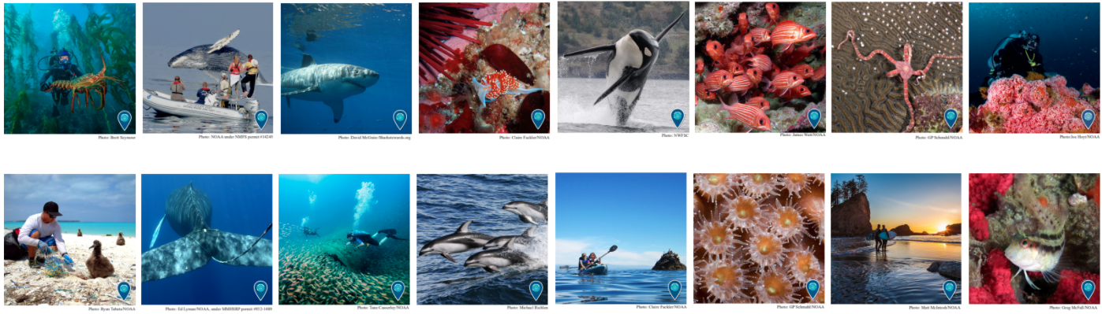

National Marine Sanctuaries
“America’s Ocean and Great Lakes Treasures”
Notes:
Instructional suggestion:
Use the images to lay the groundwork for the types of habitats and organisms provided protection by national marine sanctuaries.
Some organisms shown include: sea turtles, whales and dolphins, sharks, and invertebrates, like corals and sea stars.
Instructor Notes:
Few places on the planet can compete with the diversity of the National Marine Sanctuary System, which protects America's most incredible natural and cultural marine resources. National marine sanctuaries are America’s ocean and Great Lake treasures.

Slide 4
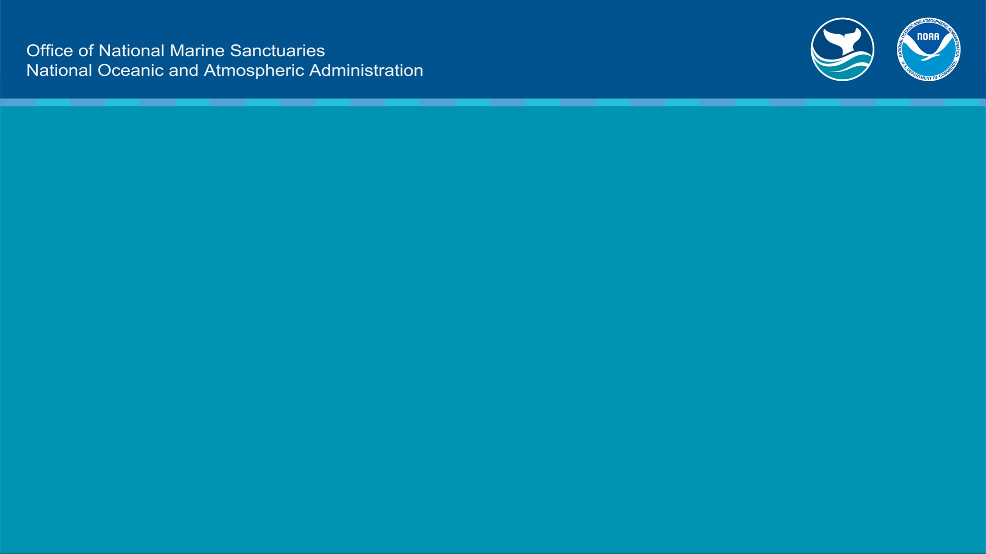
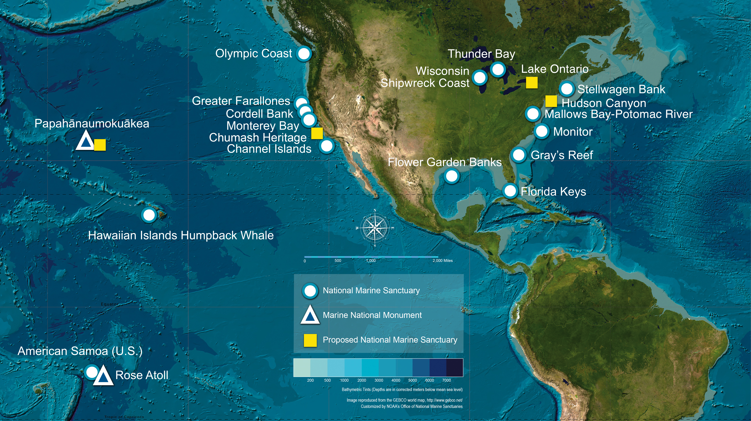
What is a marine sanctuary?
Why are they important?
A marine sanctuary is an area that allows important ocean resources to be protected now and for future generations.
sanctuaries.noaa.gov
Notes:
Instructional suggestion:
Think-Pair-Share. Ask students to explain what they think a marine sanctuary is and why they are important. Allow them to share their ideas with a partner and then solicit contributions from the whole group.
Click map to watch a short video that highlights the National Marine Sanctuary System.
Instructor Notes:
The National Marine Sanctuary System encompass more than 620,000 square miles of marine and Great Lakes waters. This network of underwater areas includes a system of national marine sanctuaries and Papahānaumokuākea and Rose Atoll marine national monuments. These protected areas are on both the west and east coasts of the United States, and off Hawaii and American Samoa. Additionally, there are protected areas within the freshwater environments of the Great Lakes.
Image: a map of marine sanctuaries and monuments in the US

Slide 5
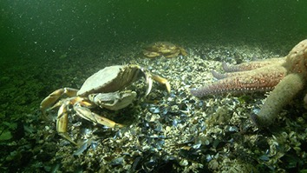
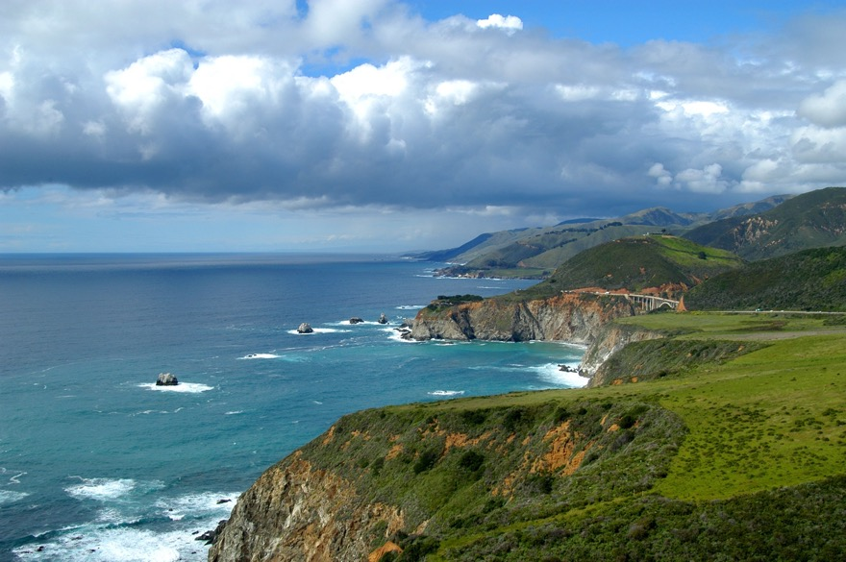
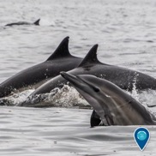
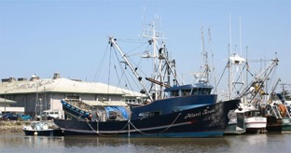
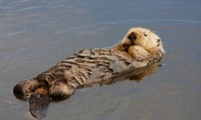
Monterey Bay National Marine Sanctuary
Notes:
History
Designated in 1992, Monterey Bay National Marine Sanctuary (MBNMS) is a federally protected marine area offshore of California's central coast.
https://montereybay.noaa.gov/intro/welcome.html
Pictures Courtesy of:
Background Bixby Canyon Bridge, Robert Schwemmer, NOAA
Dolphins- Douglas Croft
Dungeness Crab- Paul Hillman/NOAA
Commercial Fishing Boat- Becky Stamski/ NOAA MBNMS
Otter- Steve Lonhart/MBNMS

Slide 6
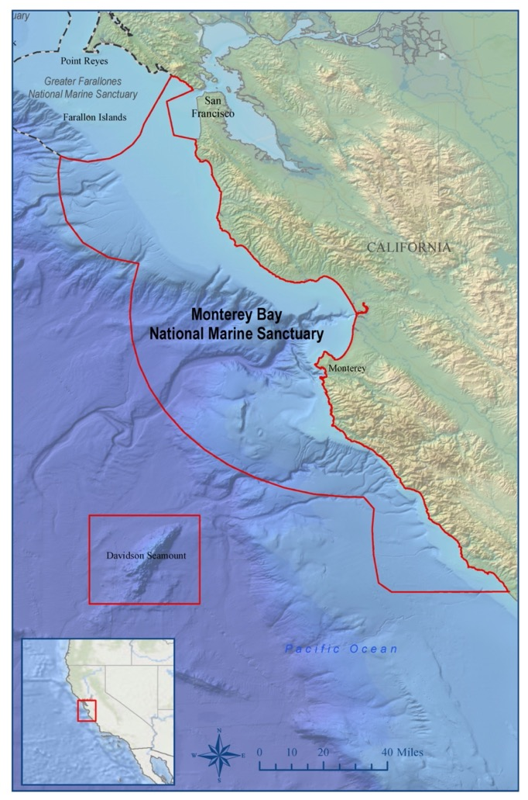
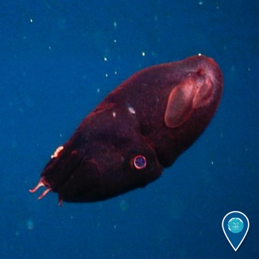
Monterey Bay National Marine Sanctuary
Why is Monterey Bay National Marine Sanctuary unique?
“Serengeti of the Sea”
Notes:
Why is Monterey Bay National Marine Sanctuary unique?
Monterey Bay National Marine Sanctuary has the nation’s largest kelp forests and one of North America’s largest underwater canyons. Known as the ‘Serengeti of the Sea,’ this marine environment is home to 34 species of marine mammals including humpback and blue whales, otters, seals, and sea lions, great white sharks, four turtle species, 180 species of birds, 525 species of fishes, and countless invertebrates. It also has nearly 1300 reported shipwrecks and more than 700 prehistoric sites.
Sustainable tourism and recreation opportunities are limitless: whale watching, diving, boating, surfing, kayaking, fishing, tidepooling, and beach exploration. And the Sanctuary’s marine research, monitoring, and conservation activities are just as extensive, with many offering citizen science activities and volunteer engagement.
https://marinesanctuary.org/sanctuary/monterey-bay/
Image Courtesy of:
Map – NOAA, https://montereybay.noaa.gov/materials/mappages/mbnmscolormap.html
Vampire Squid- NOAA

Slide 7
Student Outcomes: What will you learn today?
Upon completion of the lesson, students will be able to:
* Identify the stages of the Dungeness crab’s life cycle and understand the role of the Dungeness crab in the marine food web.
* Explain what ocean acidification is and how it affects Dungeness crab at developmental larval stages.
* Explain how the effects of ocean acidification on the Dungeness crab population impacts the marine food web and, in turn, the commercial fishing industry.
* Explain what actions people can take in their daily lives to reduce climate change impacts and support a healthy marine food web and a thriving commercial fishing industry.
Notes:
Student Outcomes. Instructor reads the outcomes to the students.

Slide 8
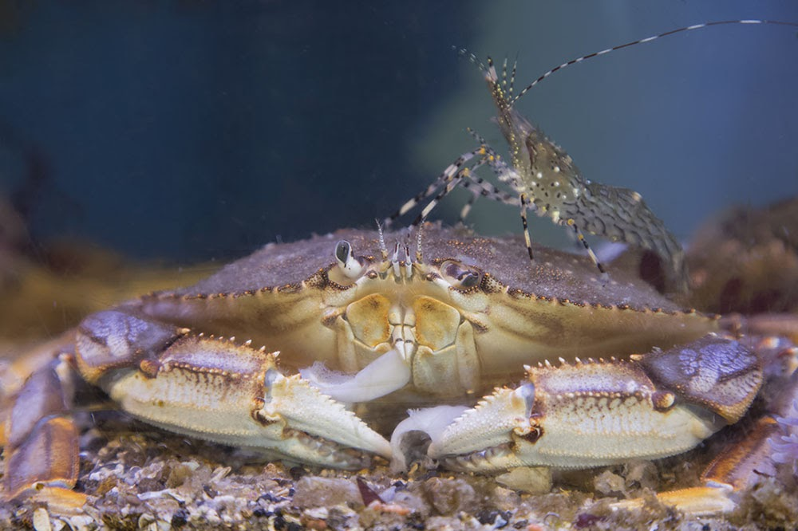
What is a Dungeness crab?
Notes:
What is a Dungeness crab?
Dungeness crabs got their name from the town of Dungeness, Washington, where the commercial fishery for this species began in 1848. They thrive in cold water environments and live sandy environments like bays, inlets, and estuaries, including in seagrass beds and rocky structures.
Dungeness crabs are naturally found in the Pacific Ocean and span three countries: Canada, the United States, and Mexico.
Dungeness crabs are preyed upon by fish, octopus, sea otters, and even larger species of crab, and they eat worms, shrimp, mussels, smaller crabs, clams, and anything else they can find.

Slide 9
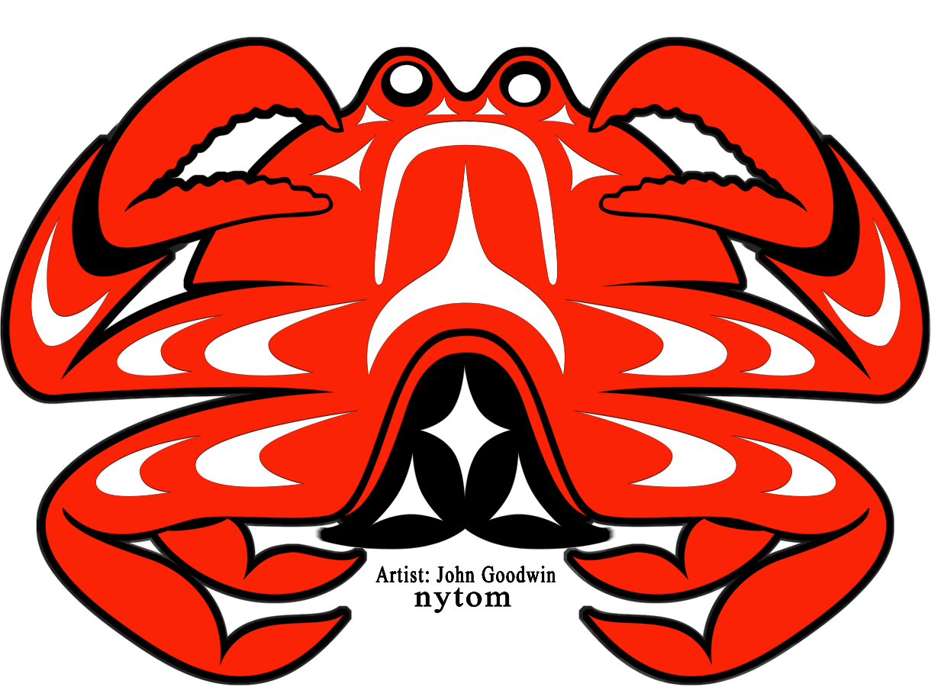
Dungeness Crab are Embedded in Culture
Notes:
What is the cultural importance of the Dungeness crab?
Dungeness crabs have been culturally significant for indigenous peoples along the west coast since time immemorial, for thousands of years. Tribal Dungeness crab fisheries provide food, income, and communal activity for many Native Americans. Indigenous legends and stories include the value of the crab and show how important they are to the community.
Legend and Photo credit: https://sanctuaries.noaa.gov/education/crab-toolkit.html

Slide 10
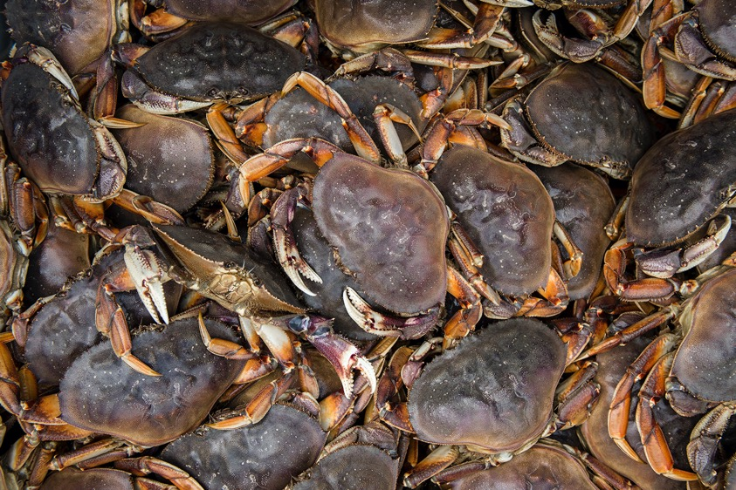
Commercial Importance of Dungeness Crab
The Dungeness crab fishery in the United States is valued at $220 million annually
$220,000,000 every year!
Notes:
What is the commercial importance of the Dungeness crab?
Dungeness crabs are safe for people to eat and provide for the West Coast’s most valuable commercial fishery, valued at more than $170 million annually! (Actually, a more current figure is in the photo caption: $220 million!) A NOAA-funded study has documented for the first time that ocean acidification along the US Pacific Northwest coast is impacting the shells and sensory organs of some young Dungeness crab, a prized crustacean that supports the most valuable fishery on the West Coast.
photo and caption insert taken from:
https://nmssanctuaries.blob.core.windows.net/sanctuaries-prod/media/archive/education/pdfs/dungeness_crab_oa_fact_sheet.pdf
Photo credit: Austin Trigg/ONMS

Slide 11
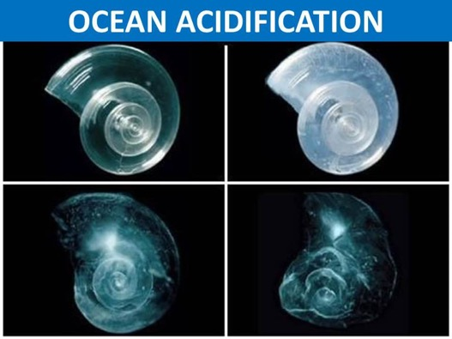
What is ocean acidification?
Ocean acidification refers to a reduction in the pH of the ocean over an extended period of time, caused primarily by uptake of carbon dioxide (CO₂) from the atmosphere.
NOAA What is Ocean Acidification Video
Notes:
What is Ocean Acidification?
For more than 200 years, or since the industrial revolution, the concentration of carbon dioxide (CO₂) in the atmosphere has increased due to the burning of fossil fuels and land use change. The ocean absorbs about 30 percent of the CO₂ that is released in the atmosphere, and as levels of atmospheric CO₂ increase, so do the levels in the ocean.
When CO₂ is absorbed by seawater, a series of chemical reactions occur resulting in the increased concentration of hydrogen ions. This increase causes the seawater to become more acidic and causes carbonate ions to be relatively less abundant.
Carbonate ions are an important building block of structures such as sea shells and coral skeletons. Decreases in carbonate ions can make building and maintaining shells and other calcium carbonate structures difficult for calcifying organisms such as oysters, clams, sea urchins, shallow water corals, deep sea corals, and calcareous plankton.
These changes in ocean chemistry can affect the behavior of non-calcifying organisms as well. Certain fish's ability to detect predators is decreased in more acidic waters. When these organisms are at risk, the entire food web may also be at risk.
Ocean acidification is affecting the entire world’s ocean, including coastal estuaries and waterways. Many economies are dependent on fish and shellfish and people worldwide rely on food from the ocean as their primary source of protein.
Slide and note text courtesy of: NOAA. What is Ocean Acidification? National Ocean Service website, https://oceanservice.noaa.gov/facts/acidification.html, 03/30/20.
Image courtesy of: NOAA
NOAA. What is Ocean Acidification? National Ocean Service website, https://oceanservice.noaa.gov/facts/acidification.html, 03/30/20.
Image courtesy of: NOAA

Slide 12
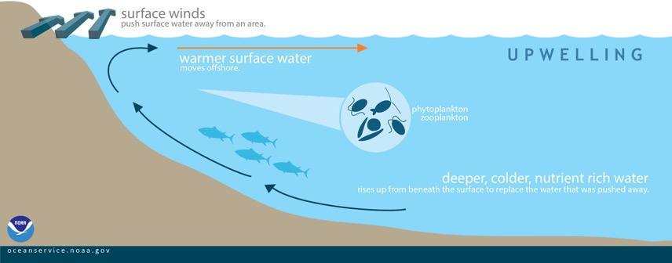
What is upwelling?
This graphic shows how displaced surface waters are replaced by cold, nutrient-rich water that “wells up” from below. Conditions are optimal for upwelling along the coast when winds blow along the shore.
Notes:
What is upwelling? How does it relate to ocean acidification?
Winds blowing across the ocean surface push water away. Water then rises up from beneath the surface to replace the water that was pushed away. This process is known as “upwelling.”
Water that rises to the surface as a result of upwelling is typically colder and is rich in nutrients. These nutrients “fertilize” surface waters, meaning that these surface waters often have high biological productivity. Therefore, good fishing grounds typically are found where upwelling is common.
How does this affect Dungeness crabs?
There was a research study in the Global Change Biology journal published by Kristin Marshall on Jan. 12, 2020. She was the lead author of the study which was done at the University of Washington partnered with NOAA Fisheries’ Northwest Fisheries Science Center.
“The research used sophisticated models of the California Current ecosystem off the Pacific Coast to assess the impacts of a projected 0.2 unit decline in the pH of seawater in the next 50 years, which equates to a 55 percent increase in acidity. The California Current is considered especially vulnerable to acidification because the upwelling of deep, nutrient-rich water low in pH already influences the West Coast through certain parts of the year.”- UW News Staff, https://www.washington.edu/news/2017/01/12/ocean-acidification-to-hit-west-coast-dungeness-crab-fishery-new-assessment-shows/, 1/18/2021.
Photo, caption and slide notes Courtesy of:
NOAA. What is upwelling? National Ocean Service website, https://oceanservice.noaa.gov/facts/upwelling.html, 04/09/20.

Slide 13
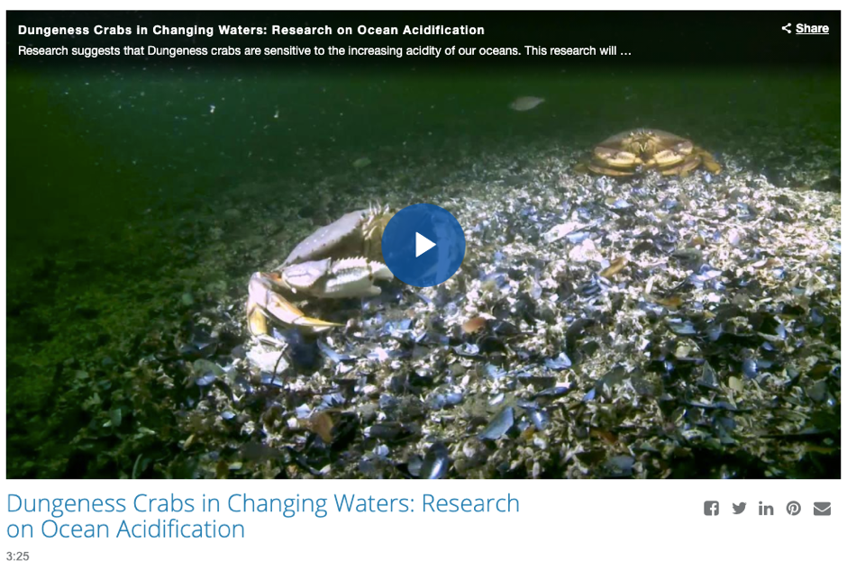
How does OA affect Dungeness crabs?
Click this link: NOAA fisheries Dungeness crab Video
Notes:
How does ocean acidification affect Dungeness Crabs?
(make sure to use ”Present” mode before the video link is clicked)
Some of the harmful impacts associated with OA are beginning to be felt by shellfish growers. On the West Coast of North America, shellfish farming of oysters, abalone, clams, and mussels is an important contributor to both local and state economies.
Shellfish larvae are particularly sensitive to changes in the pH of seawater. During the first critical days of their lives, these larvae rely on dissolved carbonate to quickly build their shells so they can continue to grow and develop. Lower ocean pH has resulted in less available dissolved carbonate, resulting in substantial declines in shellfish survival. These effects have already caused severe declines in the production of key shellfish species including oysters, mussels, and scallops. Such declines cause substantial revenue losses for aquaculture companies dependent on the health of these species. (https://www.cencoos.org/learn/oa/impacts)

Slide 14
How does OA affect Dungeness crabs?
Notes:
How does ocean acidification affect Dungeness crabs?
(Read the information from the graphic.)
Image courtesy of NOAA, https://www.noaa.gov/ocean-acidification-high-co2-world-dangerous-waters-ahead

Slide 15
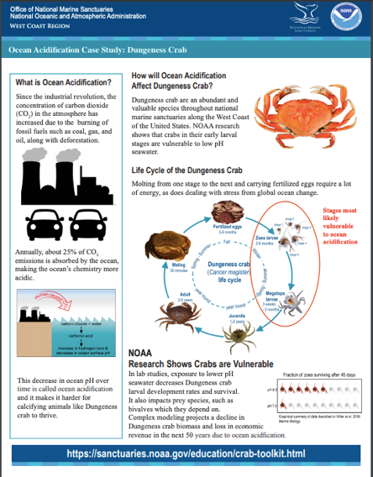
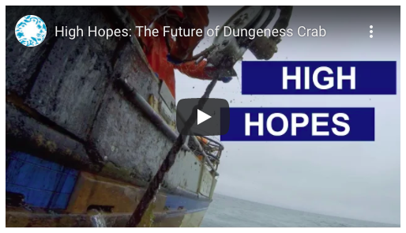
How does disruption to the Dungeness crab population affect the commercial fishing industry?
Ocean Acidification Case Study Dungeness Crab link
Ocean Conservancy Dungeness Crab "High Hopes" Video link
Notes:
How does disruption to the Dungeness Crab population affect the commercial fishing industry?
(make sure to use ”Present” mode before the links are clicked)
https://nmssanctuaries.blob.core.windows.net/sanctuaries-prod/media/archive/education/pdfs/dungeness_crab_oa_fact_sheet.pdf
Image credit: NOAA
Video: Ocean Conservancy

Slide 16
Learn more at
montereybay.noaa.gov

