Slide 1
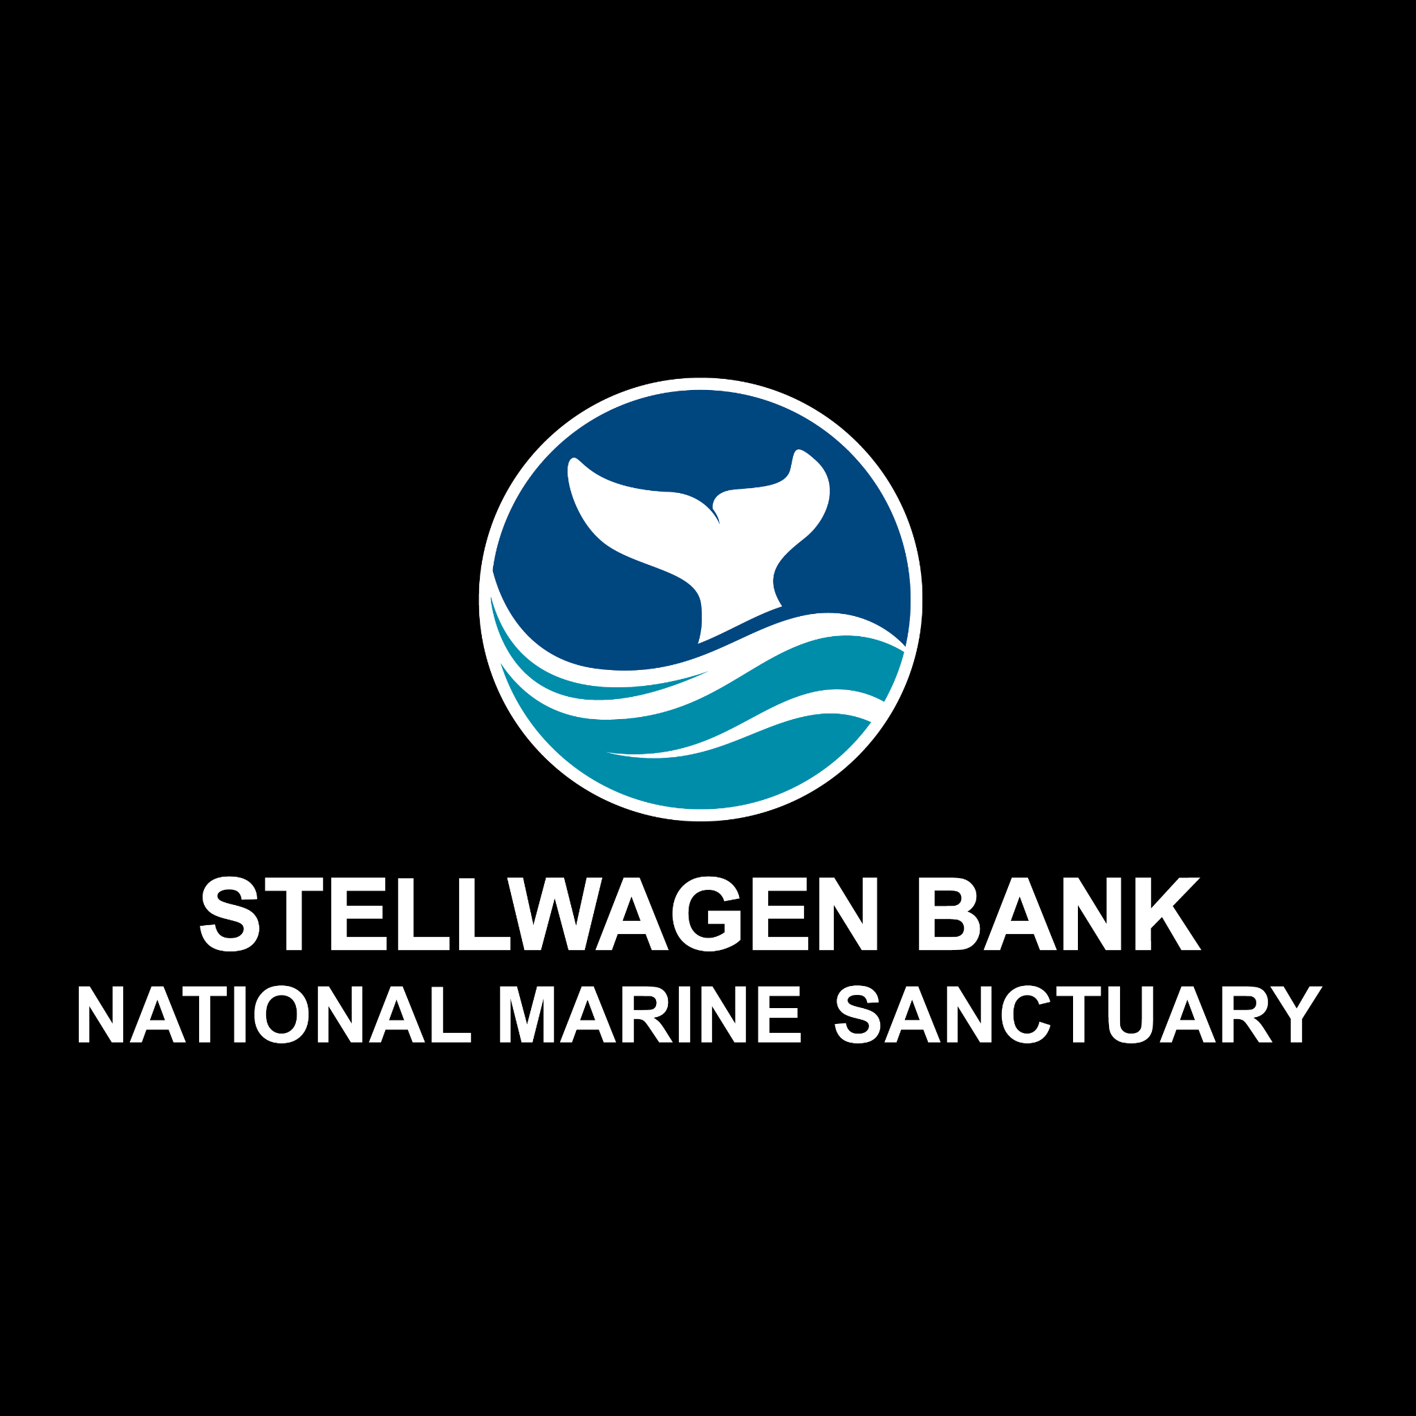
Exploring Whale Sounds

Slide 2
Stellwagen Bank National Marine Sanctuary
Notes:
Instructional suggestion:
Share with students the purpose of the Ocean Guardians Dive Club: to learn about the importance national marine sanctuaries and how scuba skills can be used to study and protect them.

Slide 3
National Marine Sanctuaries
“America’s Ocean and Great Lakes Treasures”
Notes:
Instructional suggestion:
Use the images to lay the groundwork for the types of habitats and organisms provided protection by national marine sanctuaries.
Some organisms shown include: sea turtles, whales and dolphins, sharks, and invertebrates, like corals and sea stars.
Instructor Notes:
Few places on the planet can compete with the diversity of the National Marine Sanctuary System, which protects America's most incredible natural and cultural marine resources. Sanctuaries are America’s ocean and Great Lake treasures.

Slide 4
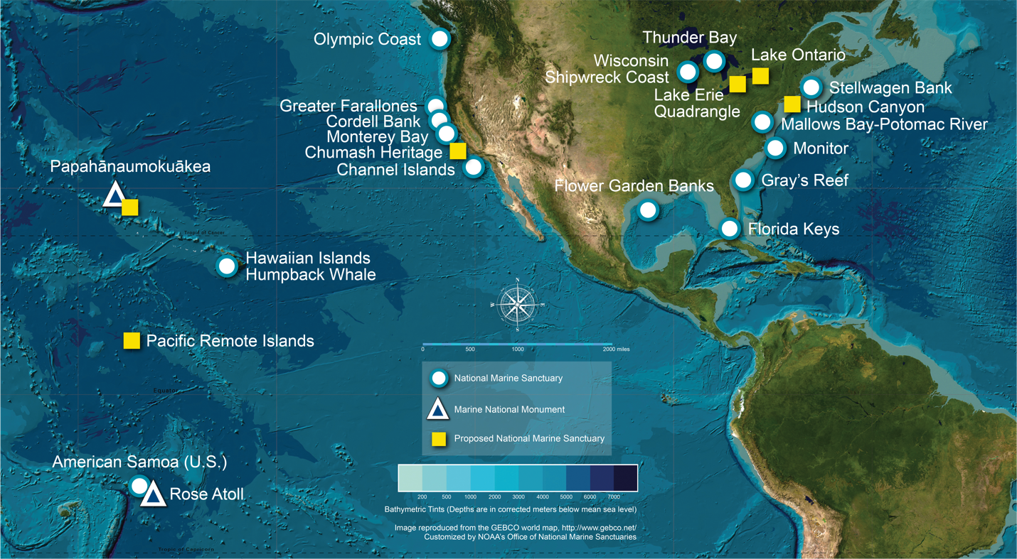
What is a national marine sanctuary?
Why are they important?
A national marine sanctuary is an area that allows important ocean resources to be protected for current and future use.
sanctuaries.noaa.gov
Notes:
Instructional suggestion:
Think-Pair-Share. Ask students to explain what they think a national marine sanctuary is and why they are important. Allow them to share their ideas with a partner and then solicit contributions from the whole group.
Click map to watch a short video that highlights the National Marine Sanctuary System.
Instructor Notes:
National marine sanctuaries encompass more than 620,000 square miles of marine and Great Lakes waters. This network of underwater areas includes a system of national marine sanctuaries and Papahānaumokuākea and Rose Atoll marine national monuments. These protected areas are on both the west and east coasts of the United States, and off Hawai’i and American Samoa. Additionally, there are protected areas within the freshwater environments of the Great Lakes.
Image: a map of national marine sanctuaries and marine national monuments in the U.S.

Slide 5
Stellwagen Bank National Marine Sanctuary
Notes:
Instructor Notes:
Stellwagen Bank National Marine Sanctuary celebrated its 30th anniversary on November 4, 2022.

Slide 6
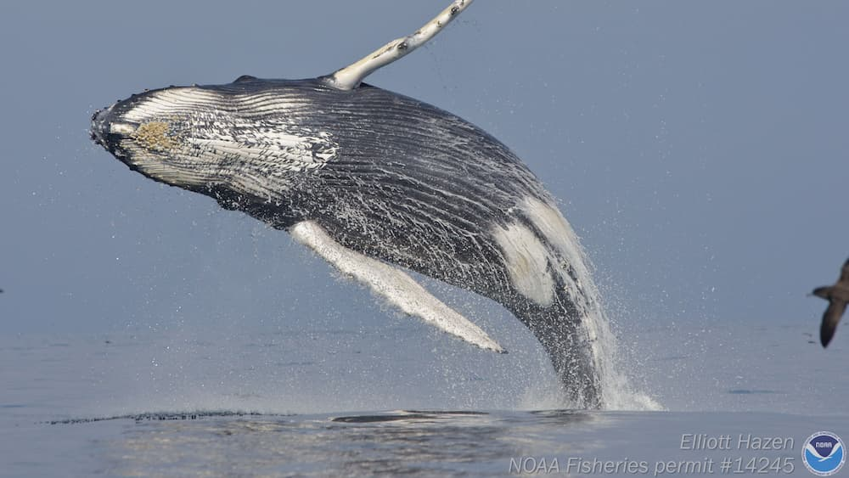
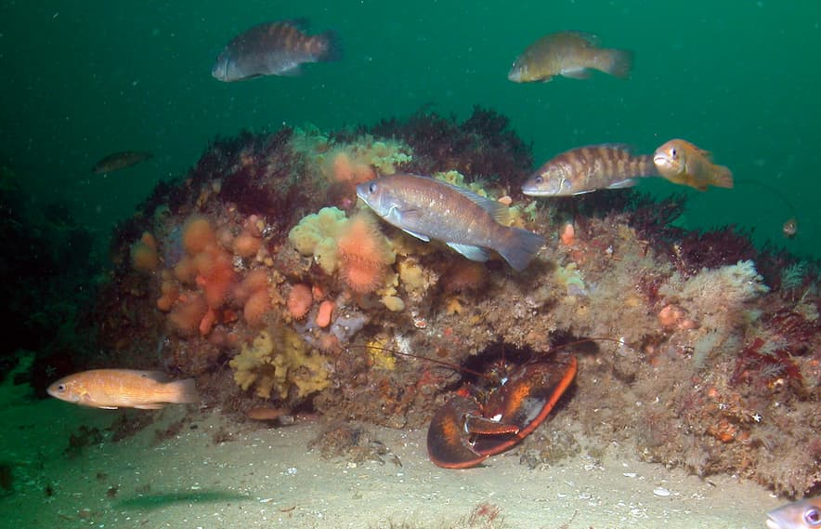
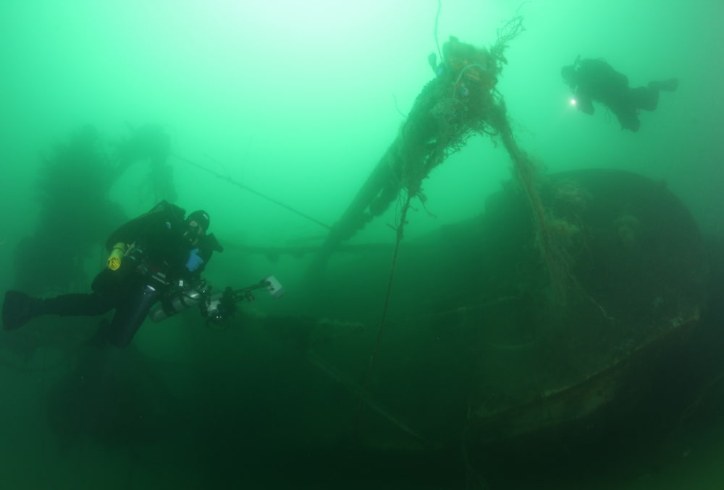
Stellwagen Bank National Marine Sanctuary
What resources does Stellwagen Bank National Marine Sanctuary protect?
- ecosystems: rocky reefs
- organisms: whales
- other resources: shipwrecks
Notes:
Instructional suggestion:
Ask students to propose some types of resources that might be protected by the sanctuary. Possible answers include: sensitive habitats, endangered or threatened species, historical artifacts, and/or important cultural resources.
Images:
Top: A humpback whale breaching.
Bottom left: A rocky reef, one of may seafloor habitats in Stellwagen Bank National Marine Sanctuary,
Bottom right: Divers exploring the the F/V Patriot. F/V means designates this was a fishing vessel.

Slide 7
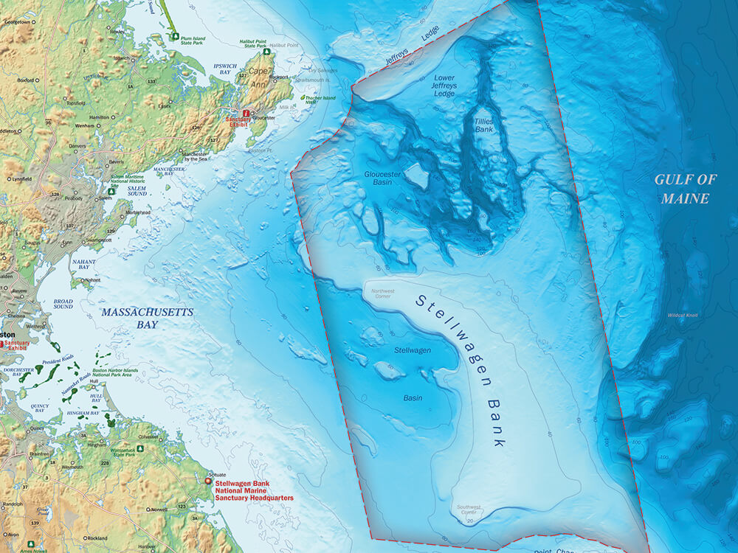
Stellwagen Bank National Marine Sanctuary
Notes:
Instructional suggestion:
Use this slide to share with students basic information about the sanctuary.
Image: map of Stellwagen Bank National Marine Sanctuary.

Slide 8
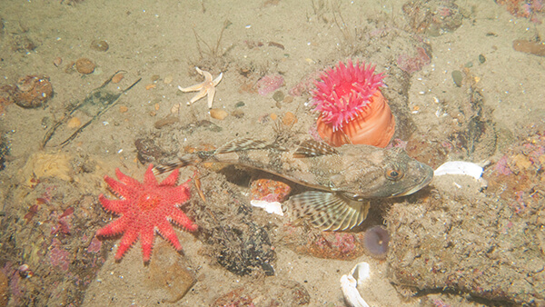
Banks and their Importance
Notes:
Instructional suggestion:
Prior to watching the video prompts students to explain what they think a bank is and why they might be important? Revisit these questions after watching the video.
Click, or advanced the slide, to watch the video.
Instructor Notes
A bank is an underwater plateau that is often a site of upwelling, a wind-driven process that brings cold, nutrient-rich waters to the surface, resulting in an abundance of phytoplankton that fuels a diverse food web.

Slide 9
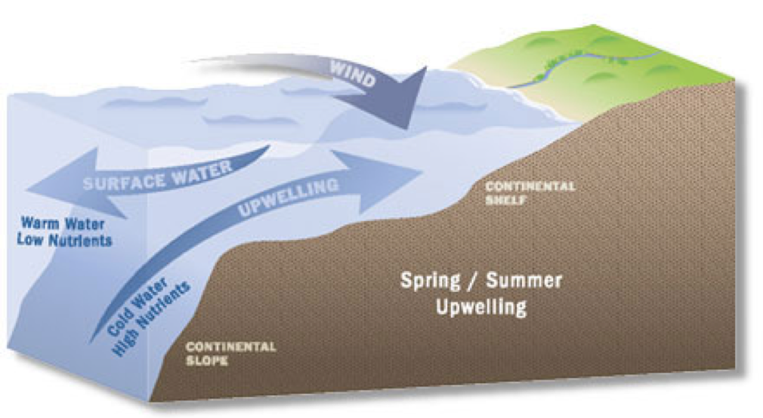
Impacts of Upwelling
Notes:
Instructional suggestion: Click image for animation of upwelling.
Instructor Notes:
Prevailing winds and currents result in upwelling, a process that brings cold, nutrient-rich waters to the surface, resulting in an abundance of phytoplankton that fuels a diverse food web. Copepods, a type of zooplankton, feed on the abundant phytoplankton and, in turn, provide a source of food for many species of filter-feeding whales, like right whales and humpbacks. Twenty two species of marine mammals use sanctuary habitats resulting in one of the premier whale-watching destinations in the world. The sanctuary also supports robust recreational and commercial fisheries. Abundant populations of forage fish including sand lance (also known as sand eels), mackerel, and herring provide food for whales, sharks, sea birds, and commercially important fish like cod and bluefin tuna.
Image: a diagram of upwelling.

Slide 10
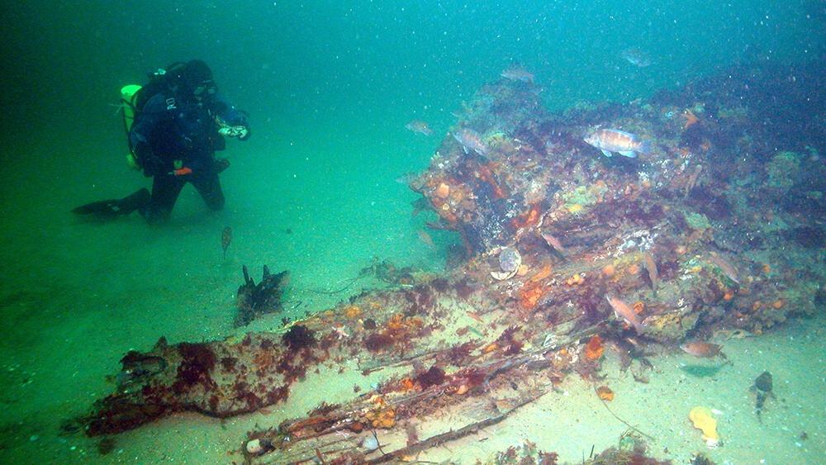
Diving in
Stellwagen Bank National Marine Sanctuary
Notes:
Instructional suggestion:
Click image to view 360 dive of the schooner Paul Palmer. Prompt students to make observations of the type of life they see taking advantage of the wreck. View other 360 dives as desired: https://sanctuaries.noaa.gov/vr/stellwagen-bank/.
Instructor Notes:
The partially buried remains of the coal schooner, Paul Palmer, lie in waters 80 feet below the surface on a stretch of flat, sandy seafloor on top of Stellwagen Bank. Built in Waldoboro, Maine in 1902, the unlucky schooner, which set sail on its final voyage on a Friday the 13th in 1913, was nearly twice destroyed by dock fires before it burned and sank off Cape Cod. Lobsters often use the nooks and crannies of shipwrecks. Many wrecks are covered with invertebrates like sponges.
Image: A diver observes Paul Palmer's stern timbers.. Photo: NOAA

Slide 11
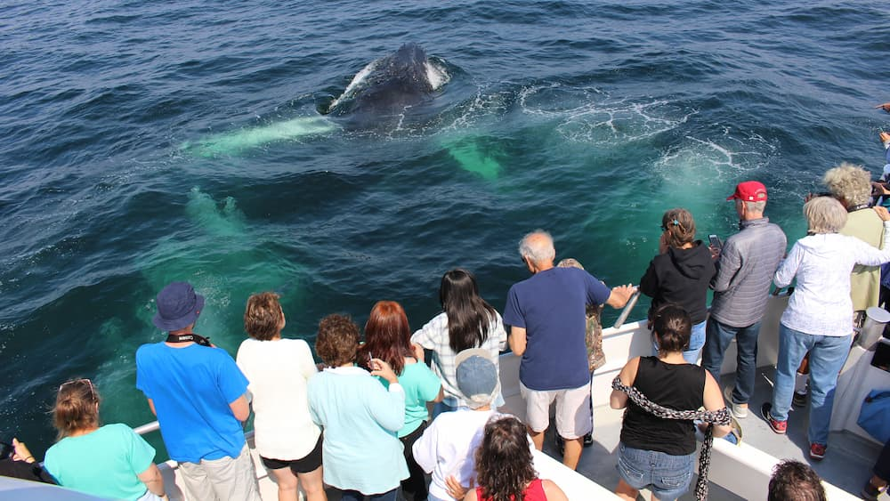
Whales in
Stellwagen Bank National Marine Sanctuary
Notes:
Instructional suggestion:
Click the image to watch a short video highlighting whale watching in Stellwagen Bank National Marine Sanctuary. Ask students to make observations of whale behavior.
Video link: https://www.youtube.com/watch?v=9EHZvGOlExY
Instructor Notes:
The waters off New England and around Stellwagen Bank once supported a whaling industry that, after depleting local waters, moved to other locations around the globe. Whales are now protected in U.S. waters and visitors to Stellwagen Bank National Marine Sanctuary are regularly treated to sightings of humpback, minke, and fin whales. During spring and fall, critically endangered North Atlantic right whales feed in these waters, but vessels are prohibited from approaching closer than 500 yards, making viewing difficult. Several other whale species can also be found in the sanctuary, including sei and pilot whales, with occasional sightings of sperm and blue whales in nearby waters. Small toothed whales commonly seen are Atlantic white-sided dolphins, common dolphins, and harbor porpoises. Whale-watching is a multi-million dollar industry that provides thousands of jobs. NOAA regulations are in place to protect whales and include fishing gear restrictions in right whale seasonal management areas (that encompass the sanctuary) to reduce entanglements, as well as speed restrictions and modifications to the Boston shipping lanes aimed at reducing boat strikes.

Slide 12
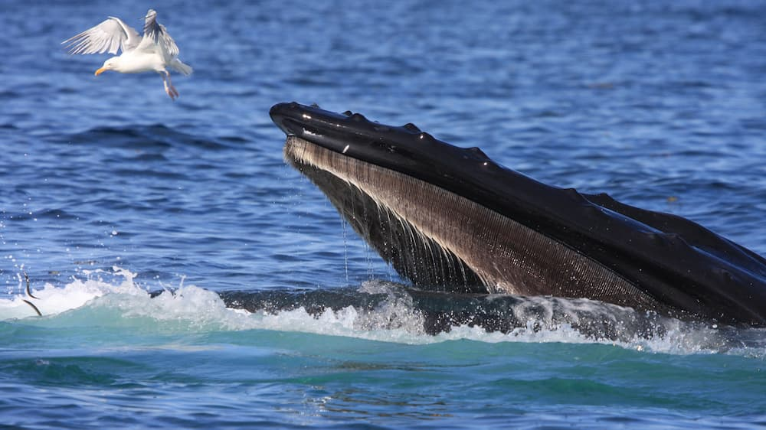
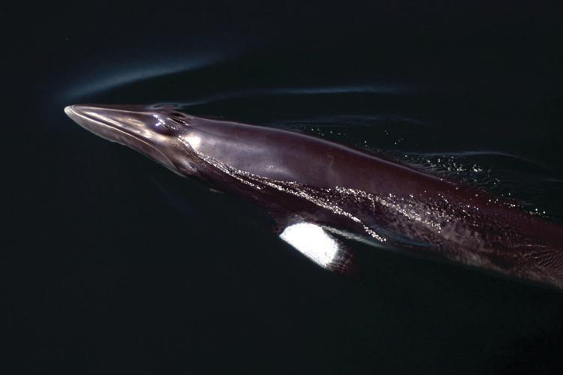
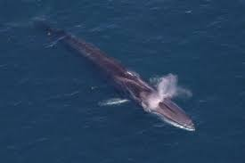
Whales in
Stellwagen Bank National Marine Sanctuary
Characteristics of whales:
Baleen vs. toothed whales
Large-brained
Highly social
Use sound to communicate and gather information
Notes:
Instructional suggestion:
Use these images to share basic characteristics of whales. Click the top humpback image to watch a short video about this species.
Video link: https://drive.google.com/file/d/1Hph23OgfXGajro7xGwMhxGSkPhjsu_Ji/view
Instructor Notes:
A whale is a general term for a group of marine mammals that includes dolphins and porpoises. There are two main groups of whales: baleen and toothed. Baleen whales have baleen, plates which sieve zooplankton and small fish from the water. Toothed whales have teeth and feed on fish, squid, and other marine mammals such as seals and sea lions. Humpbacks, minke, and fin whales are baleen whales. Orca, dolphins, and porpoises are toothed whales. Whales are large-brained, highly-social animals that use sound to communicate and socialize, as well as, to sense their surroundings, navigate, and locate prey. Sound travels much faster and farther in water than air, thus allowing whales to communicate and gather information over long distances and from all directions. Baleen whales use their larynx, the upper part of the trachea, or air passage, to produce sounds. Toothed whales can produce sounds using their larynx as well as specialized air sacs near their blowhole. The three main types of sounds made by toothed whales are clicks, whistles, and pulsed calls. Baleen whales generate a variety of sounds that include grunts, growls, moans, cries, and trumpets. These vocalizations can be produced singly or linked together. Some vocalizations are used for social communication and some sounds are used for echolocation, a way of using sound echoes to gather information about the environment.
Images: The most common whales seen in Stellwagen Bank National Marine Sanctuary.
Top: A humpback whale feeds on sand lance, a small schooling fish. Photo: Jeremy Winn (NOAA Permit #775-1875)
Bottom left: Minke whale at the surface. Photo: Whale and Dolphin Conservation Society
Bottom right: Fin whale. photo: NOAA

Slide 13
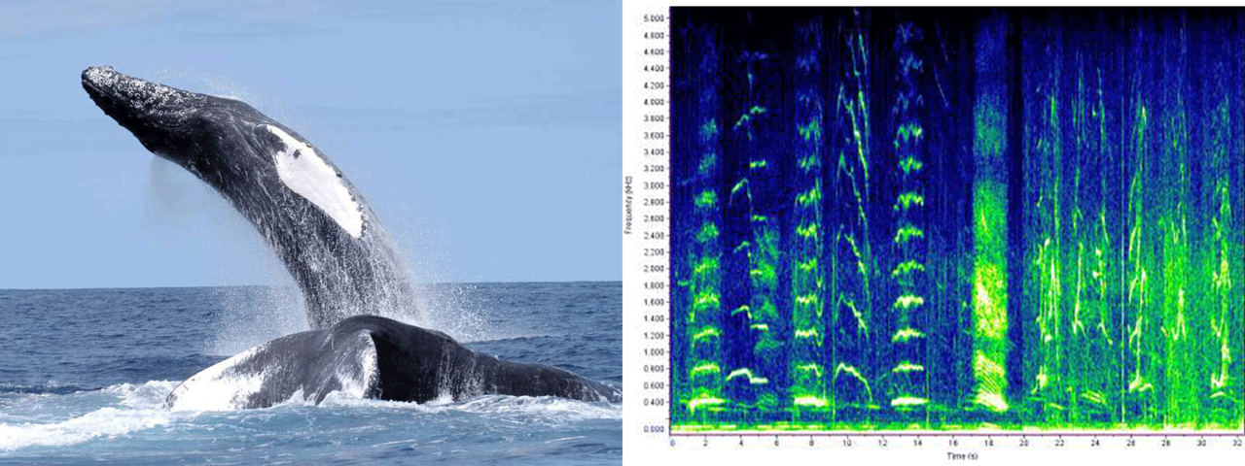
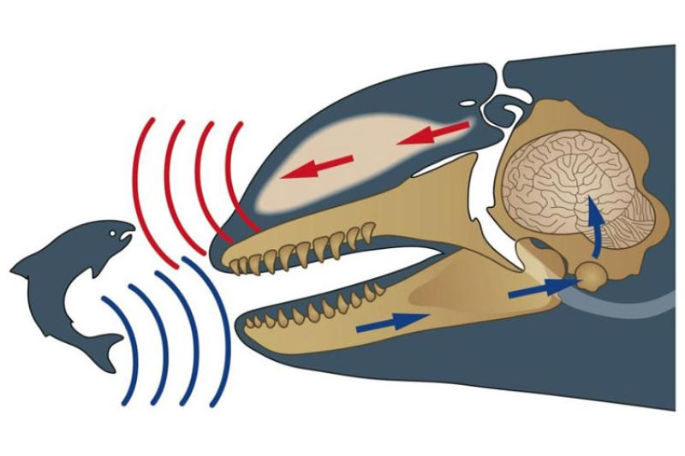
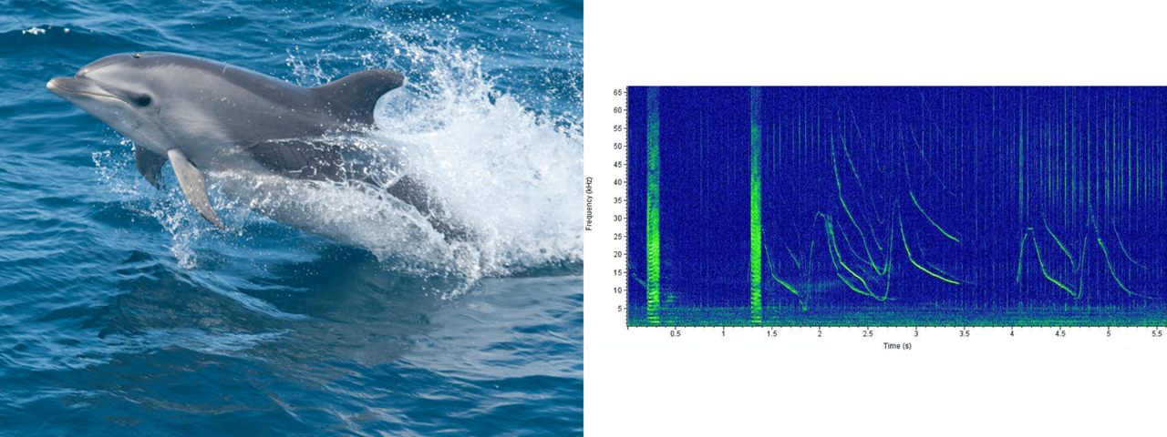
Whales in Stellwagen Bank National Marine Sanctuary
Echolocate using clicks
Vocalize using a variety of sounds
Notes:
Instructional suggestion:
Use this slide to share the basics of how whales use sound. Toothed whales -- whistles; Baleen whales -- grunts, moans, cries. Then, click each sound icon (or advance) to hear a recording of sounds made by each species. Listen to sounds of other whale species as desired: https://www.fisheries.noaa.gov/national/science-data/sounds-ocean.
Images:
Right: Spectrograms—shown on the right of each image below—are a way to visualize sound, and represent frequency (Y-axis) over time (X-axis). Credit: Northeast's Passive Acoustic Research Group/
Top: Humpback whale
Bottom: Bottlenose dolphin
Left: This illustration of echolocation by Uko Gorter shows a whale sending out sound waves to locate prey, and the sound echoes that bounces back to the whale from a fish.
Instructor Notes:
Toothed whales, such as dolphins in the sanctuary, use clicks to echolocate in order to navigate, find prey, and identify objects. When the sound waves of the click bounce off of an object, they return to the whale as an echo, allowing it to identify the shape of the object and its location. Whistles are vocalizations used during social activities. Baleen whales do not use echolocation but use sound to communicate and coordinate activities. The right whale is identified by its distinctive social upcall (which drops in pitch and then rises quickly and looks like a check mark when visualized in a spectrogram). Humpback whale songs, commonly produced in the breeding grounds, have also been detected in the sanctuary, where the males may be practicing the year’s version of the song. Whales may also use their tails and fins to make loud slapping noises on the surface of the water to communicate. The sound can be heard for hundreds of feet below the surface and may be a territorial display or hunting technique.

Slide 14
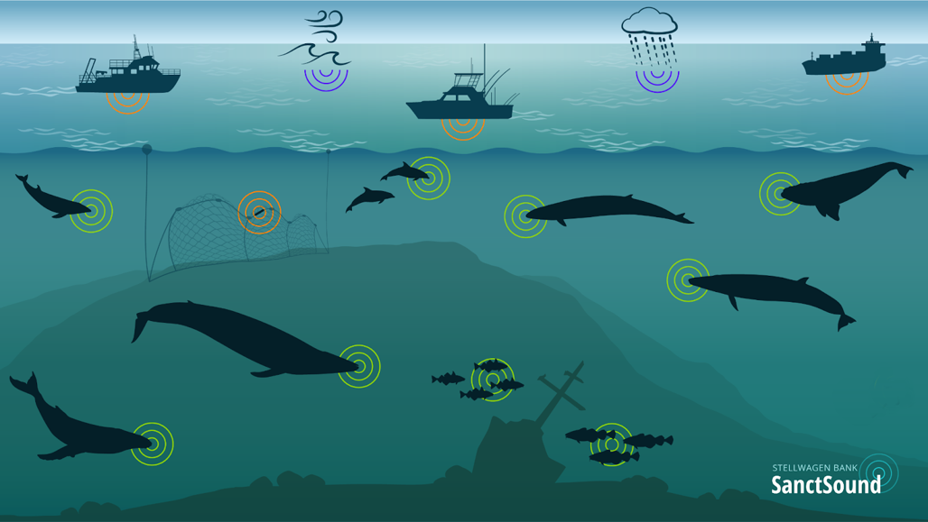
Whales in
Stellwagen Bank National Marine Sanctuary
Ocean noise and sound pollution impact whales
behavioral changes
masking: reduced ability to communicate, navigate, and hear important sounds from predators and prey
Notes:
Instructional suggestion:
Use this slide to share the basics of sources of ocean noise and how it may affect whales. Prompt students to predict how a whale might be affected by masking.
Instructor Notes:
Communicating with, and being able to detect, sound is critical for whale survival. However, human-caused ocean noise is increasing. Human-caused ocean noises include sounds produced for specific purposes, such as sonar and seismic air guns used to find oil and gas deposits. Human-made noise also includes unintentional sounds from vessel traffic and construction activities, like that associated with coastal construction or off-shore wind farms. Scientists are concerned about the potential impacts of this “sound pollution” on marine species. In whales, exposure to these noises can cause behavioral changes, like changes to dive/rest intervals or migration routes, as well as hearing loss. There is some evidence to suggest that noise pollution may be linked to strandings. Increased ocean noise can make it more difficult for whales to communicate, navigate, and hear important sounds from predators and prey and may be a significant problem for mothers who need to keep in close contact with their calves. This is called acoustic “masking.” The specific impacts of masking on whales is currently being studied but is likely detrimental to their survival.
Image: The marine soundscape illustrates the sound contributions in Stellwagen Bank National Marine Sanctuary from geologic sources (such as waves and weather), biological sources (such as fishes, marine mammals), and human sources (such as ships, pinger, and echosounders).

Slide 15
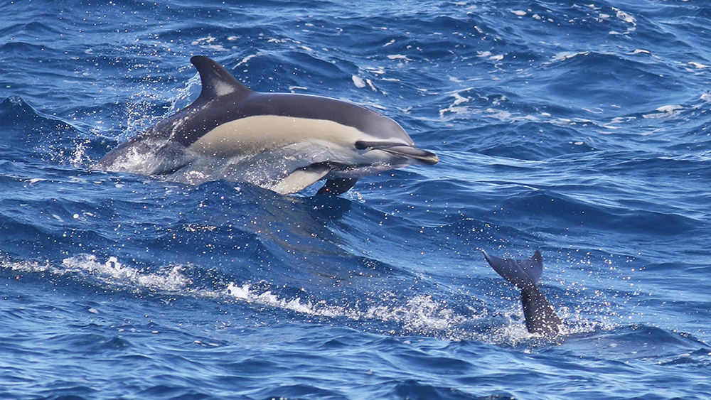
Stellwagen Bank National Marine Sanctuary
Echolocation Simulation Debrief
How successful were you in using echolocation? Respond from both the perspective of the dolphin and the echo.
What was challenging? Respond from both the perspective of the dolphin and the echo.
Was your success impacted by acoustic masking? Why or why not?
How does this simulation successfully model the use of echolocation?
How could this simulation be improved?
Notes:
Image: A common dolphin. Photo: Peter Flood

Slide 16
Learn more at
stellwagen.noaa.gov

