Slide 1
Notes:
Welcome slide, can introduce self here.

Slide 2
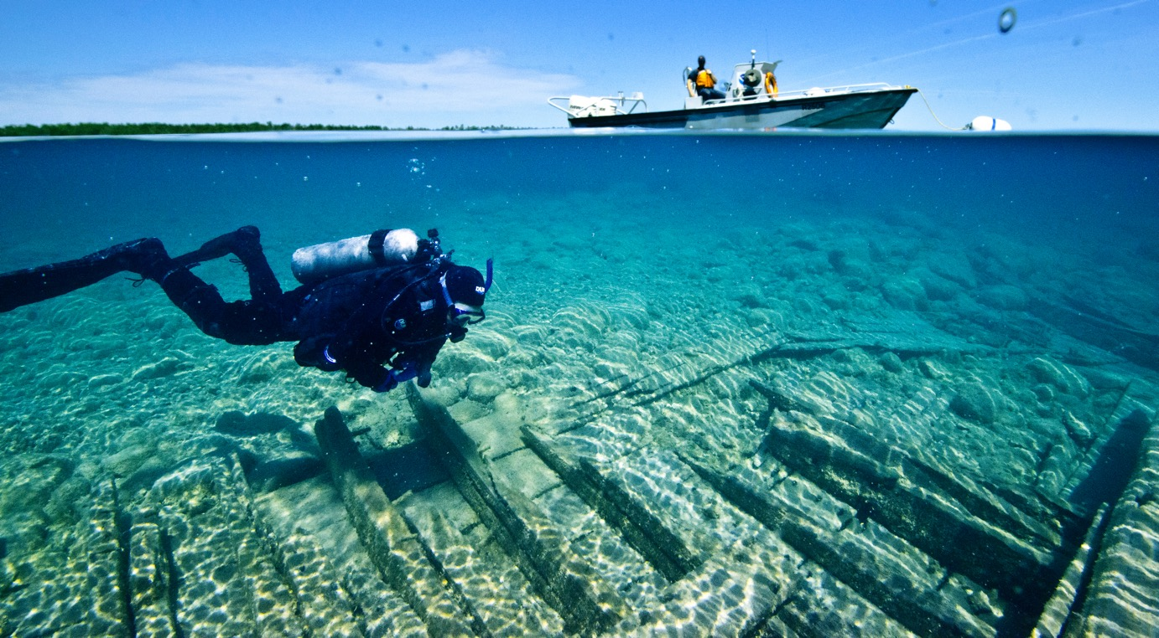
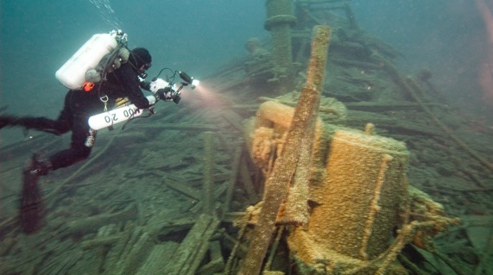
Thunder Bay National Marine Sanctuary
Notes:
History
Located in northwestern Lake Huron, Thunder Bay is adjacent to one of the most treacherous stretches of water within the Great Lakes system. Unpredictable weather, murky fog banks, sudden gales, and rocky shoals earned the area the name "Shipwreck Alley."
Managed jointly by the National Oceanic and Atmospheric Administration (NOAA) and the state of Michigan, the sanctuary preserves our rich maritime heritage through education, research, and resource protection.
Here’s a link to an Atlas Map of Thunder Bay National Marine Sanctuary:
https://nmsthunderbay.blob.core.windows.net/thunderbay-prod/media/archive/images/tbnms_expan_map1.jpg
Pictures Courtesy of:
https://marinelife.noaa.gov/media_lib/preview.aspx?ID=12025&p=img
https://marinelife.noaa.gov/media_lib/preview.aspx?ID=22614&p=img

Slide 3
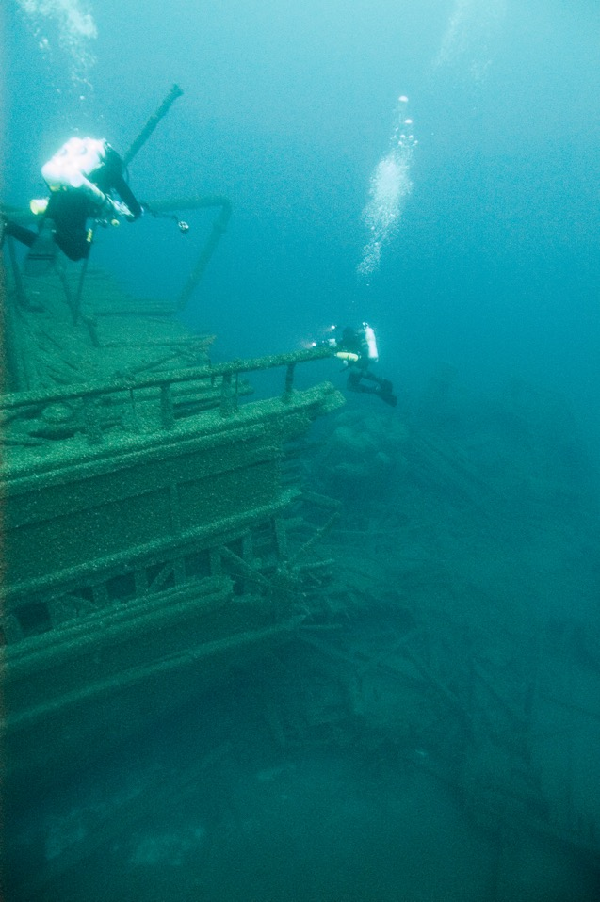
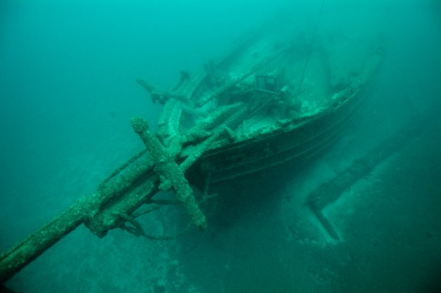
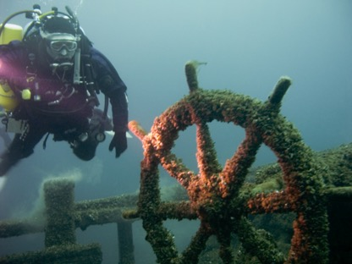
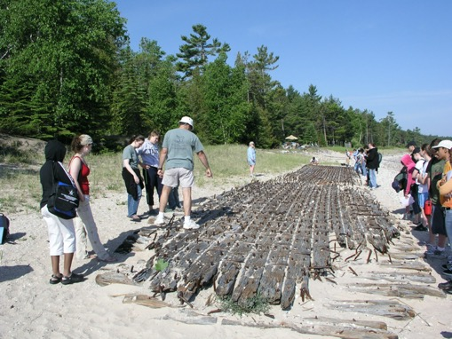
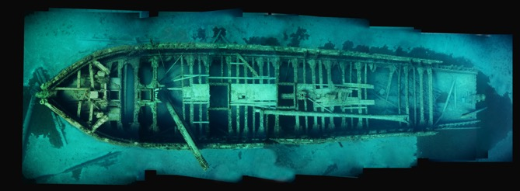
Maritime Archaeology is…
…the scientific study of material remains under the surface of the water of past human life and activities.
Notes:
Maritime Archaeology is… (read slide).
Why is Thunder Bay unique?
Fire, ice, collisions, and storms have claimed nearly 200 vessels in and around Thunder Bay, including pioneer steamboats, majestic wooden schooners, and huge steel freighters. Today, the 4,300-square-mile Thunder Bay National Marine Sanctuary protects one of America’s best-preserved and nationally significant collections of shipwrecks. Over 90 shipwrecks have been located in this area, and there may be as many as another 100 yet to be discovered. These historic sites capture dramatic moments from centuries that transformed America. As a collection, they illuminate an era of enormous national growth and remind us of risks taken and tragedies endured.
Pictures Courtesy of: NOAA
https://marinelife.noaa.gov/media_lib/preview.aspx?ID=12000&p=img
https://marinelife.noaa.gov/media_lib/preview.aspx?ID=12011&p=img
https://marinelife.noaa.gov/media_lib/preview.aspx?ID=12021&p=img
https://marinelife.noaa.gov/media_lib/preview.aspx?ID=22592&p=img
Insert: https://marinelife.noaa.gov/media_lib/preview.aspx?ID=22585&p=img

Slide 4
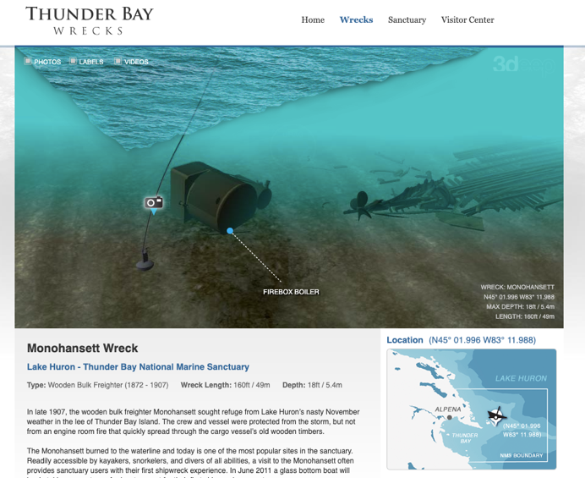
Maritime Archaeology is…
Check out this 3D Monohansett to see what Maritime Archaeologists do!
Monohansett 3D Shipwreck
Notes:
What is a Maritime Archaeology?
Show students the 3D video of the Monohansett shipwreck to get an idea about how maritime archaeologists study a shipwreck. http://www.thunderbaywrecks.com/wrecks/monohansett/

Slide 5
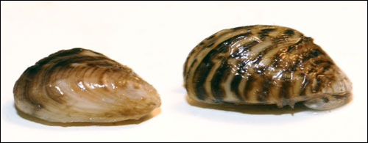
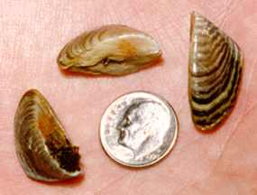
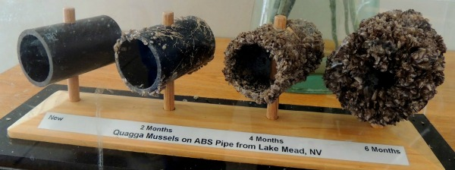
What is an invasive species?
Quagga mussels and zebra mussels are invasive species at Thunder Bay National Marine Sanctuary.
Notes:
One threat to Thunder Bay National Marine Sanctuary is invasive species. What is an invasive species? What is an example of an invasive species at Thunder Bay National Marine Sanctuary?
An invasive species is a plant or animal that is foreign to an ecosystem. During the past two centuries, invasive species have significantly changed the Great Lakes ecosystem. These changes have greatly affected the economy, health, and well being of the people that rely on the system for food, water, and recreation. Once established, it is extremely difficult to control their spread. Credit: https://www.epa.gov/greatlakes/invasive-species-great-lakes
Of the many invasive species in the Great Lakes, zebra and quagga mussels have had the greatest negative impact on sanctuary resources. Additionally, other invasive species that degrade water quality have an indirect effect by potentially limiting physical access to sanctuary resources (e.g., beach closures). While zebra mussels are mostly confined to hard objects and substrates, quagga mussels can also live and thrive on muddy or sandy bottoms and can tolerate a wider range of temperatures and water depths than zebra mussels. Zebra and quagga mussel colonization is causing archaeological resources to deteriorate and hinders the ability to accurately and precisely conduct archaeological documentation.
Both zebra and quagga mussels affect natural ecosystem functions by altering nutrient cycles and re-engineering physical habitat. They are consumptive filter feeders; each mussel can filter a liter of water per day, thereby depleting the food supply for many native invertebrates, including zooplankton and benthic macroinvertebrates. Native declines have a severe impact on the many fish species that depend on them as a food source. Zebra and quagga mussels have an affinity for hard surfaces such as boat hulls, engines, docks, buoys, break walls, pipelines and submerged archaeological resources. Their presence on shipwrecks and other submerged maritime archaeological sites constitutes a significant challenge for archaeologists, historians and resource managers, and in many cases reduces a site’s archaeological integrity. Although the long-term impacts to structural integrity of shipwrecks (e.g., due to corrosion or load) is still not clear, it is reasonable to expect that some degree of physical integrity is being lost.
Credit: https://sanctuaries.noaa.gov/science/sentinel-site-program/thunder-bay/invasive-species.html
Pictures Courtesy of: (Michigan SeaGrant)
Photo credit:
https://www.watershedcouncil.org/zebra-mussels.html
Photo credit: https://flatheadlakers.org/programsissues/thwarting-aquatic-invaders/zebra-mussels-other-invaders/

Slide 6
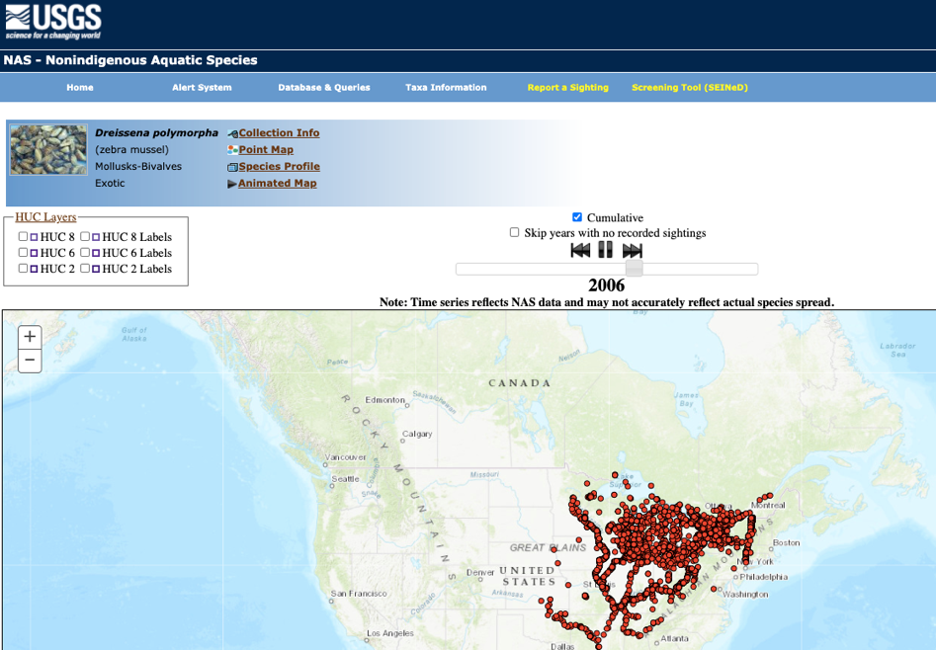
The spread of Zebra and Quagga Mussels in the United States
Watch this
simulation!
Zebra Mussel Time Series NAS Data
Notes:
Watch this simulation!
https://nas.er.usgs.gov/queries/SpeciesAnimatedMap.aspx?speciesID=5
Video Courtesy of: Esri, HERE, Garmin, FAO, NOAA, USGS, EPA

Slide 7
How do the zebra and quagga mussels affect the shipwreck preservation in Thunder Bay National Marine Sanctuary?
Notes:
What impact do the invasive species have on Thunder Bay National Marine Sanctuary?
Figures 37 and 38. Left: Only a few quagga mussels are present in this 2003 image of the anchor stowed on the port rail of the schooner Kyle Spangler, resting in 185-feet of water. The variety of wood and iron features, many quite small but still easily made out, are a testament to the preservative qualities of the Great Lakes' cold, fresh water. This high degree of preservation correlates closely to the high archaeological and recreational value of shipwrecks. Right: A 2008 photo shows the same anchor from a similar perspective. Many features are now obscured and have been since 2005. Quagga mussels completely cover the iron shank and flukes, as well as the iron anchor chain. Notably, the two small iron rings, presumably used as part of the apparatus to secure the anchor, are nearly undetectable (Left: Stan Stock; right: NOAA).
Students will be able to analyze these photos in the classroom activity.

Slide 8
Let’s learn how to scuba and
save our national marine sanctuaries!
Notes:
This is exactly why We Need Guardians like you!
Our sanctuary deserves to be protected and preserved so that everyone can enjoy it now and in the future.
Let’s learn how to scuba and save our sanctuary!

Slide 9
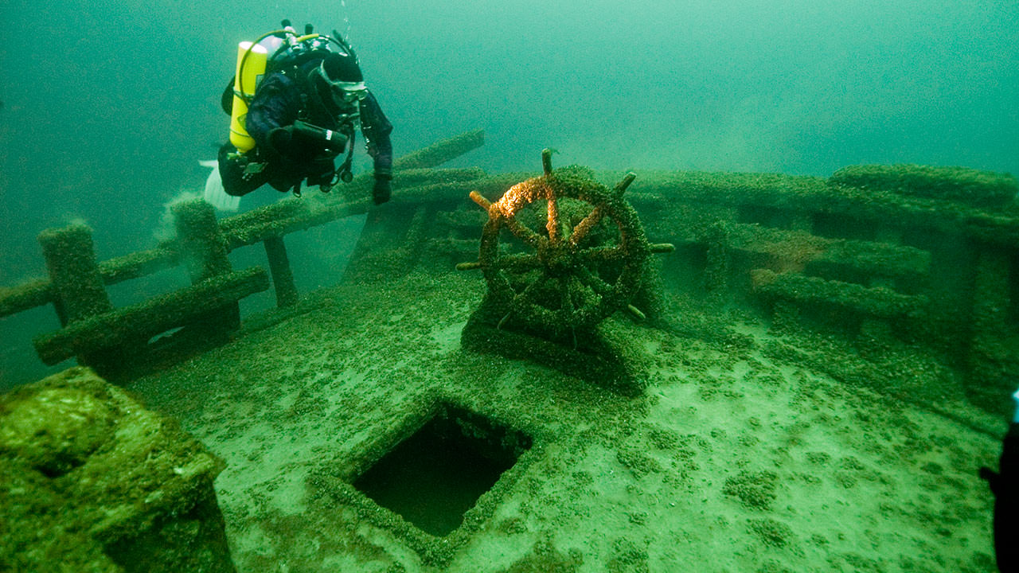
Virtual Dives at Thunder Bay National Marine Sanctuary
See References at the end of the lesson plan.
Notes:
After completing the PowerPoint you may choose to take students on a virtual dive of Thunder Bay National Marine Sanctuary by visiting
https://sanctuaries.noaa.gov/vr/thunder-bay/.
You can view these images on your large display screen with students or have them view them individually on cell phones. The images are also compatible with VR goggles.
- Ask students: What do you notice? How would you preserve this shipwreck for future generations?
Photo Credit: NOAA

